Slide 1
Training for FCI Utility dogs Judges
Biedermannsdorf, 17. bis 19. Jänner 2020

Slide 2
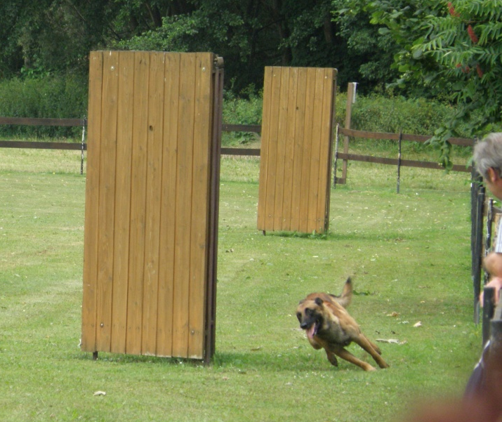
Revieren/Search for the helper
schnell und zielstrebig
direktes, enges und aufmerksames Umlaufen
HF-orientiert
vor HF kreuzen
HF Mittellinie einhalten
fast and determined
direct, tight and attentive circulation
HF-oriented
cross in front of HF
Comply with the HF center line

Slide 3
Search for the helper
The exercise begins with the basic position and ends when the dog has reached the 6th blind or when the imaginary extension of the blind has been overrun.
If the handler takes the dog in the basic position during the exercise
“ Search/Revier ”, the exercise is to be rated with 0 points. The work can continue. If this happens a second time, the protection is terminated.
If the helper is not found, the handler has two further attempts to send the dog. If this fails, phase C must be canceled.

Slide 4
Search for the helper
The dog should come straight to the dog handler on verbal signals. "Half" walking around the blinds is not correct.
Priority in the exercise:
Determination
tractability
Run closely
Circulate attentively
Direct returning from the blinds

Slide 5
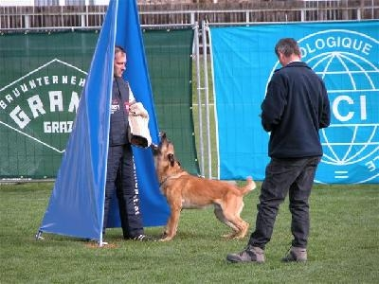
Stellen und Verbellen/Hold and Bark

Slide 6
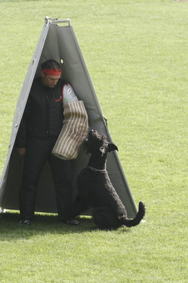
Subdivisions into hold and bark 15 points :
10 points hold, 5 points bark
First focus on the hold exercise
Then focus on the practice of barking
No mixing these two while judging
Call to the handler

Slide 7
Stellen und Verbellen/Hold and Bark
Der Hund muss den Helfer selbstbewusst, aktiv, aufmerksam stellen und dabei anhaltend verbellen.
Die Verbelldauer beträgt ca. 20 Sekunden. 20 Sekunden beginnen, wenn der Hund den Helfer erreicht und nach diese 20 Sekunden, gibt den Richter das Signal für den Hundeführer zum herantreten. Das verbellen endet wenn den Richter das Zeichen zum abrufen des Hundes gibt
The dog must hold the helper confidently, actively, attentively and bark continuously.
The barking time is approx. 20 seconds. These 20 seconds begins when the dog reaches the helper and after this 20 seconds, the Judge gifs the signal for the handler to approach. The barking ends when the Judge gives the signal for recalling the dog in the basic position.

Slide 8
Leading the dog to the place for the exercise:
““prevent the attempt to escape”
The exercise begins with the basic position. The final basic position of the last exercise is also the initial basic position for this exercise.
The dog must be easy to lead and should not be depressed towards the handler.
The attention of the dog can be directed to both, the handler or the helper.

Slide 9
Bark & Hold
If the dog, coming into the blind, grips the helper:
a one -time command for out and
“here”/”heel” is to be given.
The dog comes.= minus 14 pos.int
* If the dog does not show “out” after 1 extra command.= Disqualification and no points in A/B/C.

Slide 10
Bark & Hold
If the dog leaves the helper, before the judge’s signal to the dog handler to leave the imaginary middle line, the dog may, before the sign of the judge, be re-send to the helper.= - 14 points and insufficient for the exercise.
If the dog leaves the helper again.= Termination of phase C
If the dogs leaves the helper after the judges signal to come to the blind.= Exercise is “insufficient”

Slide 11
Bark & Hold
If the dog needs a command to stay with the helper:
deduction is up to -14 points.
If the dog does not come out of the blind after 2 extra commands ( 3 in total): Disqualification no points in A/B/C.

Slide 12
Evaluation for „OUT“
command/behavior | devaluation
Command is allowed immediate | 0
Command allowed hesitate to very hesitating |  | 0,5 - 3,0
2. command immediate |  |  | 3,0
2. command Hesitate to very hesitating |  |  |  | 3,5 - 6,0
3. Command immediate |  |  |  |  | 6,0
3. Command Hesitate to very hesitating |  |  |  |  |  | 6,5 - 9,0

Slide 13
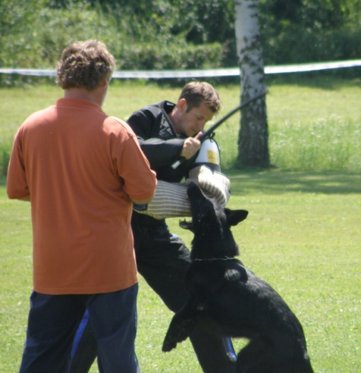
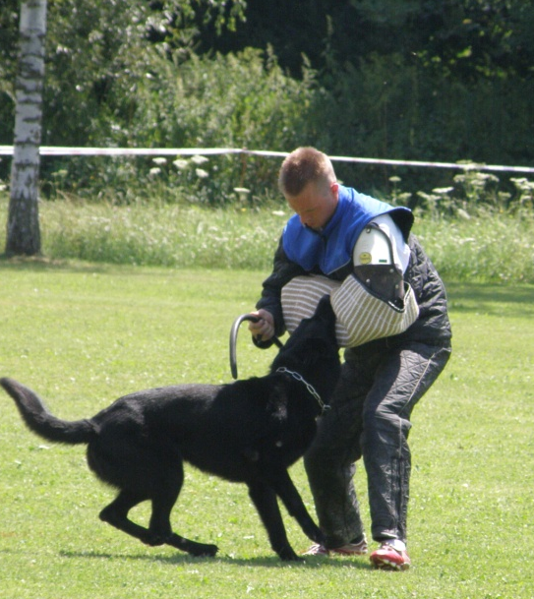
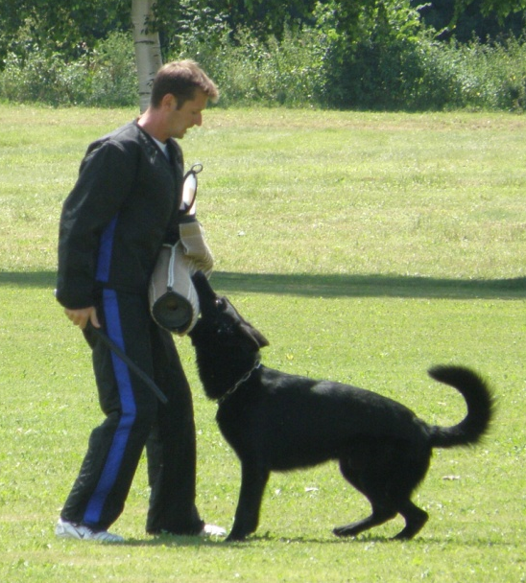
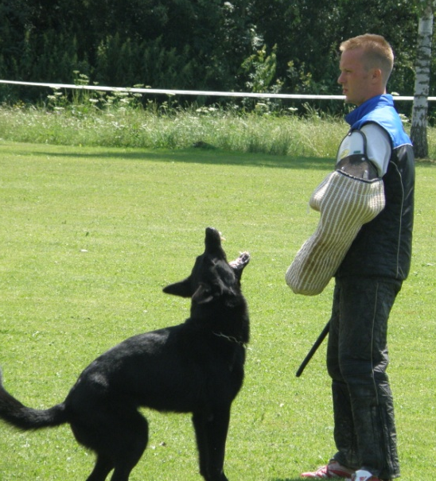
5 Phasen der Verteidigungsübungen
5 phases of defense exercises

Slide 14
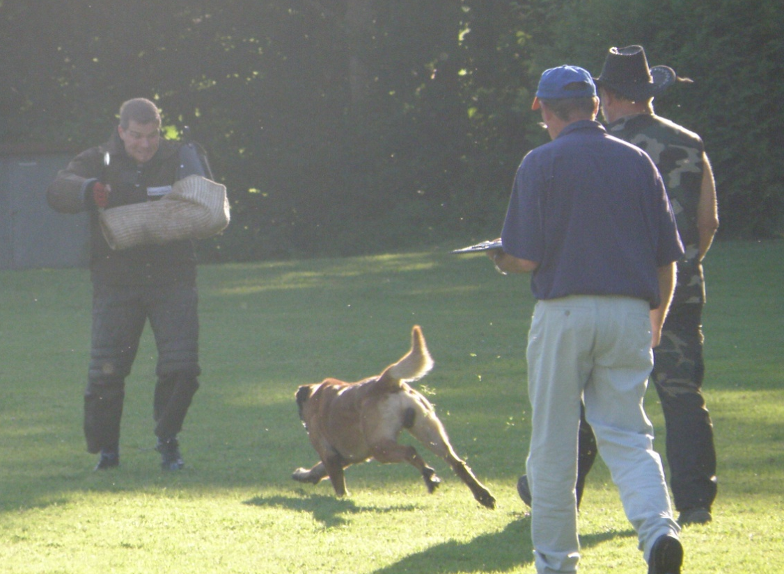
1. Opening Phase
Time between the helper's attack and the grip on the sleeve

Slide 15
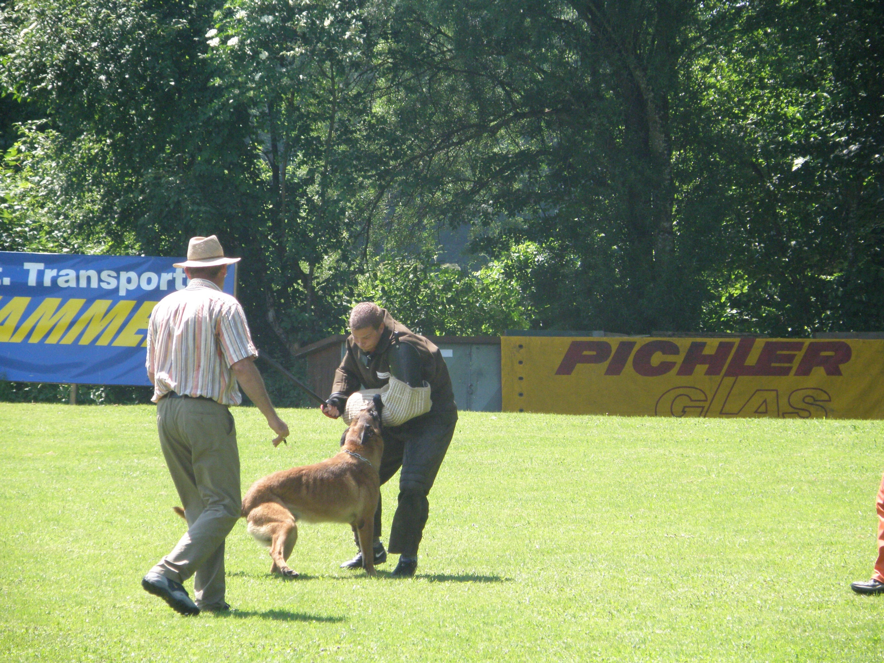
2. Pressure phase
Period from the start of the bite into the sleeve until the helper's standstill (grip behavior, activity)

Slide 16
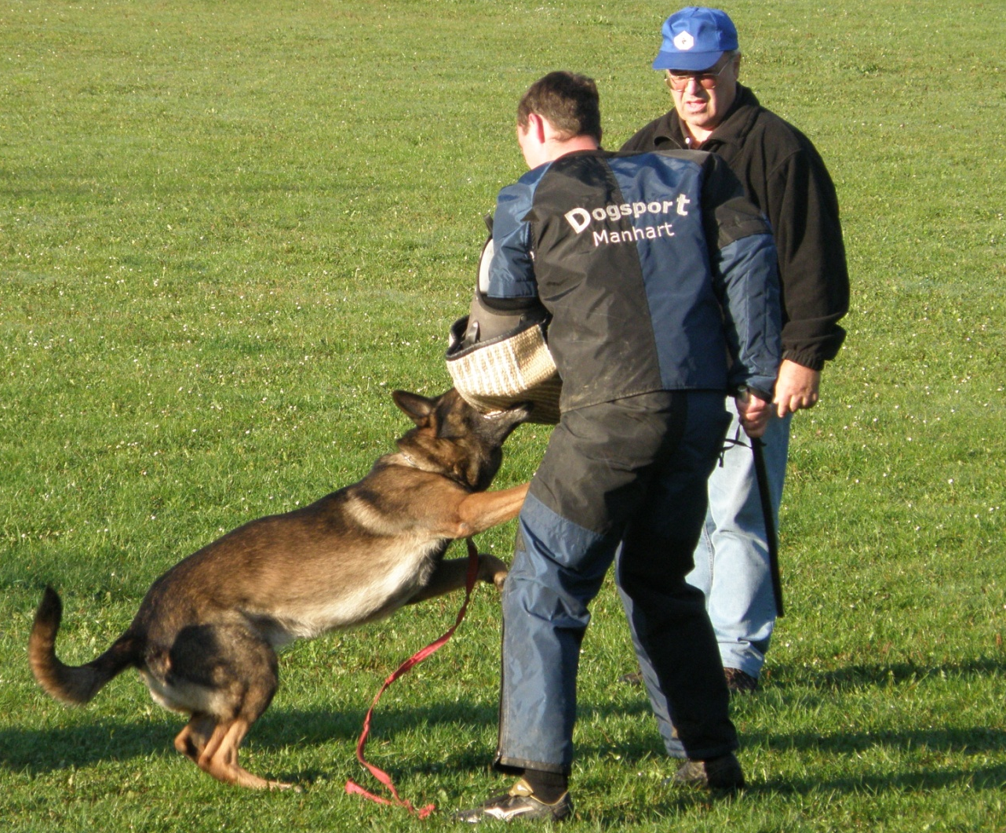
3. Transition phase
Period from stand still of the helper, to the moment of “out of the sleeve”. This can be done by the dog without a command or with a command of the DH

Slide 17
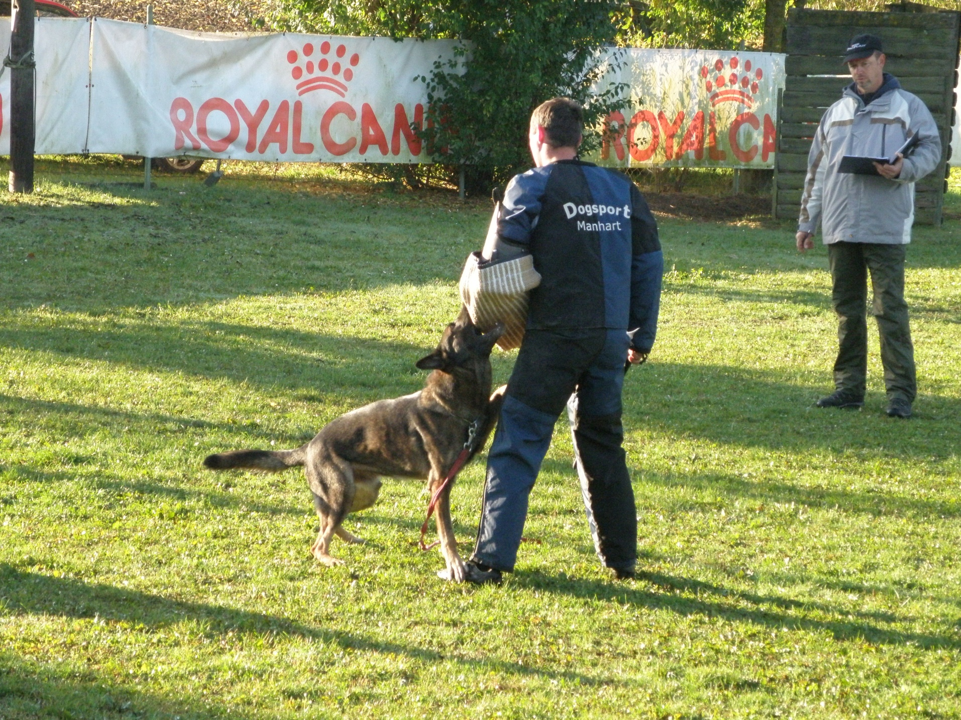
„Out“ Phase
Period from the ”out” command to the real out.

Slide 18
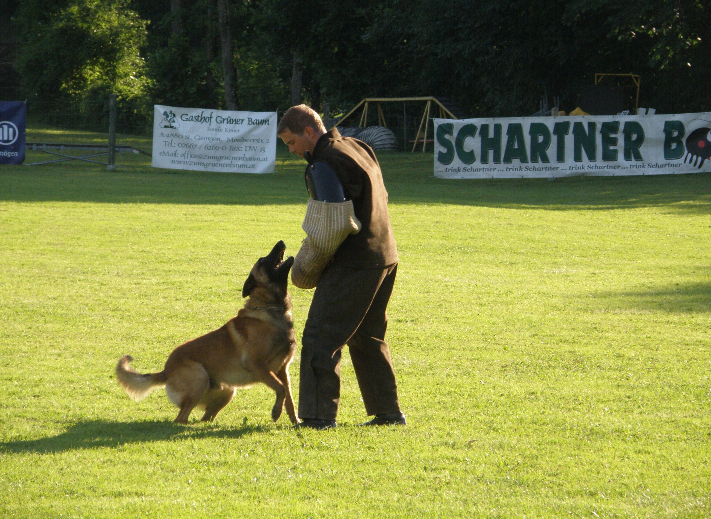
5. Guarding phase
Period of time after the “out” until the handler has switched it off

Slide 19
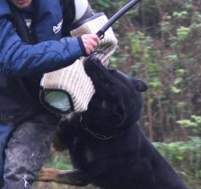
Assessment of Grip - behavior
Effectiveness of the grip
Calm Grip (active behavior)
Fullness of the grip

Slide 20
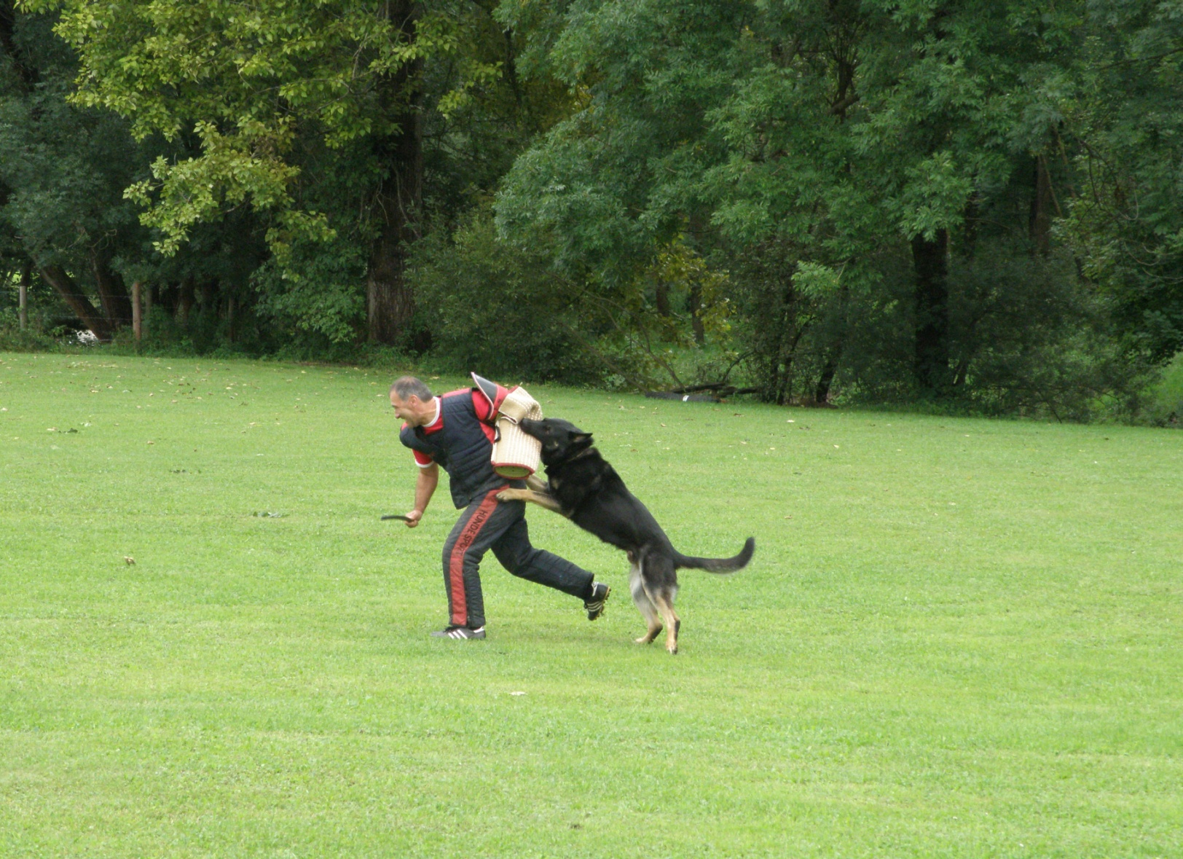
Prevent the escape
Obedience
Quiet and concentrated down position
Energetic follow-up (opening phase)
Active prevention (physical effort)
Transition
Out phase
Guarding phase

Slide 21
Preventing the escape of the helper
The dog goes, before the sign of the judge and without a command of the dog handler in the excercise, but is note biting:
IGP 1 – 19, IGP 2 – 14, IGP 3 – 9
The dog goes, before the sign of the judge and without a command of the dog handler in the excercise and bites: Disqualification an no points in A/B/C.
The dog does not prevent the escape through gripping or holding within 20 paces: phase C is terminated.

Slide 22
Preventing the escape by the helper
If the dog is crawling forwards (over the marked line) the dog is not to be corrected. This fault will go into the evaluation.

Slide 23
Preventing the escape of the helper
If the dog starts, without a command from the handler, the exercise, the exercise is rated minus 1 qualification for the exercise.

Slide 24
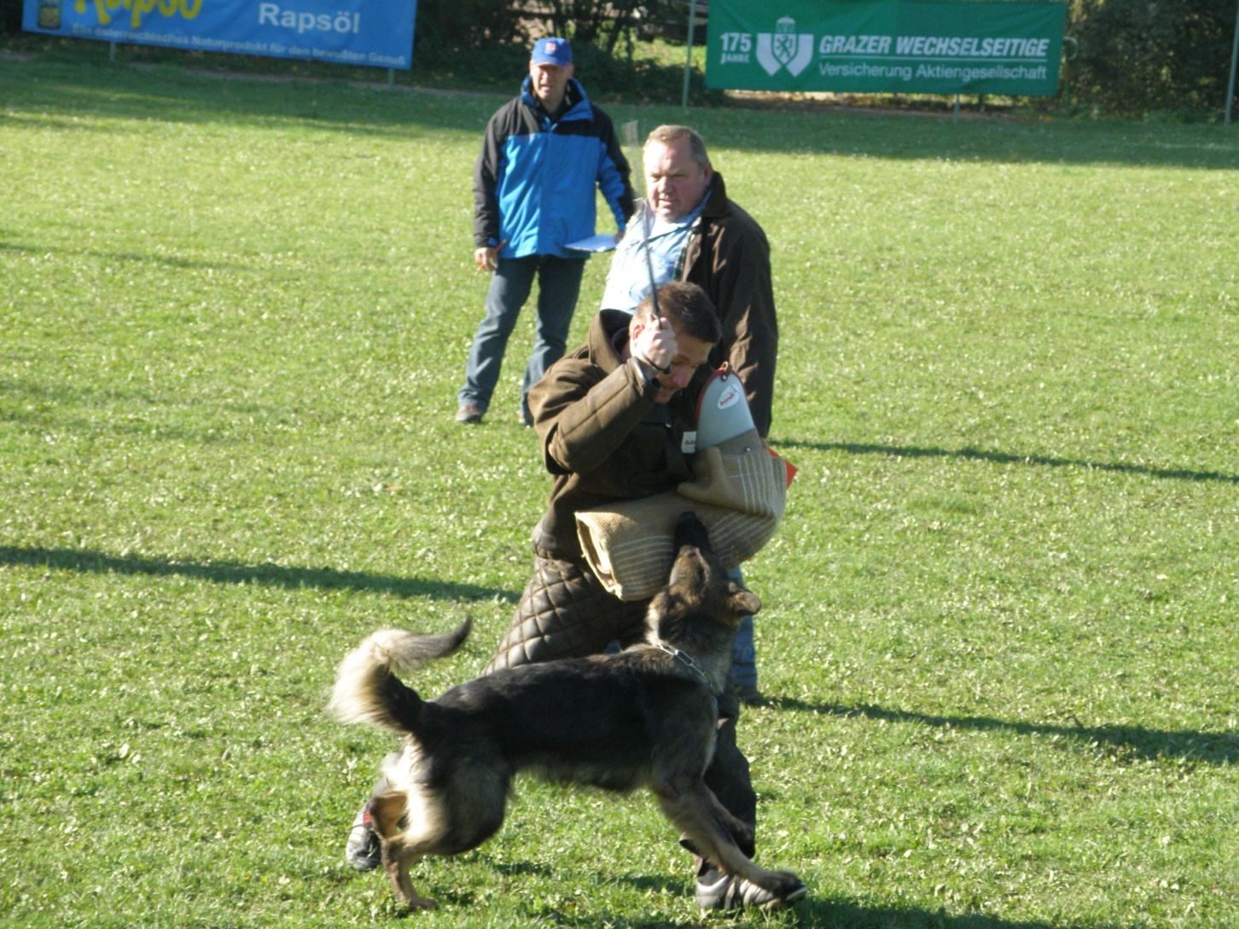
Defense against an attack from the guarding phase
Opening phase
Pressure phase
Transition phase
Out phase
Guarding phase

Slide 25
Defense of an attack during the guarding phase
Criteria for evaluation are:
How is the reaction on the attack?
How is the grip in the pressure phase?
How is the grip in the transition phase?
How does the dog release the grip after the command?
How is the guarding phase of the dog?
The verbal commands for “out” are excactly prescribed in the regulations

Slide 26
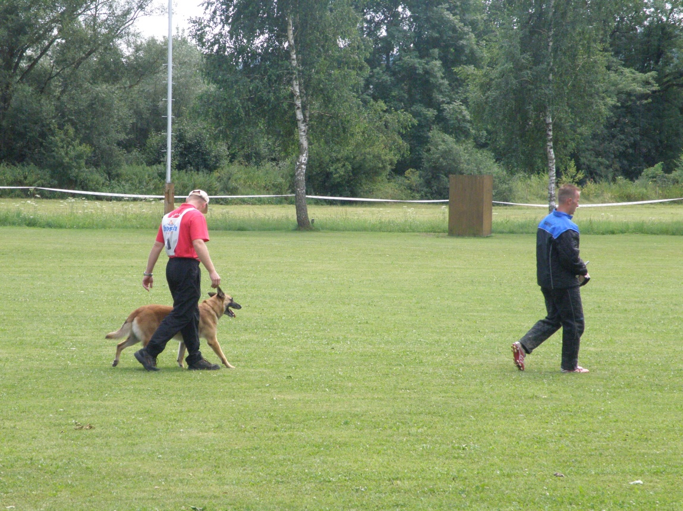
Back Transport
Correct heeling
Follow about 8 steps
Watch the helper attentive

Slide 27
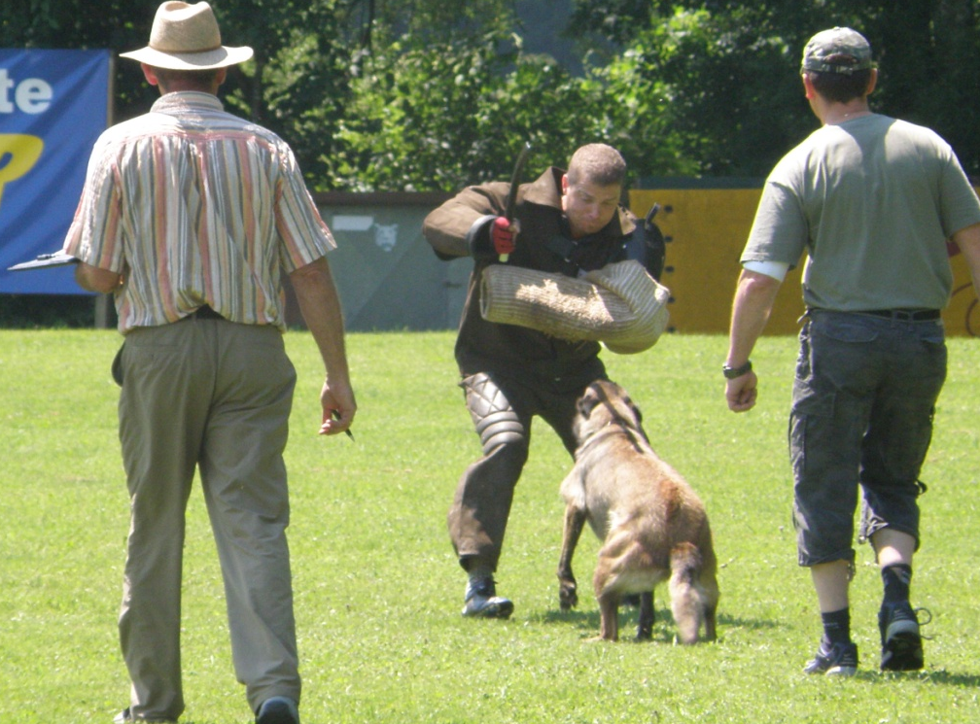
Attack from the back transport
Opening phase
Pressure phase
Transition phase
Out phase
Guarding phase

Slide 28
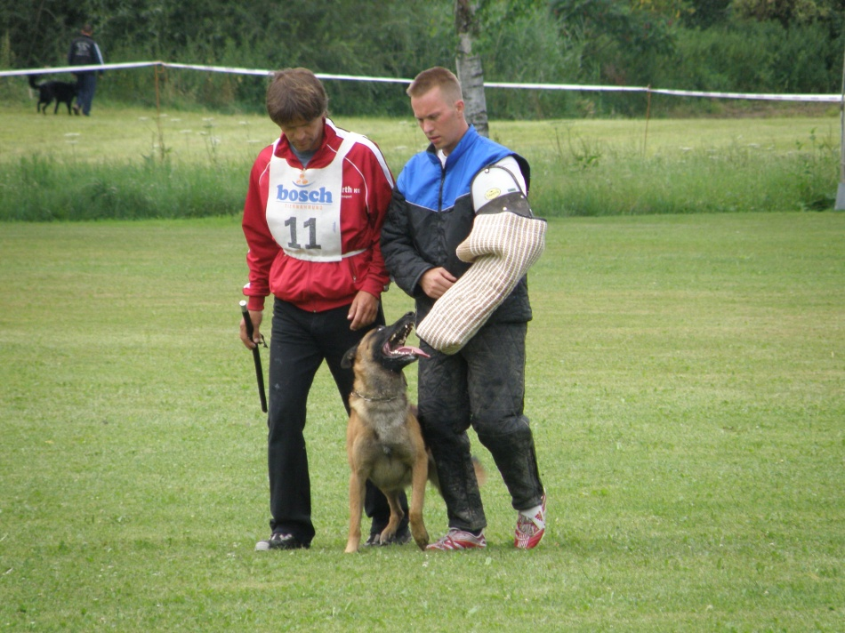
Side Transport 1
Basic positions at the beginning
and end of the side transport.
Dog heeling in a correct position.
Watch the helper attentive.

Slide 29
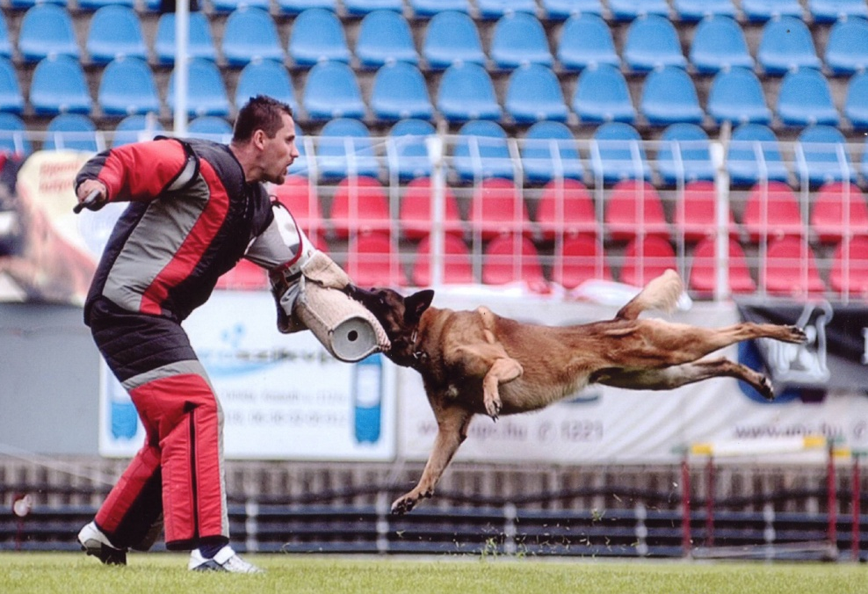
Attack on the dog out of motion
Free heeling
Waiting position
Opening phase
Pressure phase
Transition phase
Out phase
Guarding phase

Slide 30
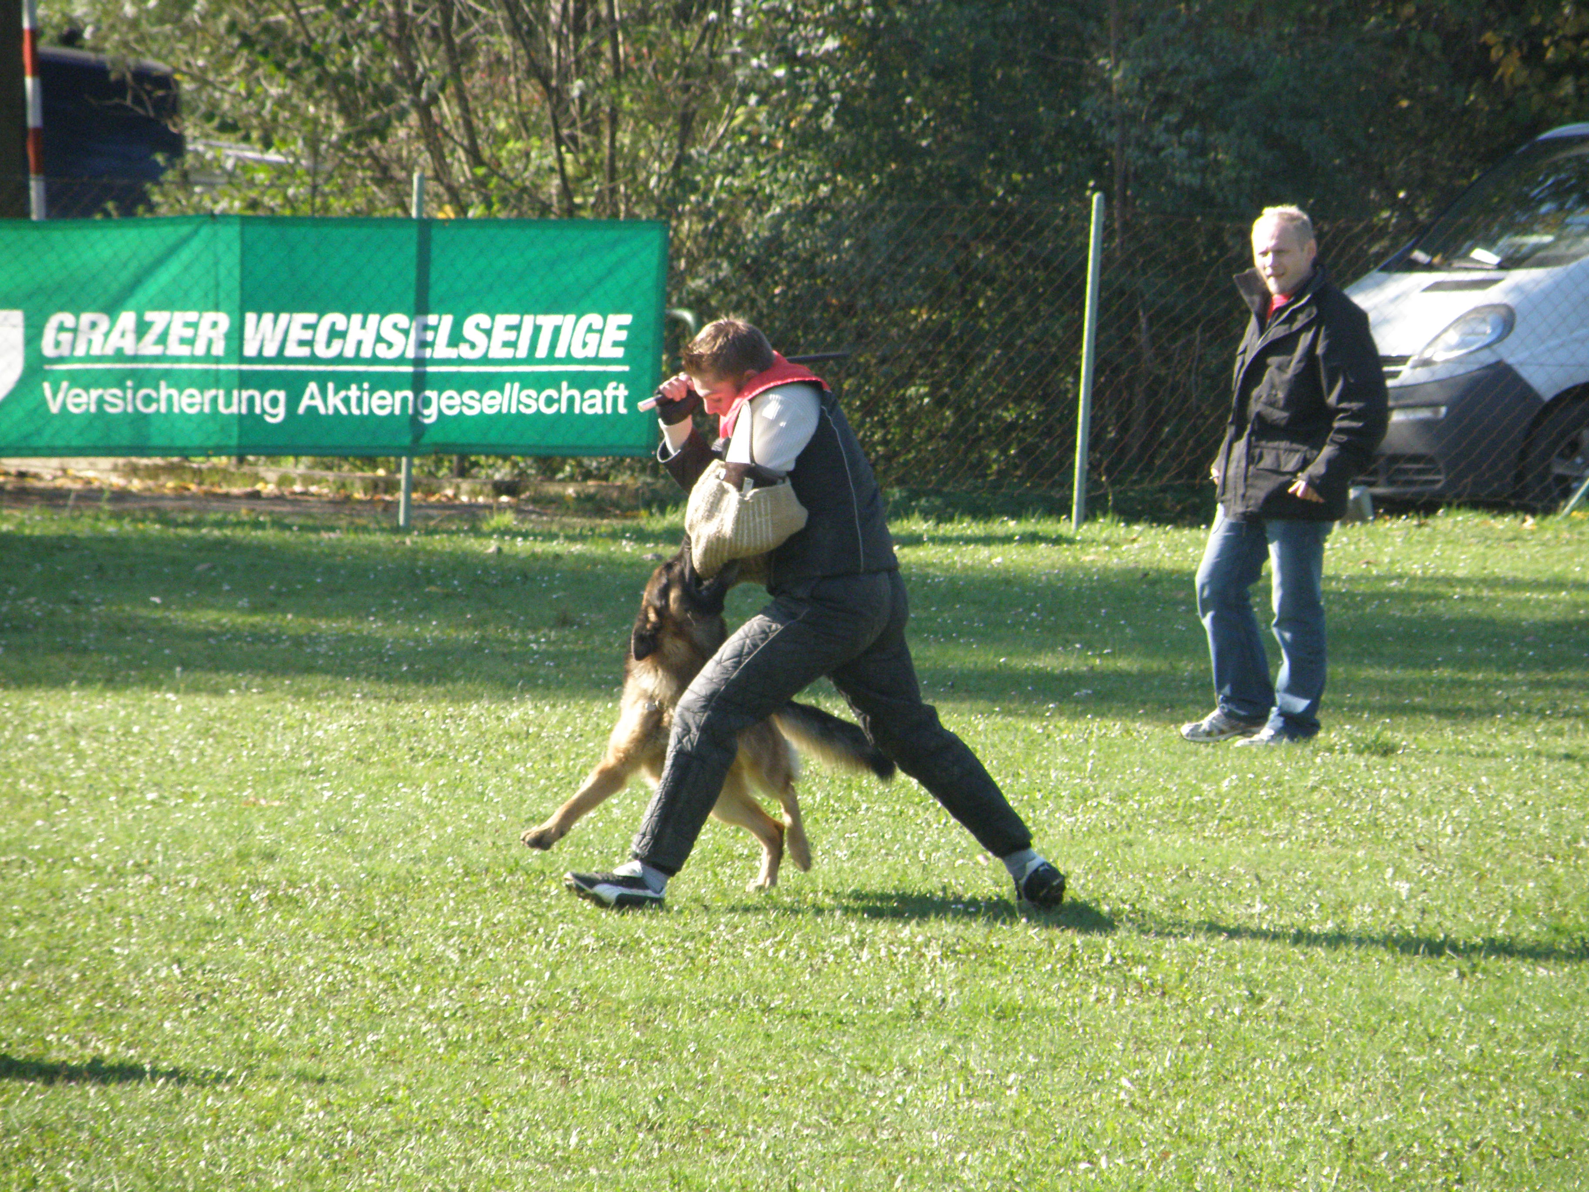
Defense against an attack out of the guarding phase
Opening phase
Pressure phase
Transition phase
Out phase
Guarding phase

Slide 31
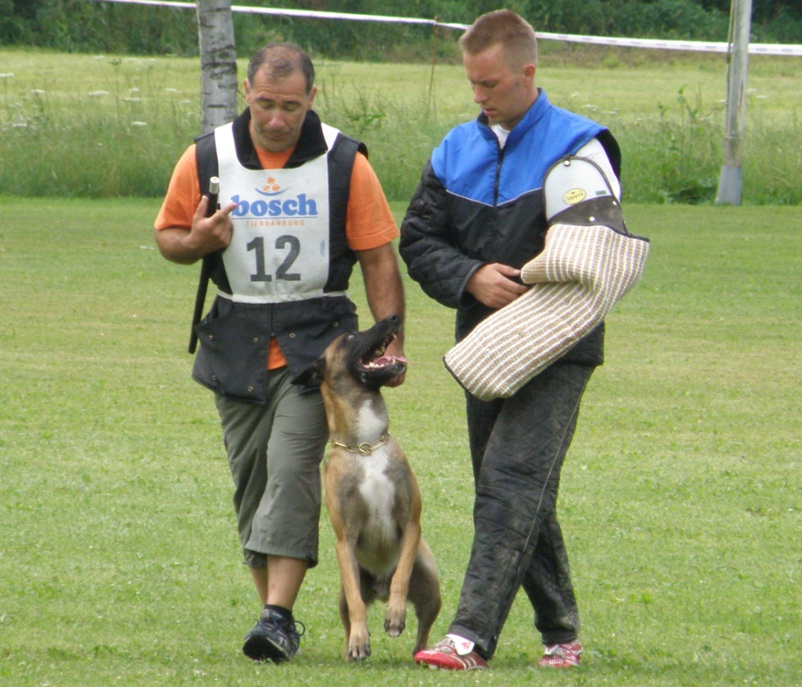
Side Transport 2
Basic positions at the beginning and end.
Dog at the foot of the handler
Watch the helpers attentive

Slide 32
Termination
The dog cannot stand the pressure of the helper.
Additional commands are given to bind the dog.
If in the exercise “search for the helper” the dog does not find the helper in the blind after 2 additional verbal commands, there must be:
TERMINATION

Slide 33
Disqualification
The dog is not in the hand of the handler – the dog is out of control
The dog bites into other parts of the body of the helper.
The dog is, in the long attack, targeting an other person than the helper
Does not “ OUT” after the 3rd verbal command – (over and done)
DISQUALIFICATION
No report - no award of any points

Slide 34
Attack on the dog out of motion
The free heeling to the place where the exercise start will also be evaluated. The dog, sitting in the correct basic position, may be held on the collar.
The straight, calm and attentively sitting dog facing the helper may however not be stimulated by the handler.
If the dog starts the exercise before the confrontation with the helper, he will be disqualified ( helper is running towards the dog in the straight line)
If the dog starts the exercise before the sign of the Judge, the exercise is insufficient.
If the dog is running to another person, ( f.i. the judge) he is not reacting to his attacker: Disqualification

Slide 35
Abandon the helper
The guarding phase after the exercise “preventing the escape of the helper” and after “Defence on an attack during the guarding phase” in IGP 3:
If the dog leaves the helper or the handler gives a command so that the dog stays with the helper, phase C is terminated.
All other exercises: If the dog leaves the helper or the handler gives a command so that the dog stays with the helper, before the instruction of the judge to continue, phase C is to be terminated.
Leaves the dog the helper after the instructions of the Judge, the exercise has to be evaluated “insufficient” and the exercise can be continued.

Slide 36
Excellent
This note can only be taken by a dog
exceptional disposition and
get excellent training.

Slide 37
Very good
Dogs with an above-average performance
but minor restrictions
in drive components or training.

Slide 38
Good
Dogs that meet the normal requirements
both in the performance
as in training.

Slide 39
Satisfactory
Dogs that barely meet the requirements
but show significant deficiencies in drive components or training.

Slide 40
Insufficient
Dogs that do not meet the requirements
and have serious defects in drive components
or have significant training deficiencies,
or are no longer in the hand of the handler.

Slide 41
Thank you for your attention

