Slide 1

International Utility Dogs Regulation
Basics: FCI PO 2019
Tracking
HarI ArČon
Interpretation
Fédération Cynologique Internationale

Slide 2
IGP Program
selects the quality of performance
selects the quality of the education
Follow the red line
      Essence of IGP
      Primary qualities
      Basic mistakes

Slide 3
Red Line
Energy to target (Motivation)
Self-confidence
Activity
Ability to be guided
Natural aggressive behavior
Instinct

Slide 4
Essence of Evaluation
Energy to target
To high
In balance
To low

Slide 5
intensiv
concentration
convincing indication of the object

Slide 6
Evaluation
Picture of the exercise
excellent
very good
good
statisfactory
unsatisfactory

Slide 7
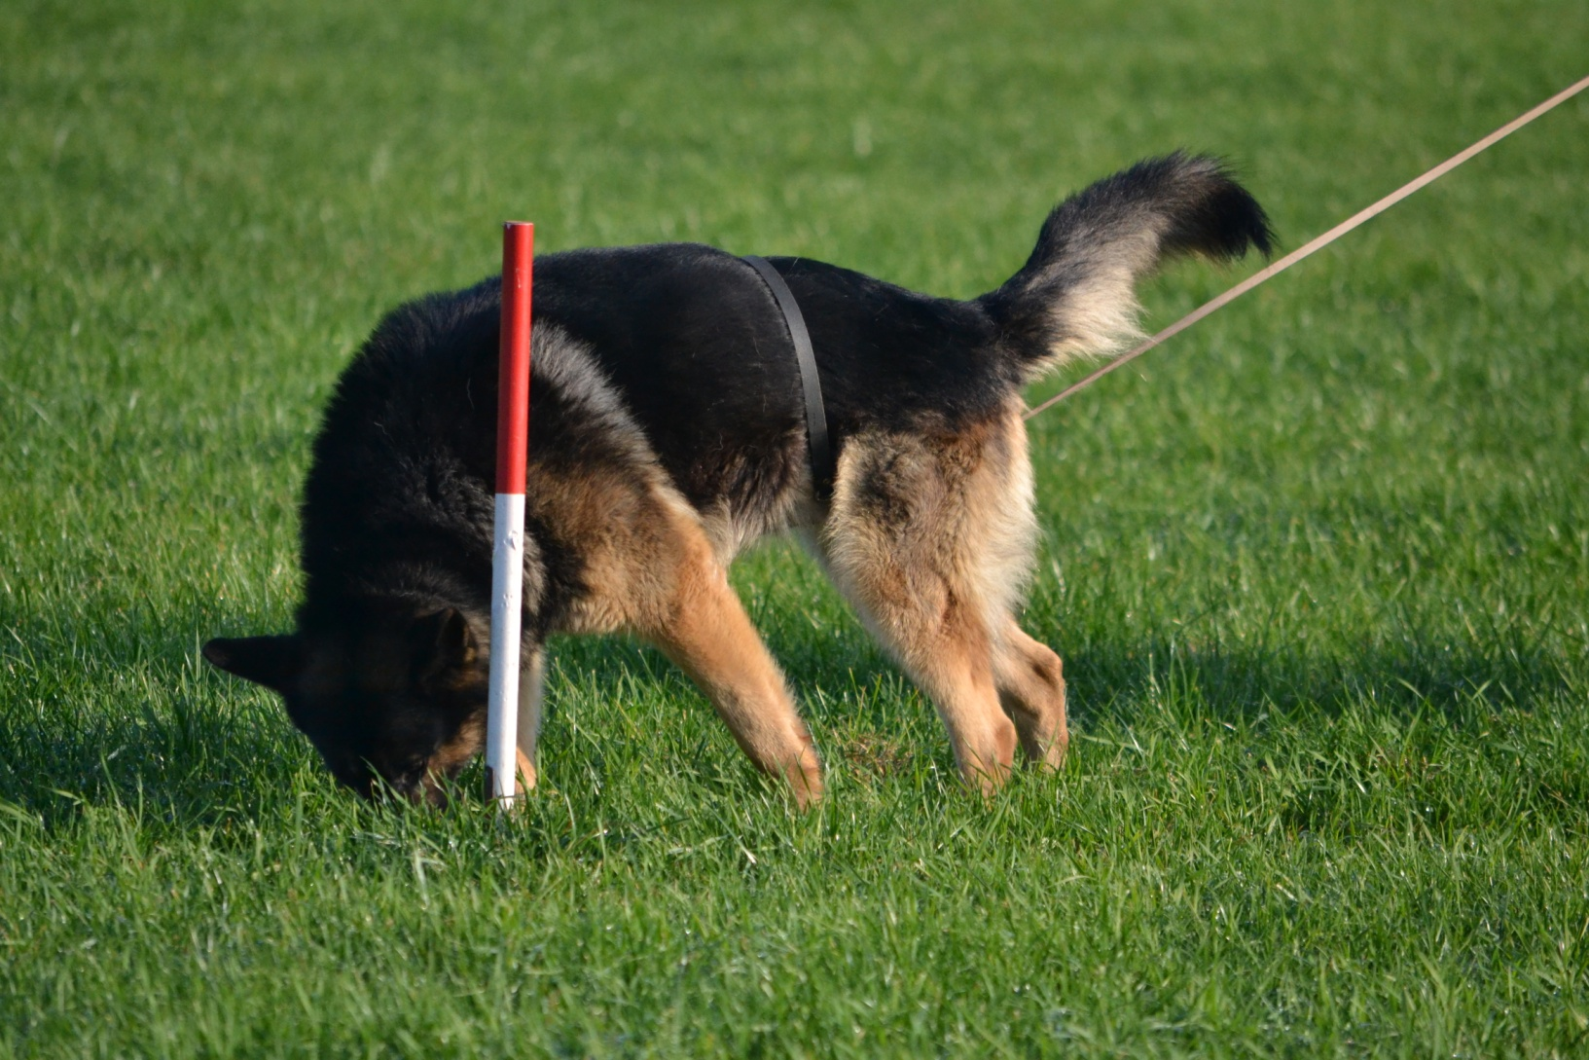

Slide 8
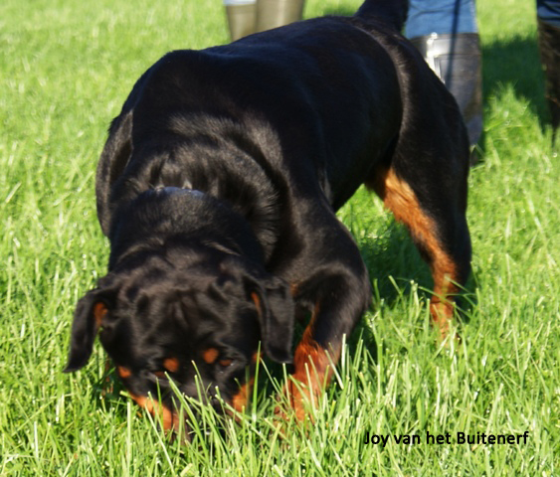

Slide 9
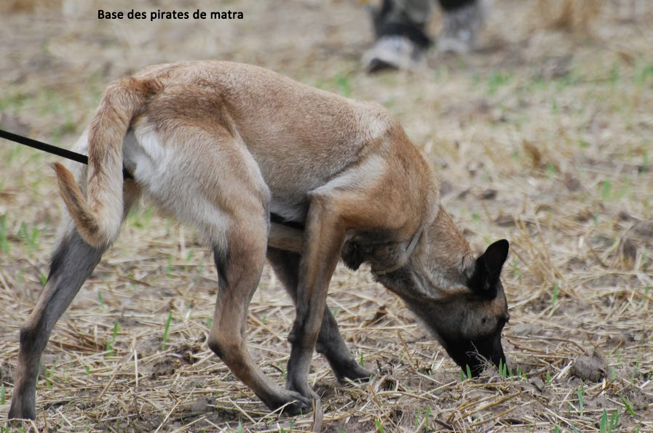

Slide 10
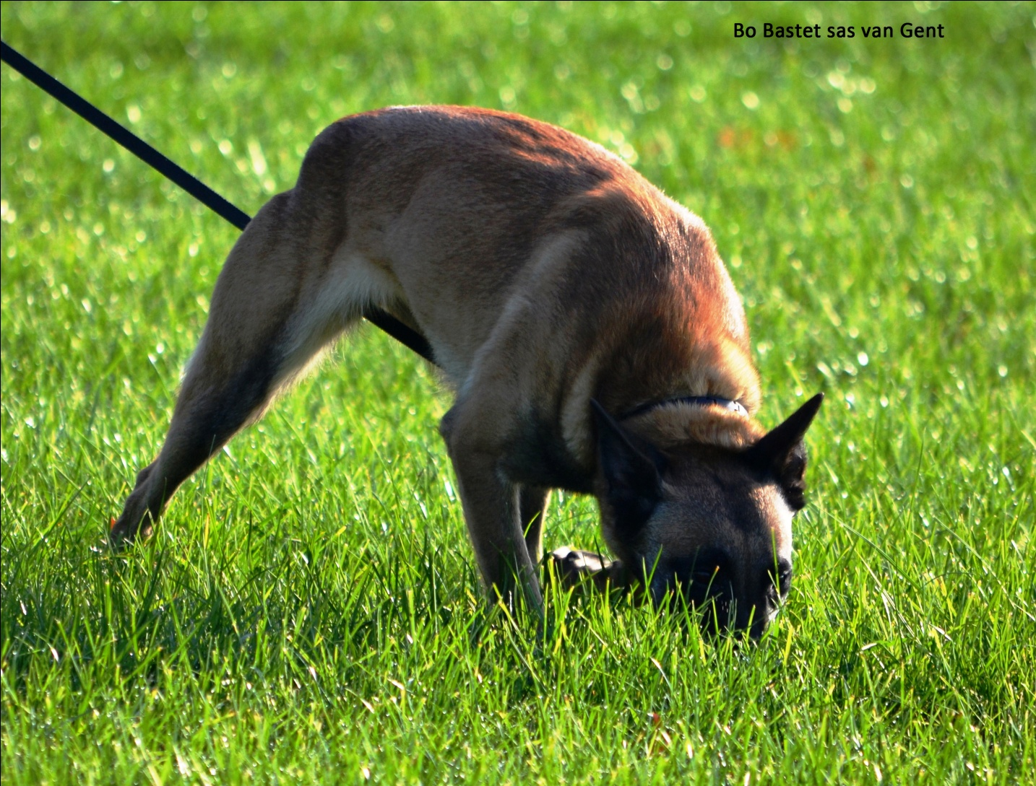

Slide 11
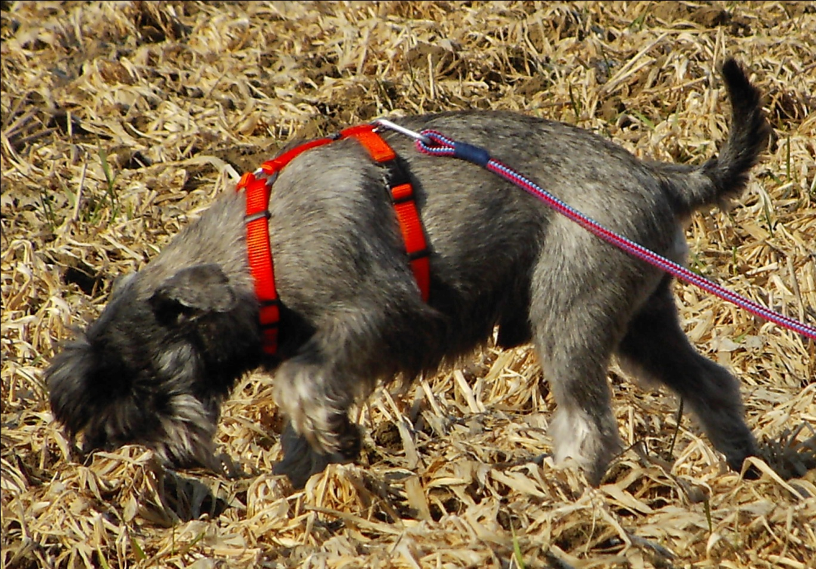

Slide 12
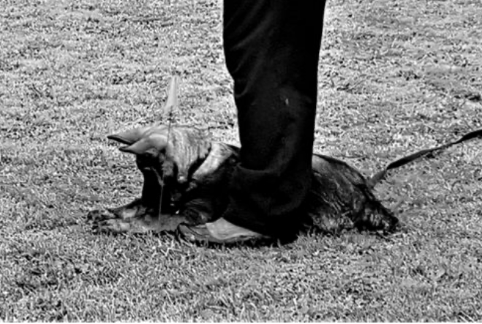

Slide 13
Essence of Evaluation
Essential things
Primary
90%
Conditions
balance of
evaluation
Secondary
10%
Intensity
Self-confidence
Concentration
Convincingly indication
Handler change
distance
Involontary
mistakes

