Slide 1
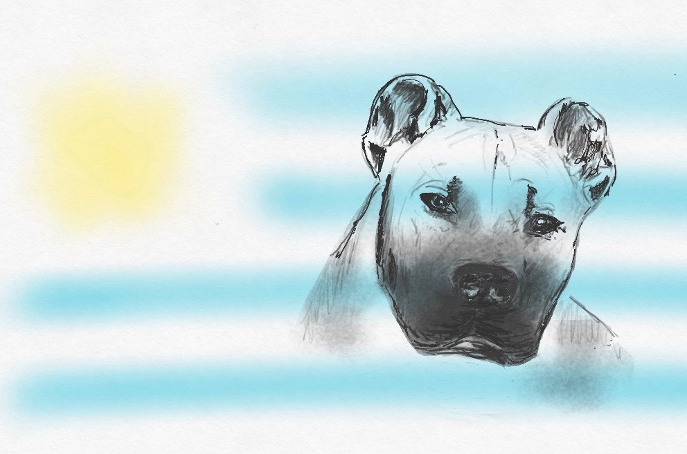


CIMARRON URUGUAYO
Kennel Club Uruguayo - Feb.2017

Slide 2
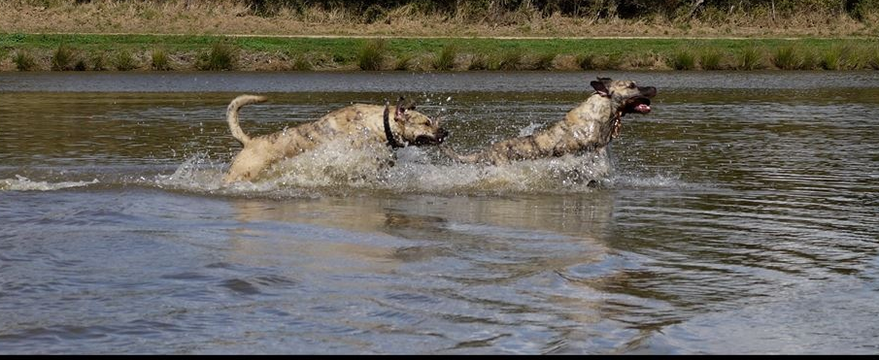
ORIGIN OF THE BREED
Many of the domestic animals brought to América by the first conquerors ended up living in freedom, becoming wild. These animals never came back to a completely wild stage; all of them kept some of their domestic characteristics. The word “Cimarrón” is used in America to name all wild animal or plant, as the opposite of domestic.
The origin of our “Cimarrón Uruguayo” is uncertain as happens with almost every breed.
What we do know is that it comes from crosses among the dogs introduced by the Spanish and the Portuguese conquerors. Many of these dogs were shiftless; nature was shaping capriciously the stock with these crossings, until reaching a definite type: our CIMARRON URUGUAYO. This same natural selection was responsible for the survival of only the strongest, the slyest, the most apt.

Slide 3

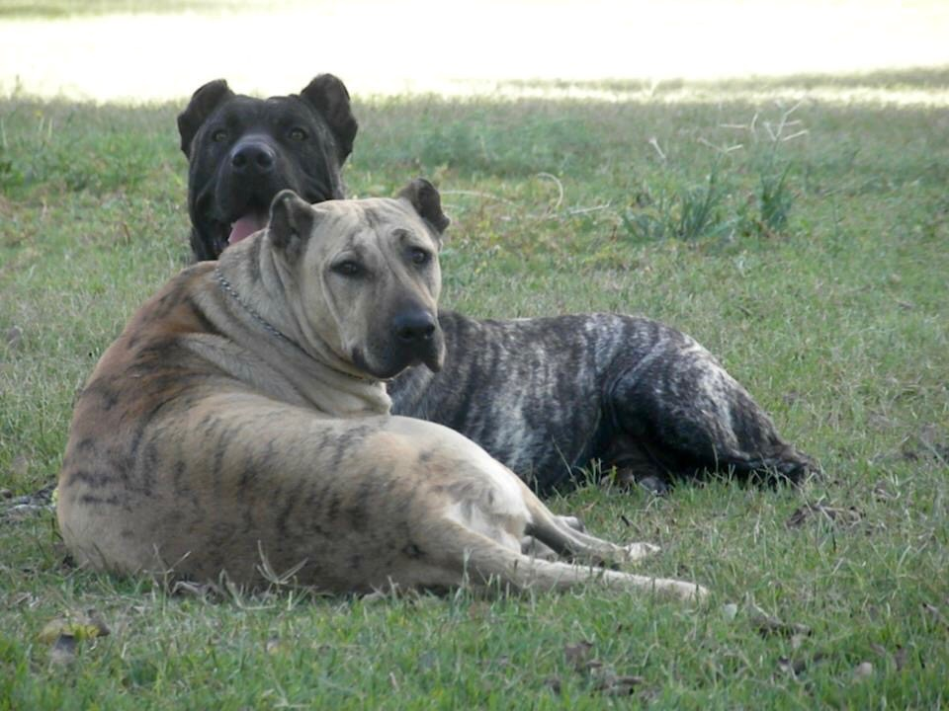
BRIEF BACKGROUND
They grew to become very well adapted to the surroundings. Having plenty of food and no natural depredators, the Cimarron bred in great numbers, becoming a real danger for livestock and even for people, according to some historical documents. This was the reason for some large killings ordered and encouraged by the authorities of the time (end of XVIII and beginning of XIX century). The tales talk about tens thousands roaming the country.
However, in spite of that, “…a great number of bitches with their whelps reached the woods of the Olimar River, the Otazo hills and the Cerros Largos (Long Hills)…” Many ranchers of Cerro Largo, knowing the CIMARRON URUGUAYO virtues at cattle work and property defense, started some selective work, preserving them from cross breeding. Thanks to this arduous work, today we are able to enjoy their qualities in Uruguay. We are happy dog lovers of the rest of the world are doing it so.

Slide 4

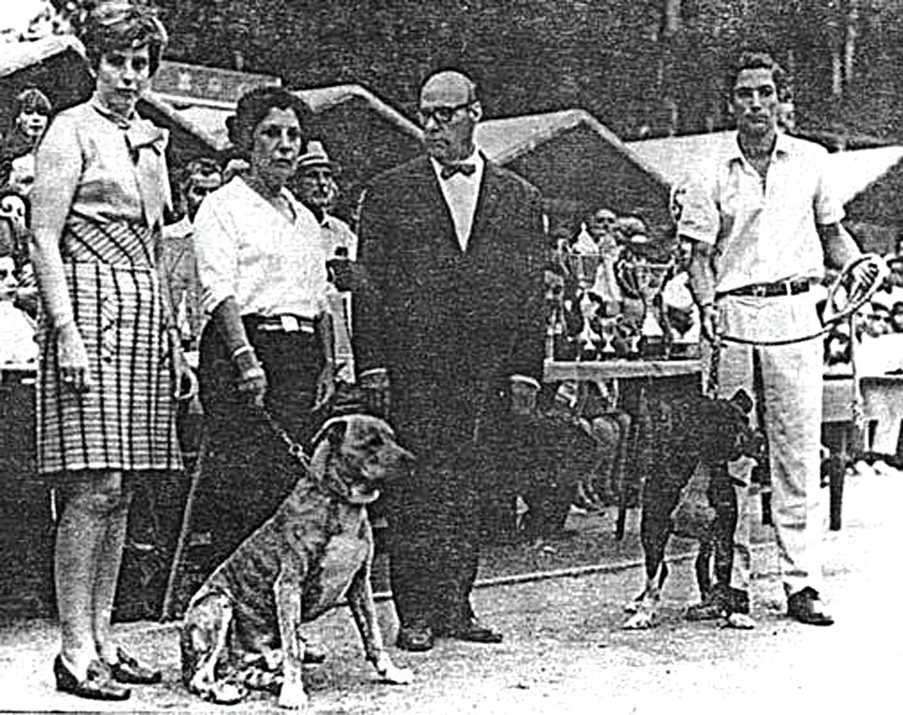
1969 - Frist time Cimarrones have been presented at a KCU general all breed Show.
Judge : Julio Vazquez
Exhibitors: Sra. Elvira S. de Pecoste - Sr. Silvera

Slide 5

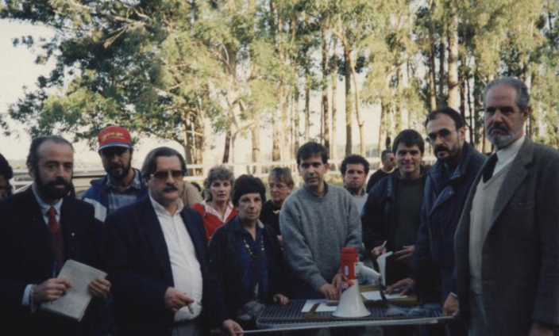
Octubre 12, 1988 the SCCU was founded.

Slide 6
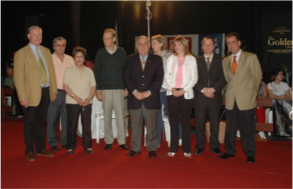
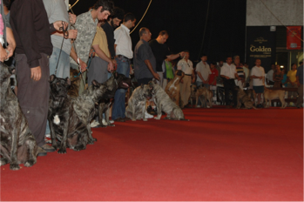
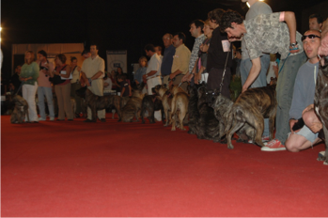
In December 2004 in Montevideo with pride and excitement, more than 130 cimarrones from all over the country were presented to FCI authorities.
(Mr. Hans Müller, Dr. Wilhelm Brass, Mr. Yves DeClerq, Mr. Miguel A. Martinez, Dr. Margarita Durán, Mr. Jorge Nallem)

Slide 7
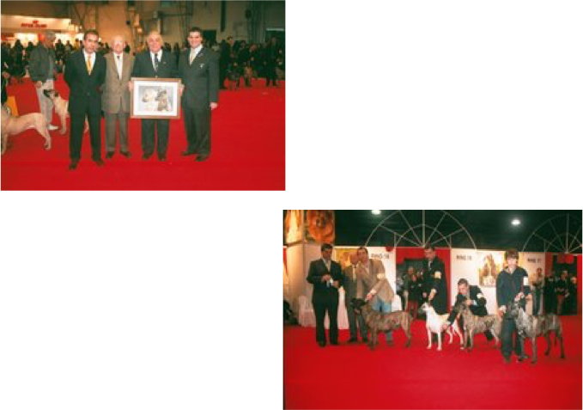
Was a great opportunity to show our breed to the world. The event was attended with many enthusiast people, international press and the dogs were inspected by
Prof. Raymond Tirquet (Standard Commission president) and Miguel A. Martinez (Am&Caribean President).
2005 - In the frame of the
World Dog Show in Argentina,
under the invitation of the
Federation Cinologica Argentina
First specialty show outside Uruguay was organized with more than twenty dogs, judged by Adrián Landarte.

Slide 8
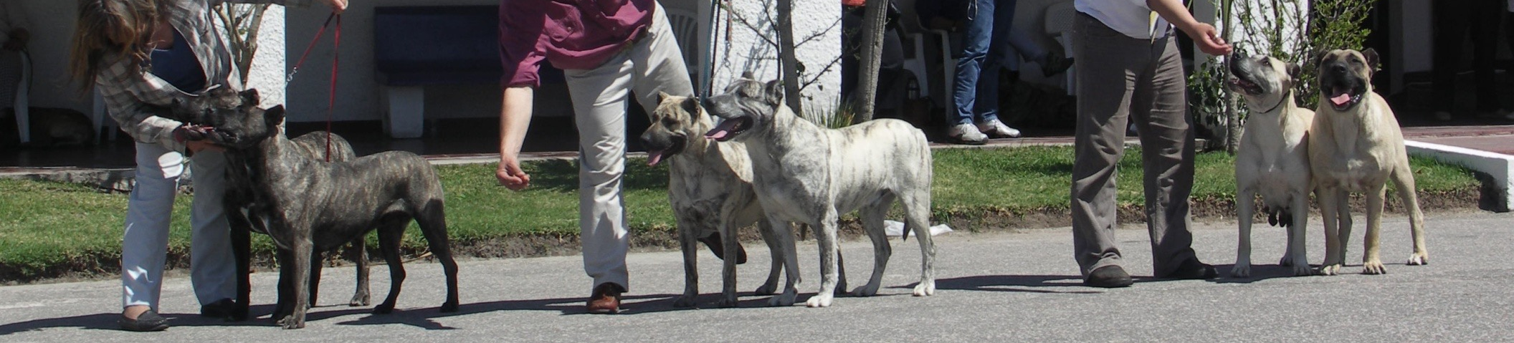
STANDARD OF THE BREED
1988
First official standard was approved and publish by the Kennel Club Uruguayo
February 21, 2006
The Cimarron Uruguayo was recognized on a provisional basis by FCI with Standard N°353
March 11, 2014
New revision of the Standard was approved by Standard and Scientific commissions and is current
FCI official valid Standard.
http://www.fci.be/Nomenclature/Standards/353g02-en.pdf

Slide 9
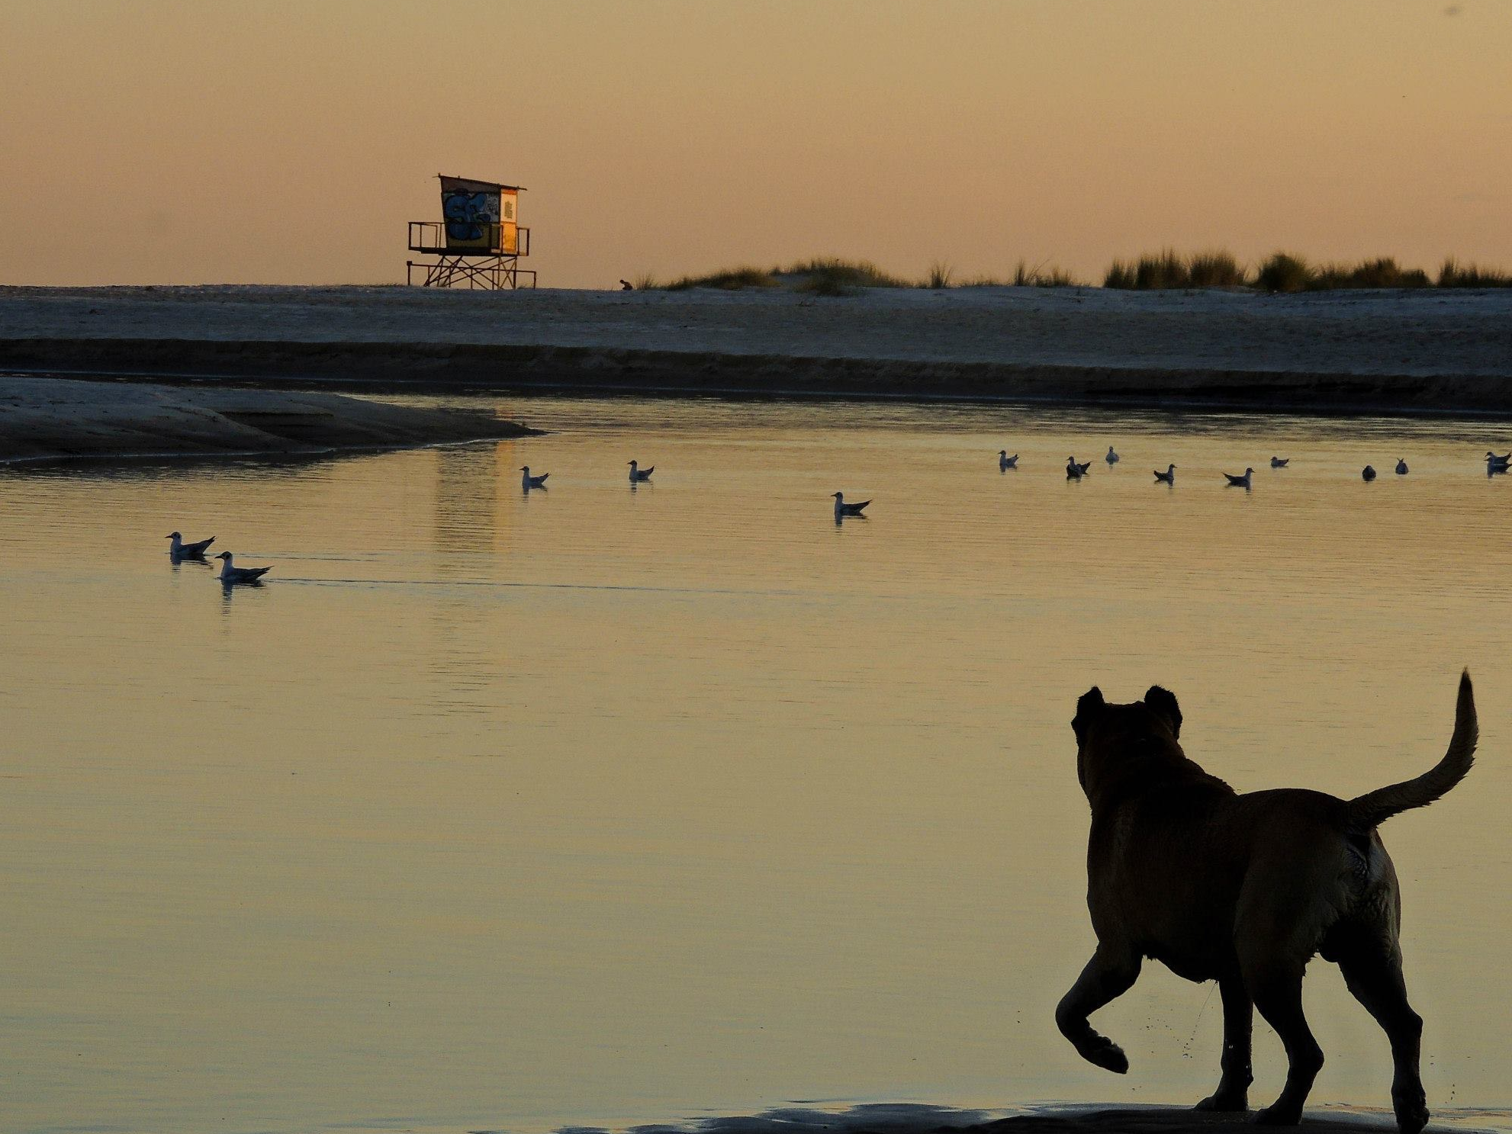
General Appearance
Medium sized dog of dogue type,
strong, compact, with good bone,
well muscled and agile.
S.Armingaud

Slide 10
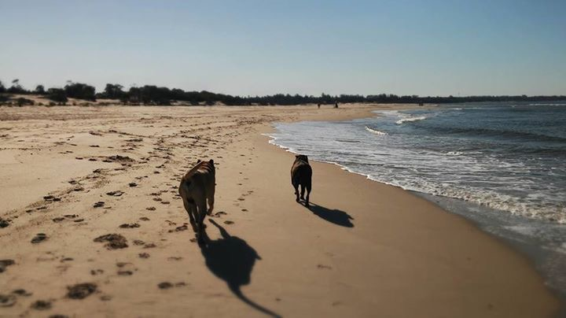
Temperament / Behavior
Balanced, intelligent and of great courage

Slide 11
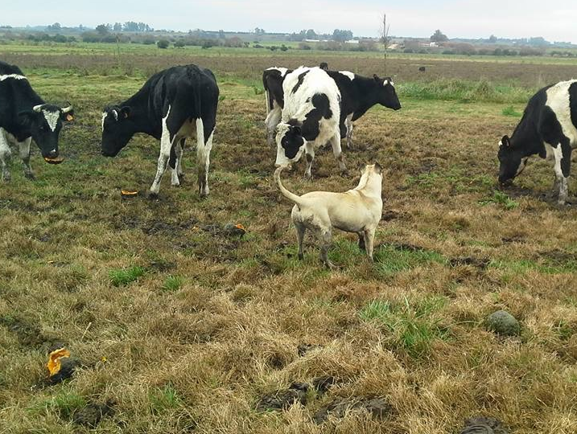
UTILIZATION
It is a very versatile dog, in Uruguay in the cities mainly used as a family dog and guard, in the field as a working dog with cattle and sheep, also used as a big game hunting dog especially for wild boars

Slide 12

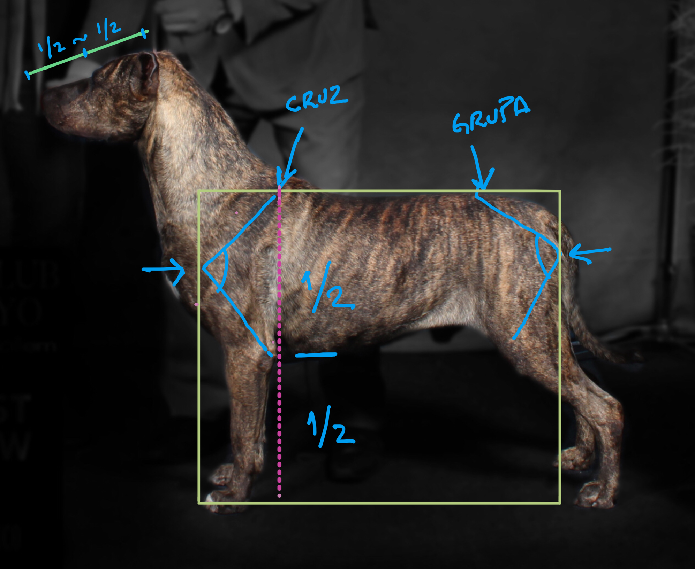
Important Proportions

Slide 13
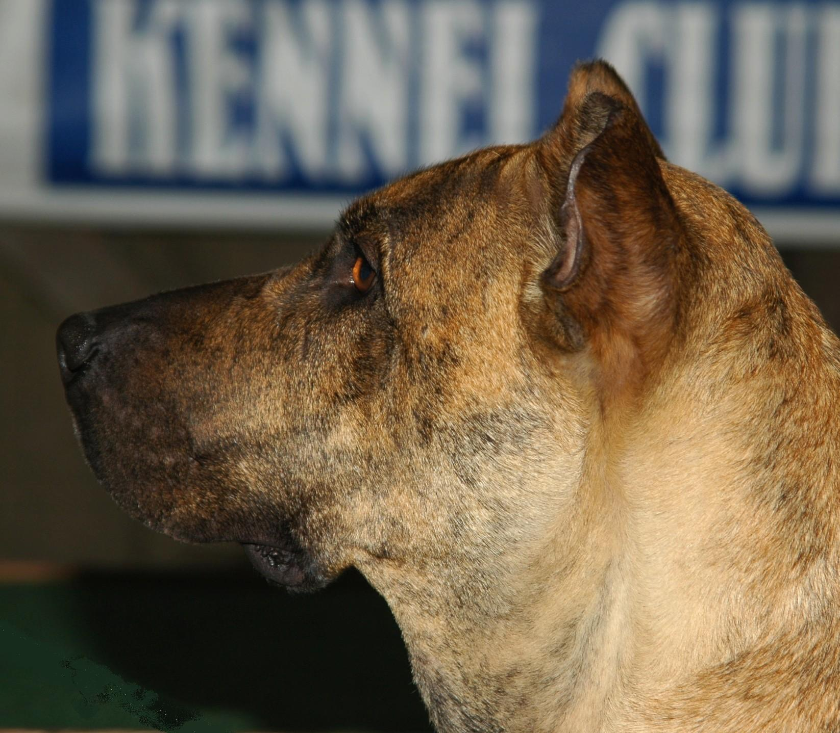
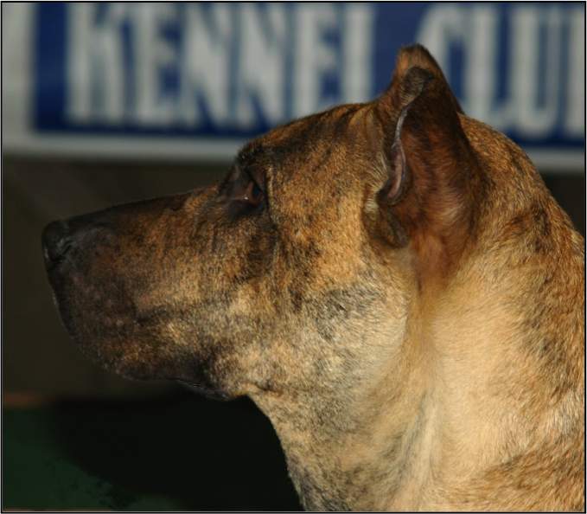
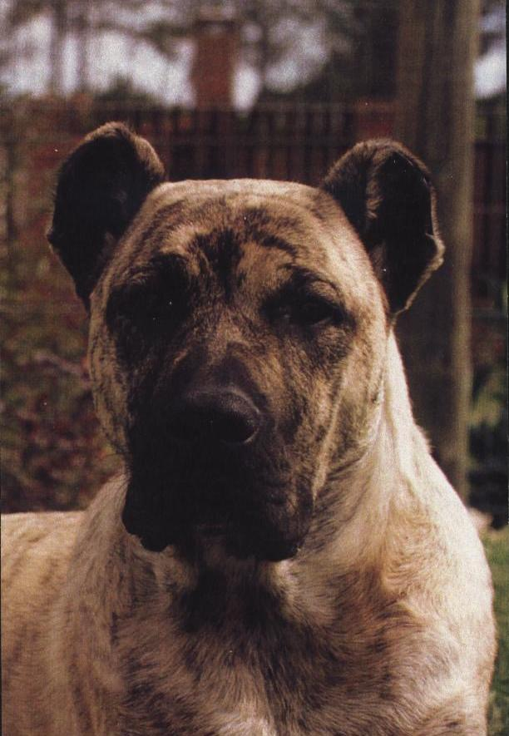
HEAD
Muzzle powerful. Medium width, slightly shorter than skull.
Skull wider than long. Occiput slightly pronounced.

Slide 14
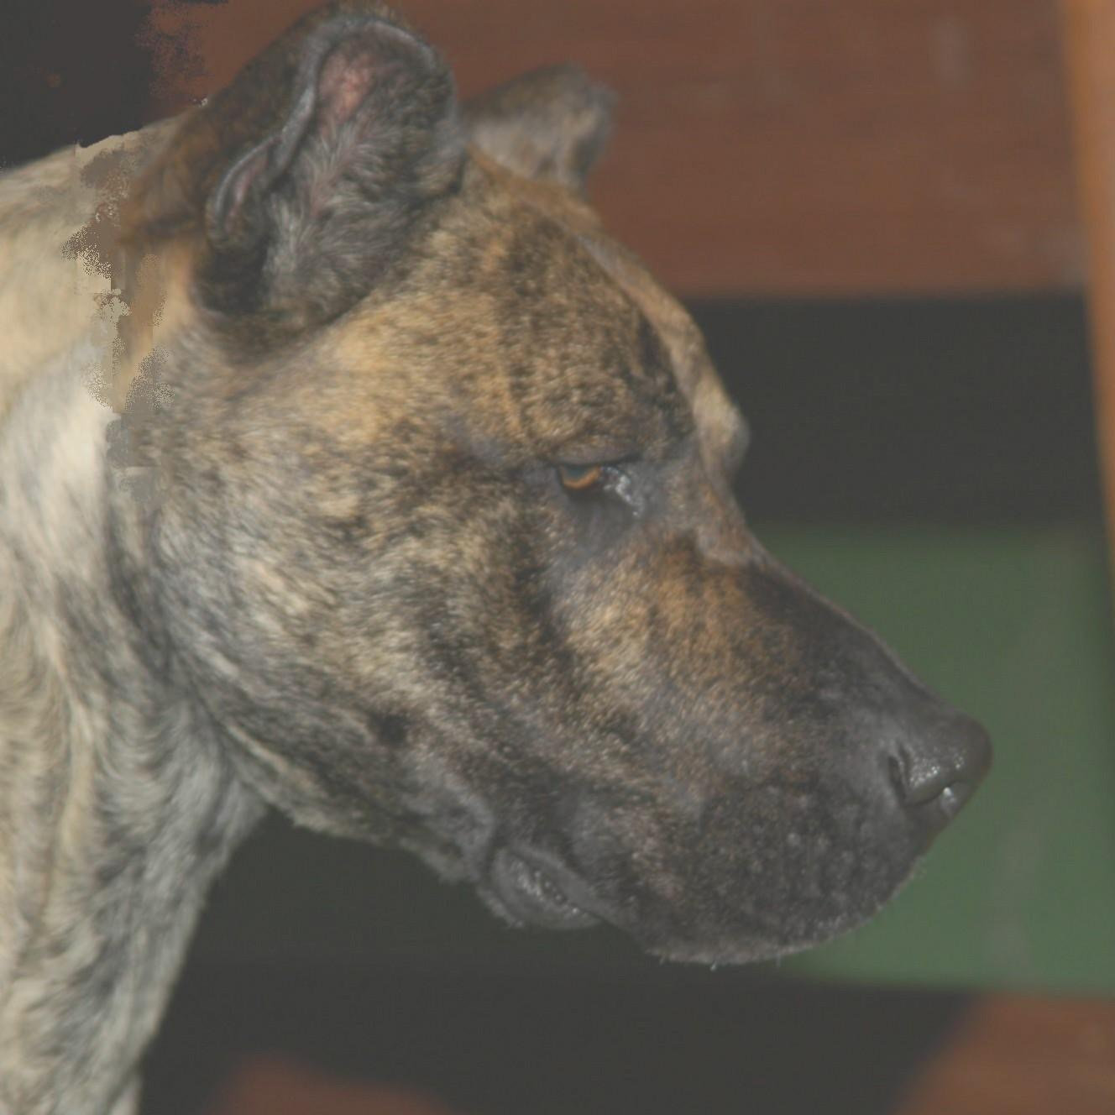
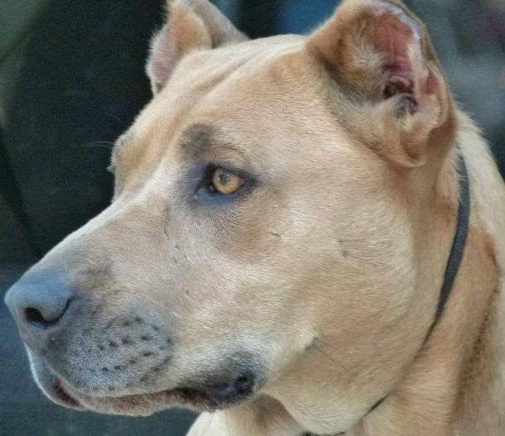
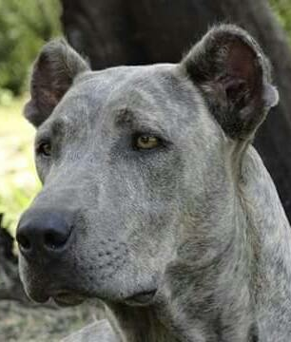
STOP : Moderate NOSE : Broad, black or in accordance with coat color.

Slide 15
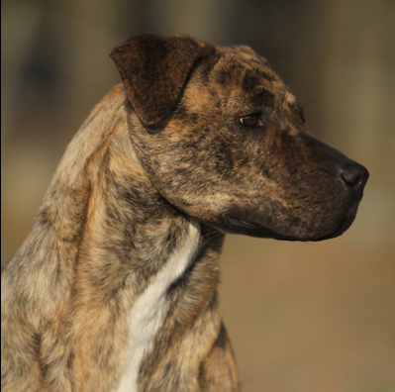
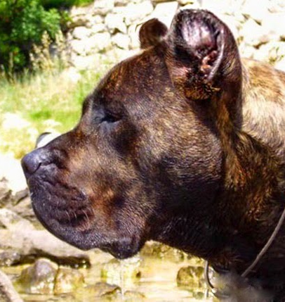

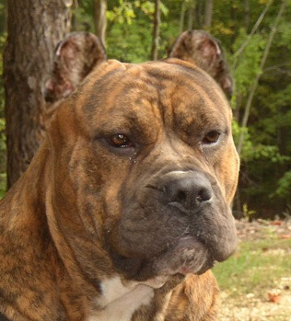
LIPS: Upper lip covers lower lip but is not hanging JAWS/TEETH: Jaws strong, powerful. Teeth strong, well aligned, preaferably complete bite, allowing absence of PM1. Scissor bite. CHEEKS Well developed, not bulging.

Slide 16
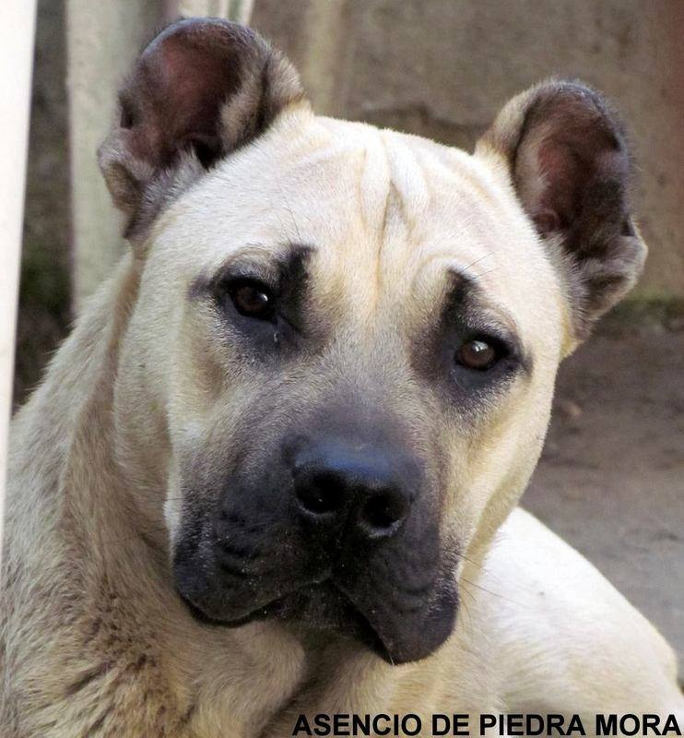
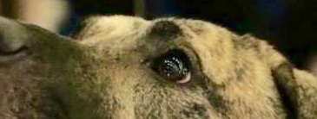
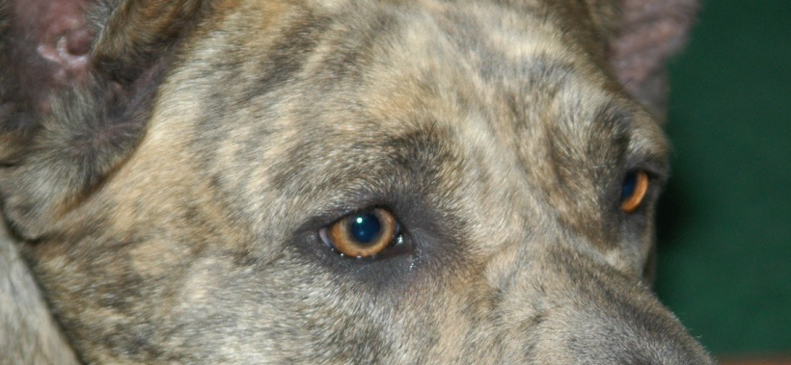
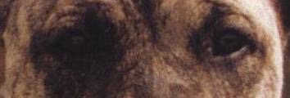
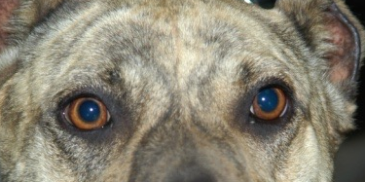
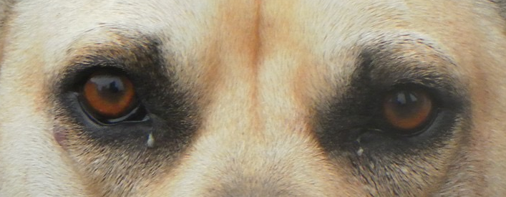
EYES: Medium size, almond shape. Any shade of brown or in accordance with coat color, the darker the better. Eyelids tightly fitting eyeball and fully pigmented.

Slide 17
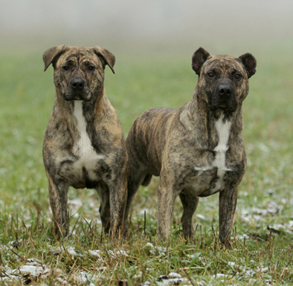

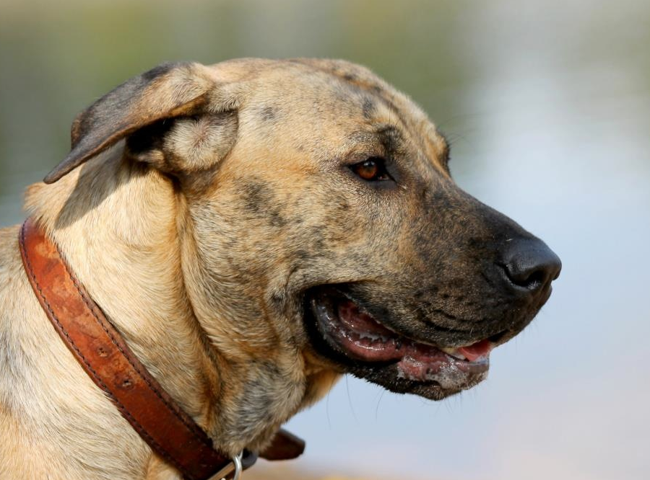
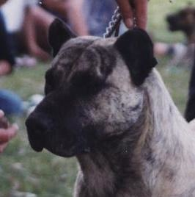
EARS: Medium size, set neither too high nor too low, triangular, drooping but not close to the cheeks or in rose shape. Traditionally cropped in country of origin.

Slide 18
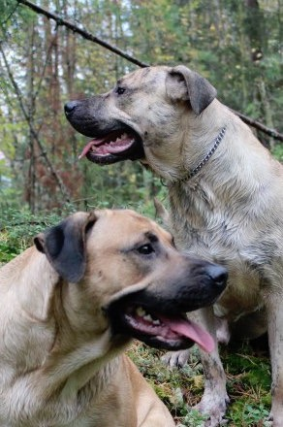

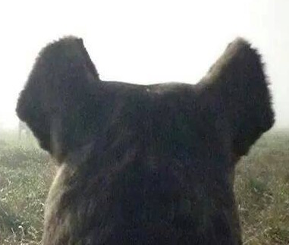
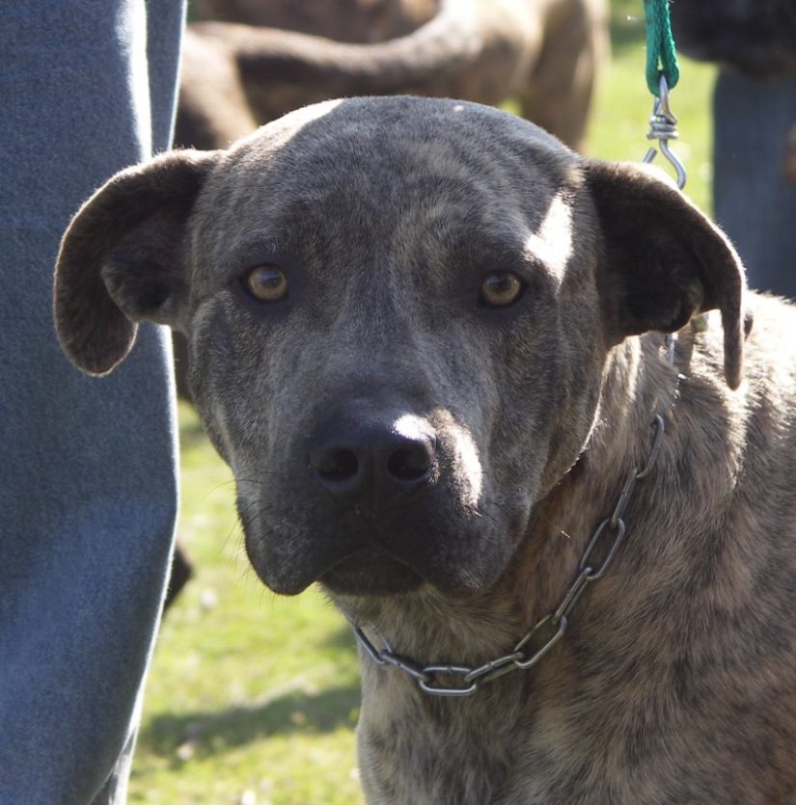
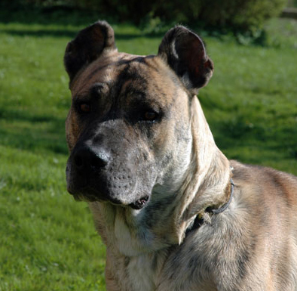

Slide 19
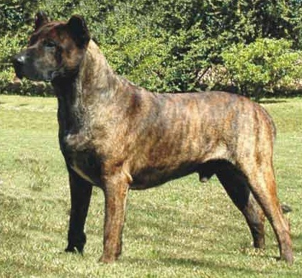

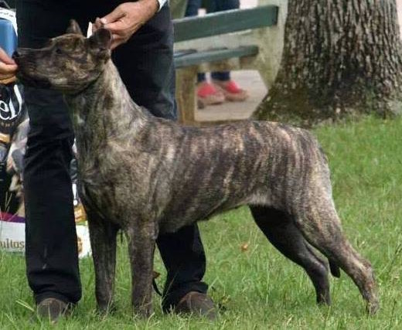
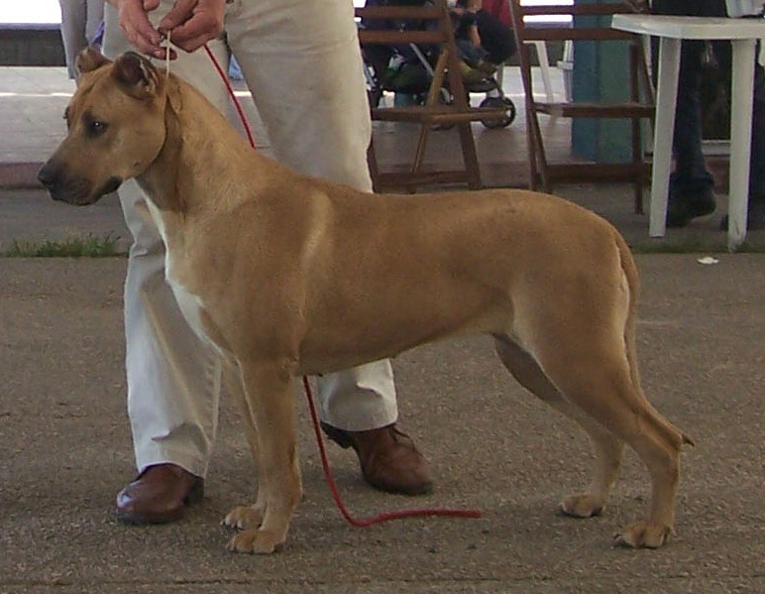
COSTILLAS
bien arqueadas,
no abarriladas.
NECK Strong, well muscled, not too long.
TOP LINE Level or with a slight depression behind the withers.
WITHERS: Well defined.
LOIN short, strong, slightly arched.
CRUOP of good length, broad, sloping at 30 on the horizontal.
RIBS well sprung, but not barrel shaped.

Slide 20
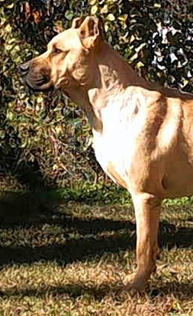
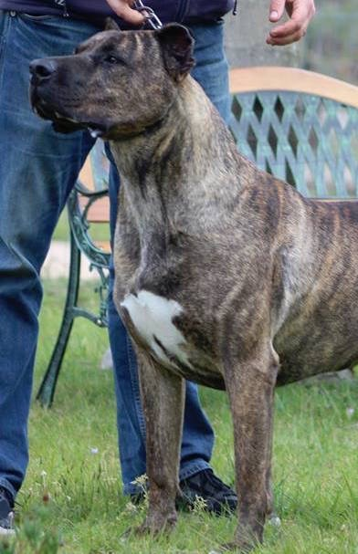
Chest deep, reaching at least to the elbow. Broad and well developed.
Forechest well defined.
Shoulder well laid back.
Upper arm same length as the shoulder blade.
Elbow neither turned in nor out.
Metacarpus seen from the side, slightly sloping.
Front feet oval shaped, well-knit toes. With strong pads

Slide 21
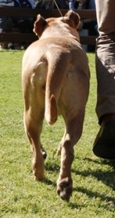
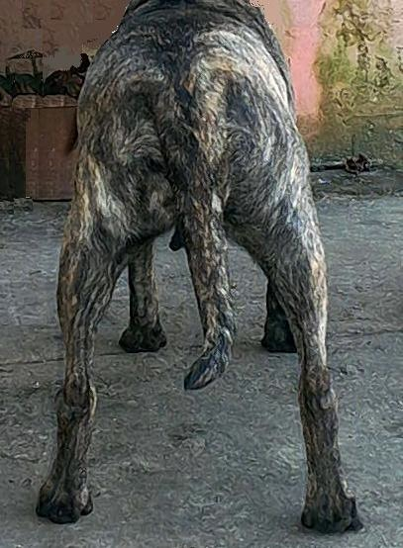
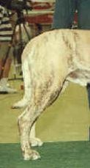
Hindquarters well muscled and powerful, seen from behind straight and parallel.
Thigh well developed
Metatarsus firm,of medium length.
Hind feet cat feet, strong pads.
Tail thick, medium set. Reaching to the hock. At rest carried low. In motion carried horizontally or slightly upward.

Slide 22
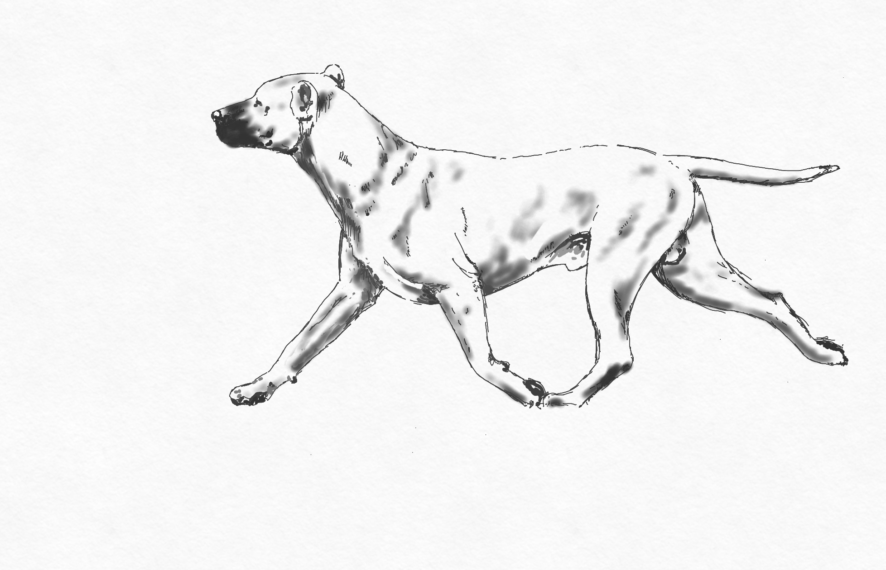
GAIT- MOVEMENT
EFFORTLESS. WITH GOOD REACH IN FRONT AND GOOD DRIVE BEHIND. IN MOVEMENT, SEEN FROM THE FORNT AND FROM BEHIND, THE LEGS ARE PARALLEL, SINGLE TRACKING WHEN SPEED INCREASES.

Slide 23
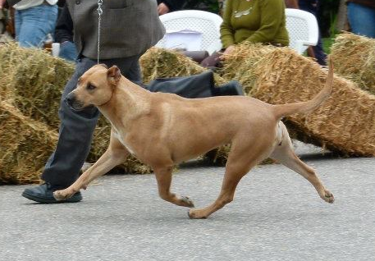
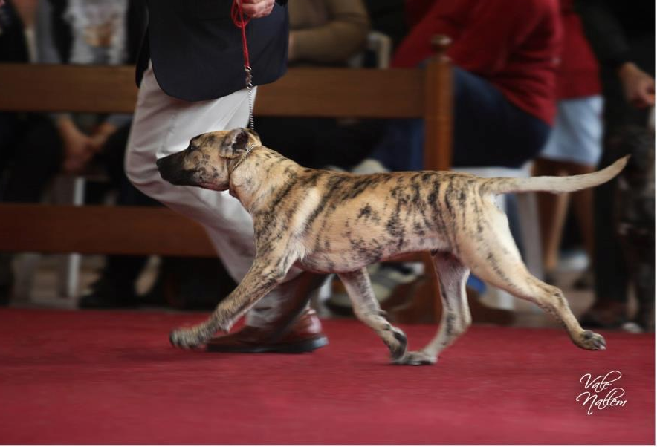
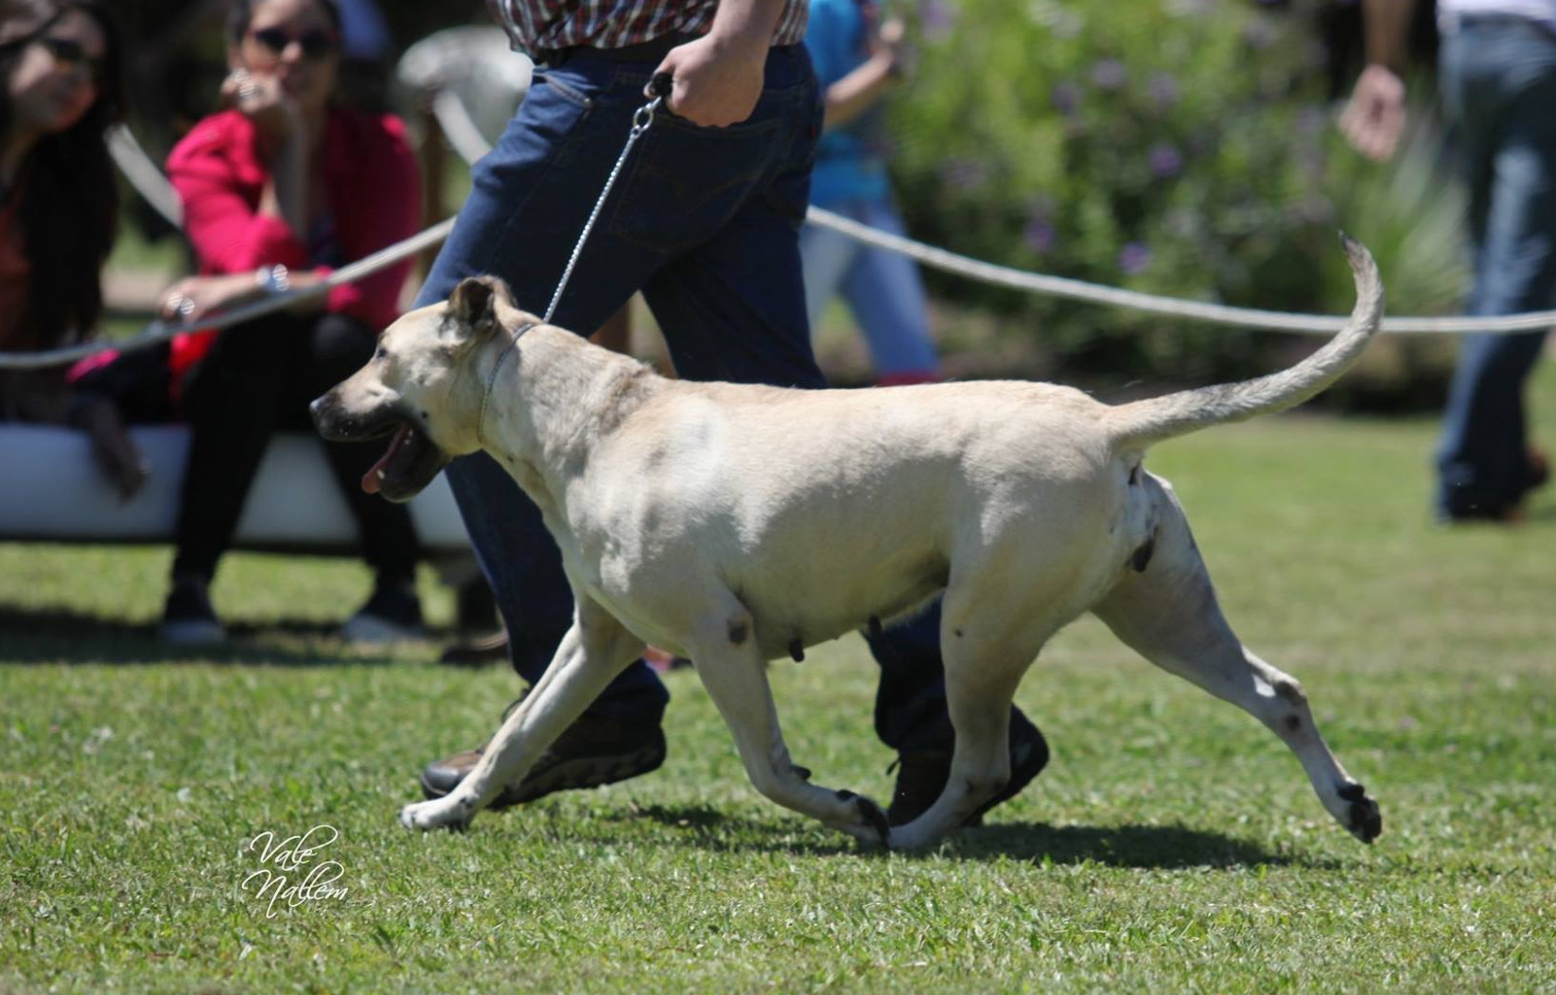

Slide 24
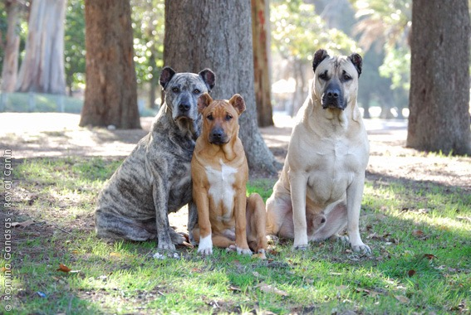
Skin thick and supple. Coat, short, smooth, close to the body, with undercoat.
Brindle or all shades of fawn, the latter may have black shadings. Also bluish brindle and bluish fawn, al with or without mask.
White marks are allowed in the following places: under jaw, the throat, fore chest, abdomen and lower part of legs not exceeding up the wrist or half way up the metatarsus

Slide 25
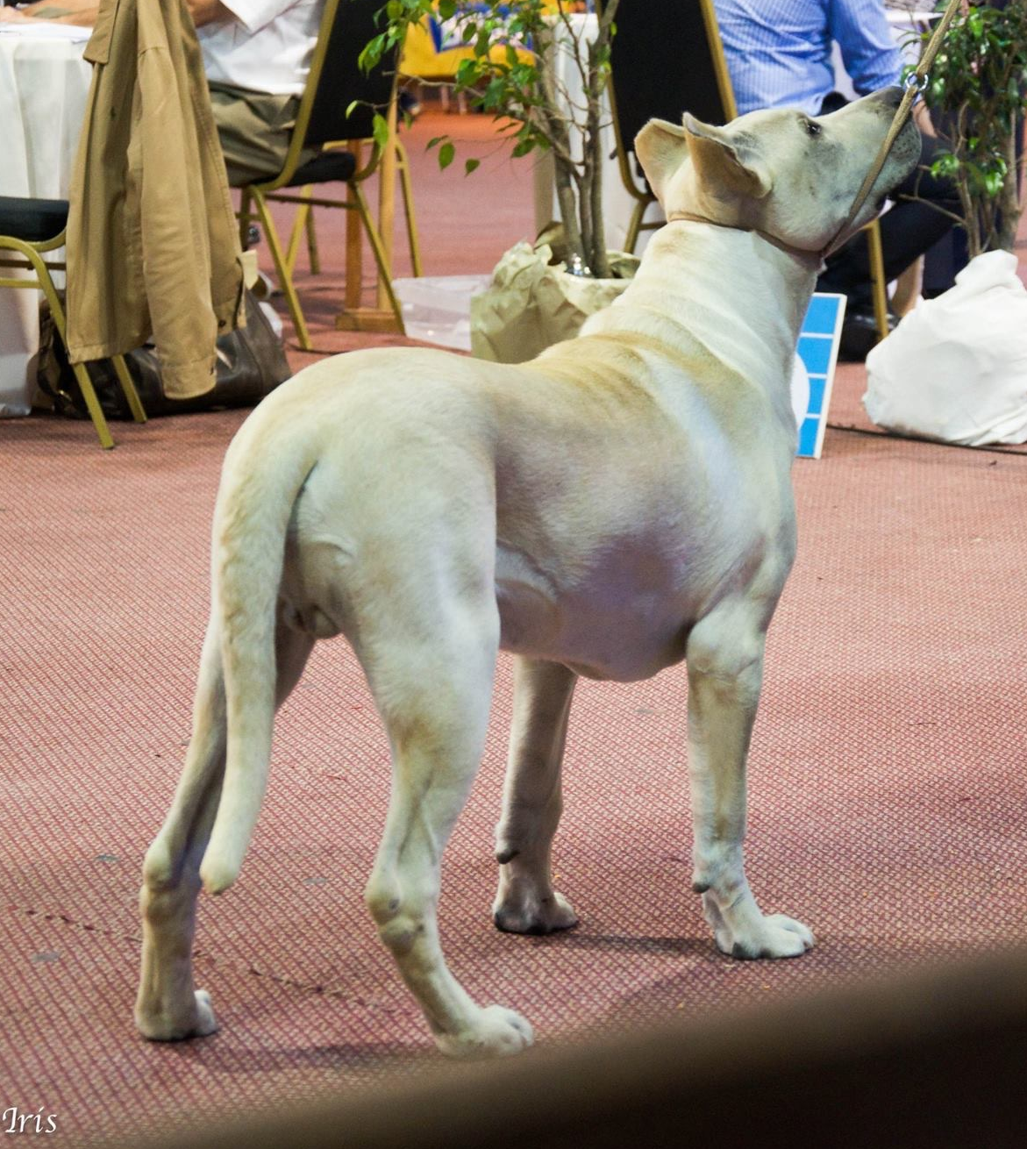




Slide 26












Manto

Slide 27








Slide 28

SIZE AND WEIGHT
HIGHT AT THE WITHERS
Males 58-61 (2 tolerance)
Females 55-58 (2 tolerance)
WEIGHT
Males 38-45kg
Females 33-40kg

Slide 29

FAULTS
Any departure from the foregoing points should be considered a fault and the seriousness with which the fault should be regarded should ve in exact proportion to its degree and its effect upon health and welfare of the dog.
Lips excessively pendulous at corners.
Excessive dewlap
Cheeks too prominent.

Slide 30


SEVERE FAULTS
White markings with the exception of those mentioned.
Clear departure from the important proportions.
Absence of sexual dimorphism
Size under or over stipulated hight (including tolerance)
Sloping topline.

Slide 31

DISQUALIFYING FAULTS
Aggressive or overly shy dogs
Any dog clearly showing physical or behavioral abnormalities shall be disqualified.
Clear lack of type
Undershot
Overshot
Unpigmented nose.
Long hair
Genetic brown (chocolate) coat color, in fawns or brindles with nose and gums brown and light eyes.
Any color not mentioned.

Slide 32




OTHER ACTIVITIES

Slide 33




OTHER ACTIVITIES

Slide 34

CIMARRON URUGUAYO
THE NATIONAL HERITAGE DOG

Slide 35

The Cimarron is the only Uruguayan breed and has a strong roots in the population and its tradition.
Is a symbol of our country since the time of independence, always with our national hero Gral. Jose G Artigas.
The Uruguayan Cimarron accompany the mounted cavalry of the body of the blandengues of Artigas in all the party and official parades.

Slide 36








More presence of the breed in different ways. (Monuments, sculptures, paints, poems, songs, postage stamp,etc.)

Slide 37

New monument recently inaugurated in Montevideo representing the windows to the future watched by cimarrones (By very well know artist Iturria)
Telling us about the importance the breed has for uruguayans.

Slide 38




Igor - Famous theatre Cimarron dog actor on stage
Batu - The mascot of the southeamerican sub20 soccer championship

Slide 39


Slide 40


Slide 41

Any other extra information or clarification please contact us to info@kcu.com.uy

