Slide 1
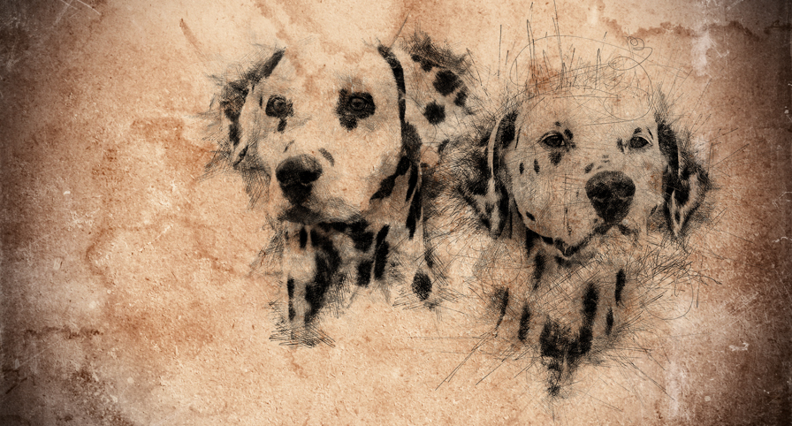


Hrvatski kinološki savez • Croatian Kennel Club
DALMATIAN
(Dalmatinski pas)

Slide 2
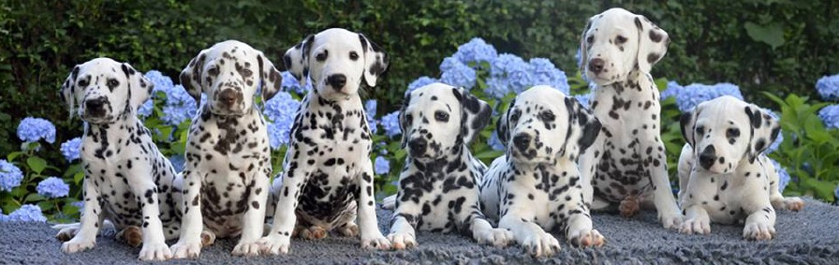

DALMATIAN

Slide 3
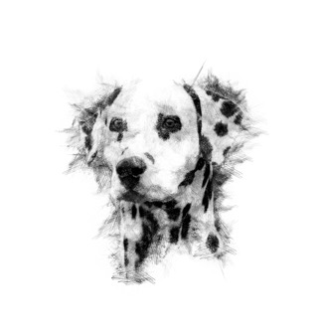
FCI group VI.
Standard No. 153

Slide 4
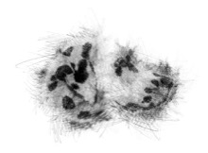
ORIGIN: Croatia
DATE OF PUBLICATION OF THE OFFICIAL VALID STANDARD: 13.10.2010.
UTILIZATION: Hunting dog. Companion dog, family dog,
suitable to be trained for various purposes.
FCI-CLASSIFICATION: Group 6 - Scenthounds and related breeds.
Section 3 - Related breeds. Without working trials.

Slide 5
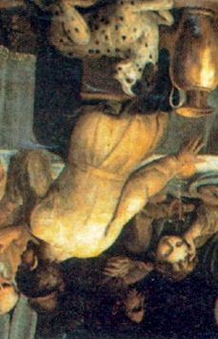
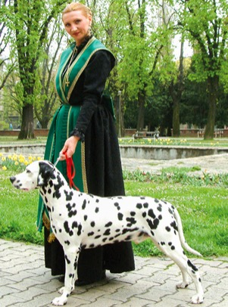
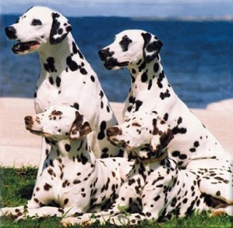
BRIEF
HISTORICAL SUMMARY

Slide 6
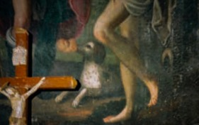

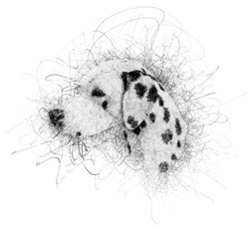
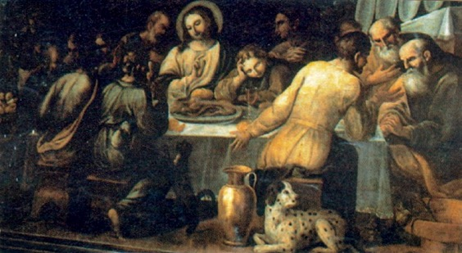
Breed History
he origin of the Dalmatian dog can be recognized in paintings and in church chronicles from the 16th to the 18th century. Dalmatians can be found on the altar painting “Madonna with Jesus and Angels” in the church of “Gospa od andjela”, town of Veli Losinj, island Losinj in Croatia, dating back to 1600 – 1630, and also on oil on canvas painting in Zaostrog, Dalmatia, Croatia (dating back to 1700-1730, most likely to Venetian period around 1710).
It suggests that the Dalmatian originates from the eastern Mediterranean region, in particular the historic province Dalmatia.
The first descriptions of the Dalmatian were found in the diocese Djakovo, in the Croatia, namely in the church chronicles of the Bishop Petar Bakic from the year 1719 and the church chronicles of Andreas Keczkemety from the year 1737. The dog was named with the Latin name “Canis Dalmaticus” and the height of the dog described with 4-5 “Spithamus”. Thomas Pennant described this breed in his work “Synopsis of Quadrupeds” in the year 1771 as very independent, named it “Dalmatian” and wrote the origin of this breed to be Dalmatia. A work by Thomas Bewick, published in 1790, refers to this breed as “Dalmatian or Coach Dog”. The first unofficial Dalmatian Standard was written by an Englishman named Vero Shaw in the year 1882. After the formation of the Dalmatian Club in England in the year 1890, this standard was transferred to the first official breed standard.
The FCI published the first Dalmatian standard on the 7th of April 1955 under the name of “Dalmatian Huntingdog”.

Slide 7
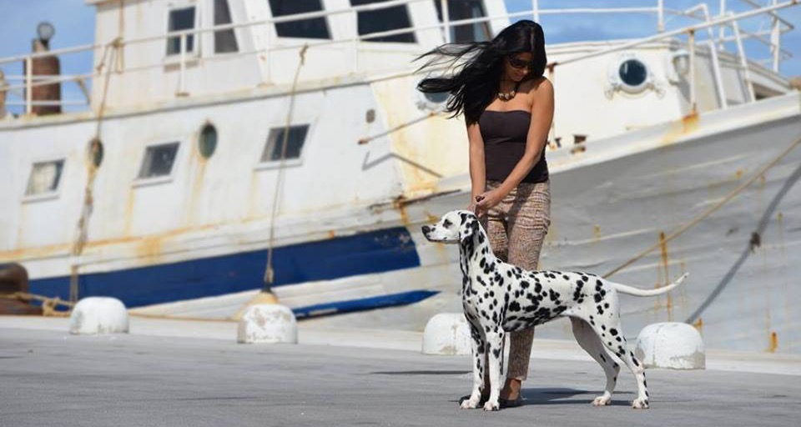

Dalmatian

Slide 8


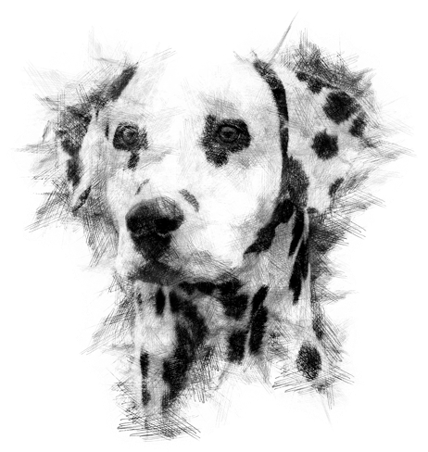

DALMATIAN
BREED STANDARD
WITH
COMMENTARY

Slide 9
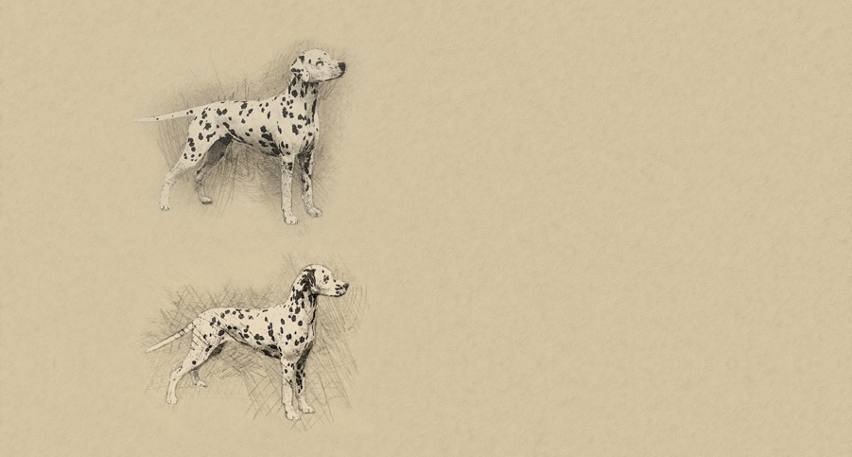

General
Appearance
Mesocephalic. Head prismatic form with hanging ears.
The body is rectangular, strong, muscled and distinctively spotted.
The movement must be elegant. The sexual difference must be visible.
IMPORTANT PROPORTIONS:
Length of the body: height at the withers = 10 : 9.
The height at the elbow joint: 50% of the height at the withers.
The height the hocks: 20-25% of the height at the withers.
Length of head: around 40% of the height at the withers.
Length of skull : length of muzzle = 1 : 1.
BEHAVIOUR AND TEMPERAMENT: Pleasant temperament, friendly,
not shy or hesitant, free from nervousness and aggression. Lively kind, loyal, independent and easy to train. The Dalmatian likes water and outdoor activities. It has a marked hound instinct.

Slide 10
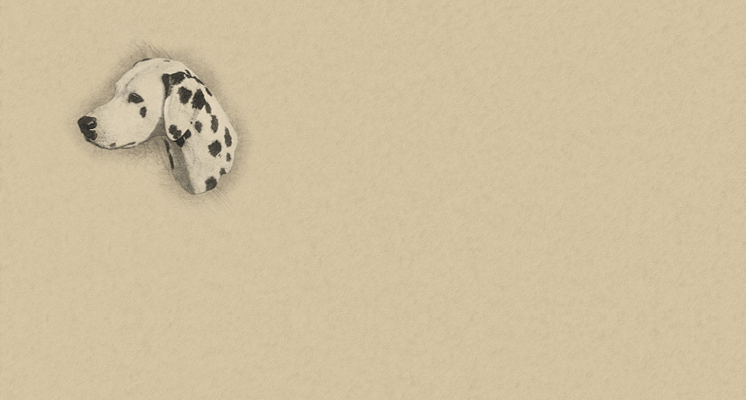
Head
The head must be in proportion and harmony with the rest of the body and not too wide in the skull area. Length from the occipital protuberance to the stop and from the stop to the tip of the nose equals 1:1, or the muzzle is slightly shorter. The upper line of the skull and the upper line of the muzzle are slightly divergent. The masseter muscle and the cheek bone must not be too developed. Head must be entirely free from wrinkle.
Cranial region
Skull: Flat, with a slight lateral rounding. Broadest between the ears and well defined temples. Slight frontal furrow. Stop: Moderately defined.
Facial region
Nose: Large with wide open nostrils, it must be completely pigmented. The colour must be in accordance to the colour of the spotting. Muzzle: Well developed and strong jawbone, nasal bridge straight.
“
Correct head
COMMENTARY OF THE STANDARD
Before the beginning of the comment to the standard it should be pointed out that the Dalmatian is not typical for its lovely head, scissor bite, rectangular body nor for parallel legs, as these are the characteristics of almost all breeds. Dalmatian originates from the hound group, more precisely it is “the Illyria hound group" for which the following applies: “dog of lighter ‘brachoid’ type, mesocephalic head of prismatic form with hanging ears. The body is rectangular, with characteristic hair and distinctively spotted.”
When the premise says that the Dalmatian is brachoid type, it refers to its rectangular body whose length exceeds height for 8-10%, with mesocephalic head whose cephalic index is around 50. Cephalic index is a number that is obtained when the width of head multiplied by 100 is divided by the length of the head (width of head x 100 / head length) with slightly divergent lines of the skull and muzzle, prominent stop, oval eyes of sub-frontal position, with "highly" set folded ears (in the line of the tip of the muzzle and internal corner of the eye). The movement should be harmonious and elegant.
On July 27th 2011, a meeting has been held related to the commentary of the currently
valid standard, dating from May 30th, 2011.
Suggestion of the commentary has been made by mr. Boris Špoljarić.
Participants in making of the final text of commentary were mr. Damir Skok, mr. Mijo Fury, mr. Zlatko Kraljić, mrs. Ivana Bakal,
mrs. Željka Halper Dražić and mr. Željko Radić.

Slide 11
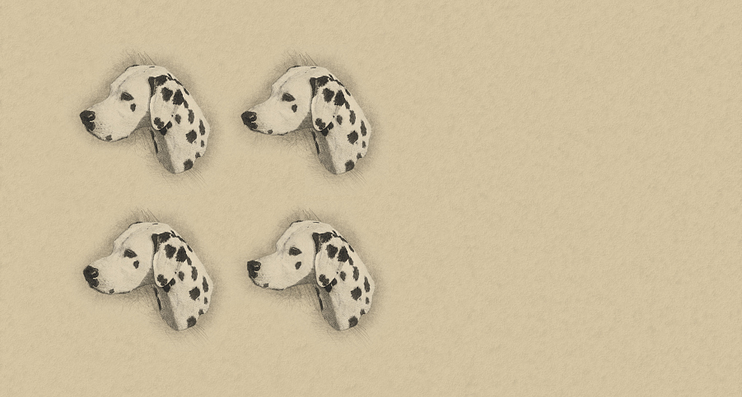
Lips: Strong, must fit the jaw rather closely and
not be pendulous, or too thick; without the corner of
the mouth too defined.
A complete pigmentation is desired.
Jaws / Teeth: Scissor bite, i.e. the upper 6 incisors closely overlapping the lower teeth, with all teeth set square to the jaw.
A complete set of teeth (42 teeth) is desired (in accordance with
the teeth formula). The teeth are evenly formed and white.
A pincer bite is tolerated in older dogs.
Eyes: Oval, in a sub-frontal position placed at an angle of 10-15˚.
The eye colour is in accordance with the spotting.
Eyelids are close to the eyeball and not loose. Eye rims are completely pigmented in accordance with the coat colour.
Ears: Set on rather high, carried close to the lateral part of the head. The length reaches to the inner corner of the eye or to the stop.
The tip is slightly rounded. The ears have the shape of an isosceles triangle. They are fine in texture and soft to the touch.
It is very important that the ears are spotted, i.e. the ears must not be completely black or brown but black or brown spotted etc. with the spotting in accordance with the colour variety on the white base.
NECK
The neck should be strong and fairly long, tapering towards the head and free from throatiness.
Muzzle too heavy,
Thick, too pronounced lips
Muzzle too light,
Weaker underjaw
Roman nose
Convergent lines of head

Slide 12
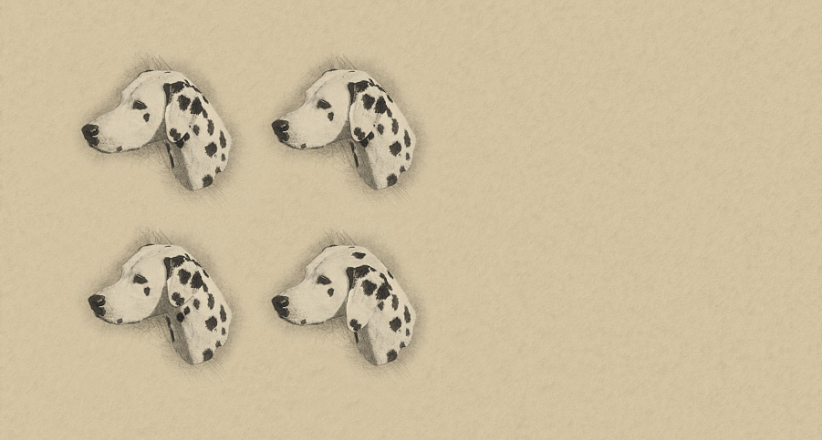
COMMENTARY OF THE STANDARD
GENERAL APPEARANCE:
General appearance is a very important item when
evaluating the Dalmatian. General impression refers to the harmony of body lines, then the movement itself, especially to elegance of movement. The elegance is extremely important as hound dog, because of the tasks designed for them for centuries (pursuit of the game), should be agile, harmonious but also strong and elegant in movement. Head has typical line proportions with correctly set ears and proper hair with as symmetrical as possible
spots. The gender difference has to be expressed, which means that males are not “feminine” nor female “masculine”.
Head: The head must be in proportion and harmony with the rest of the body and not too wide in the skull area. The length from the occipital protuberance to the stop and from the stop to the tip of the nose equals 1:1 (or 1:0,9 which means that muzzle is slightly shorter). Skull must be flat, with a slight lateral rounding. Stop has to be defined but not too much indicated nor overlong. The upper line of the skull and the upper line of the muzzle are SLIGHTLY DIVERGENT (all hounds from southeast Europe have “slightly divergent” head lines). Chewing muscles and zygomatic arches should not be too pronounced, because it disrupts the harmony of the head. The skin on the entire head should be wrinkle free.
Muzzle too long
Correct size and set ears
Ears too small and set too high
Ears too large and set too low

Slide 13

COMMENTARY
Ears: Ears should not be too long nor too short. If pulled forward, they usually reach to the inner corner of the eye or to the stop. The tip
should be slightly rounded. The ears have the shape of an isosceles triangle. They are fine in texture and soft to the touch, velvet like. It is very important that the ears are spotted, i.e. the ears must not be completely black or brown but black or brown spotted. Completely black or brown ear
is not desirable.
Eyes: Oval, in a sub-frontal position placed at an angle of 10-15˚. The eye colour (iris) is in accordance with the spotting, which means that black spotted dogs should have darker brown eyes (which seems almost black) while brown spotted dogs have lighter brown eyes. Light eye is a fault which should be penalized in accordance with its degree. Eyes of different colours (heterochromia), blue eyes, or even partially blue coloured iris should be most severely penalized i.e. disqualified. Eyelids tightly fitting to the eyeball, not loose. Eye rims are completely pigmented in accordance with the iris colour (black spotted dogs have black pigmentation, brown spotted dogs - brown).
Muzzle: Well developed and strong jawbone. Especially lower jaw (mandible) must be strong and must not be ”chin less”. Lips are strong, must fit the jaw rather closely and not be pendulous, or too thick; without the corner of the mouth too defined. A complete pigmentation in accordance to the spot coloration is desired (the same applies as in the eye colour). Large nose with wide open nostrils, it must be completely pigmented. The colour must be in accordance with the colour of the spotting. Pronounced non-pigmentation should be penalized. Complete non-pigmentation of muzzle must be disqualified.
Teeth: Only scissor bite. All other variations are not allowed, such as undershot, overshot, reverse scissors, cross bite etc. Pincer bite is tolerated in older dogs. A complete set of teeth (42 teeth) is desired, as described in standard. The lack of teeth, if it occurs, it is usually a lack of premolars, while the lack of other teeth is practically very rare. It is not good if a shortage of four premolars in a row on the same side (P1-P4) occurs, which should somehow be punished. Lack of 7 or more premolars must be disqualified. Lack of any teeth - incisor, canine or molar (with the exception of M3) - must result with disqualification.
Neck: The neck should be strong, long enough, without excess skin on throat or lower part of neck (no dewlap), whose presence should be penalized.

Slide 14
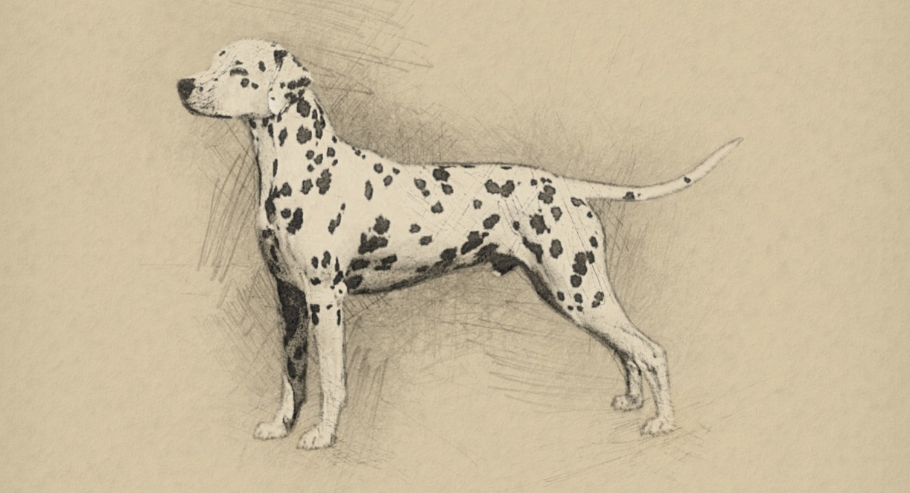
Body

Slide 15
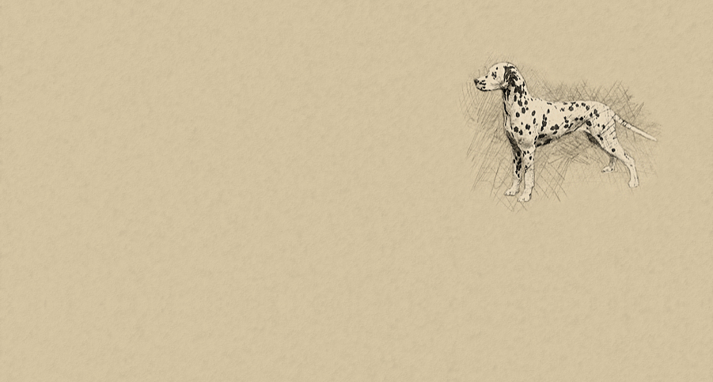
BODY: Rectangular, proportions of length of body to the height at the withers is 10:9.
Withers: Well defined.
Back: Powerful, level.
Loin: Short and muscular.
Croup: Muscular, inclined less than 30˚.
Chest: Deep and capacious, not too broad or barrel-shaped. The depth of the chest
should be 45-50% of the height to the withers. The height of the elbow is 50% of
the height to the withers. The ribs are well sprung.
Underline and belly: The belly is moderately tucked up but not drawn in.
COMMENTARY
Body: As already stated, the body has a rectangular shape whose length in relation to the height at the withers is 10:9 (the body is longer, about 8-10% of the height at the withers). The topline should be slightly sloping from withers to croup. Saddle or roach topline is not desirable. A slight “dip” can sometimes occur on the back, which can’t be as expressed as in Saluki, but can be extremely mild. It represents the typicality that occurs in all hounds of the Mediterranean region and should be considered typical for a breed.
Loins should be short and muscular, with a muscular croup inclined at an angle less than 30˚.
Chest must not be too broad or barrel-shaped. The depth of the chest should reach elbows. The distance from the ground to the elbow is equal to the distance from the elbow to the withers, ratio is 1:1.

Slide 16
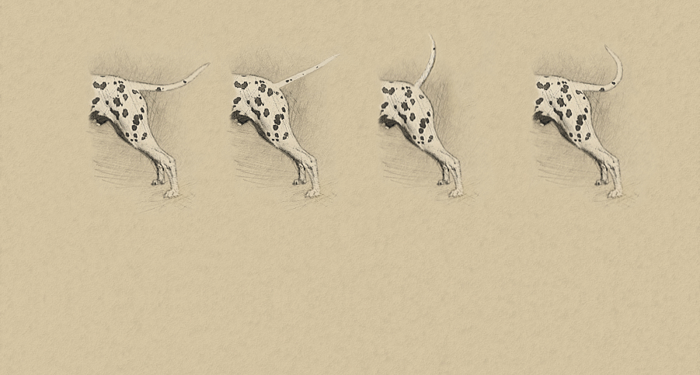
Tail set and carried correctly
Tail set too low
Tail set and carried too high
Curled tail
TAIL: Set on at the extension of the croup. Reaching approximately to the hock or slightly longer. Strong at the base evenly tapering towards the tip, not too thick but in proportion to the body. Carried sabre-shaped. Preferably spotted.
COMMENTARY
Tail: Set on at the extension of the croup. Reaching approximately to the hock or slightly longer. It must not be too thick but in proportion to the body, carried sabre-shaped (as in all hounds). Tail curved on back should be penalized while rolled tail is completely atypical for the breed and must be disqualified.

Slide 17
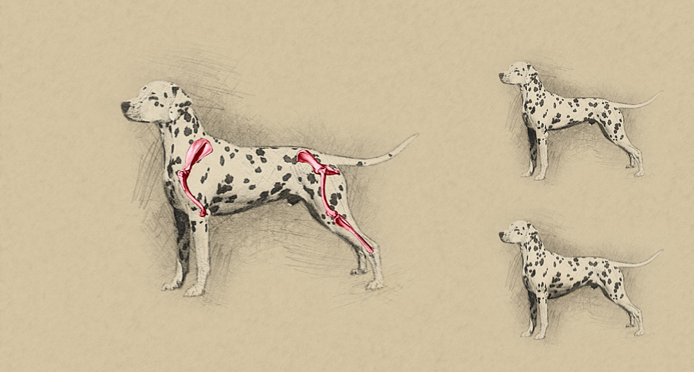
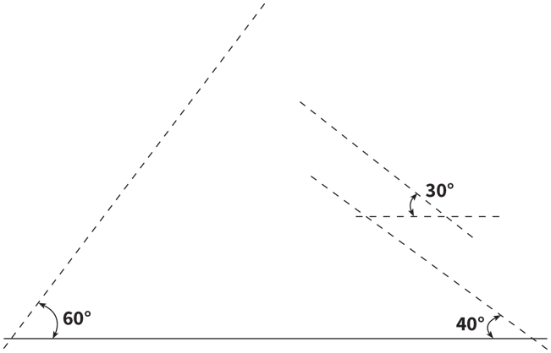
Correct Angulation
Chest not deep enough
Chest too deep

Slide 18
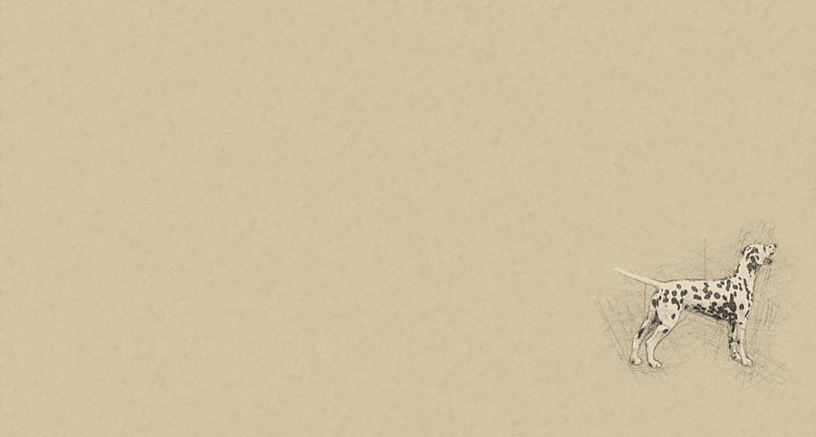
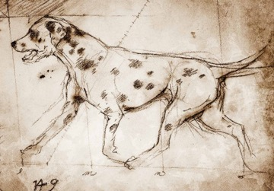
LIMBS
FOREQUARTERS:
General appearance: The forelegs must be in proportion to the rectangular body.
Shoulder: The shoulder angle is around 115-120°.
Elbow: Close to the body.
Forearm: The bones are developed in proportion to the body and strong (round),
forequarters placed straight and legs standing vertical.
Metacarpus (Pastern): Strong, slightly sloping with a spring.
Forefeet: The toes are compact, so called cat feet are typical. Pads are tough and elastic.
The nails should preferably be pigmented.
HINDQUARTERS:
General appearance: In proportion to the body.
With strong well developed muscles. Hindlegs are parallel.
Thigh: Muscular and strong.
Stifle (Knee): Strong and well developed. The stifle has an angle of 40° to the horizontal line.
Hock joint: Strong.
Metatarsus (Rear pasterns): The length of the hocks is around 20-25% of the height to the withers.
The angle of the hock is around 130°.
Hind feet: The toes are compact, so called cat feet are typical. Pads are tough and elastic.
The nails should preferably be pigmented.

Slide 19
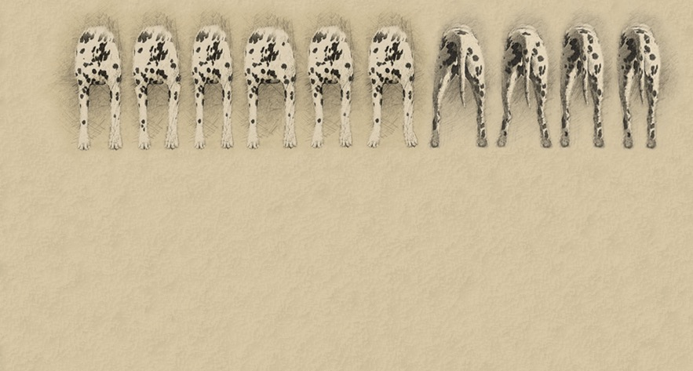
Left: Correct stance of front legs
Center: Elbows turned out
Right: Front legs positioned too narrow
Left: Front legs stance too wide
Center: Forearms not straight
Right: French stance of front legs
Left: Rear legs positioned too wide
Left center: Cow hocks
Right Center: Rear legs in correct stance
Right: Rear legs positioned too narrow
COMMENTARY
Forequarters: The forelegs must be in proportion to the body with correct angulations. The shoulder angle is around 115-120˚. Forearm is vertical, the bones are developed in proportion to the body and strong (round), forequarters are placed straight. In movement the forelegs are carried straight-forward, with neither elbows nor feet turned in or out. The toes are compact, “cat feet” are typical for a Dalmatian. The nails should preferably be pigmented but non-pigmented nails should not be penalized.
Hindquarters: As described, they must be in proportion to the body. Strong and well developed muscles. The stifle has an angle of 40 degrees to the horizontal line, the angle of the hock is around 130˚. The length of the hocks is around 1/5 of the height at the withers. Hindlegs are parallel, hocks should never be switched in (x type) or out (cow hocks), which should be severely penalized. Hind feet are the same as in forelegs.

Slide 20
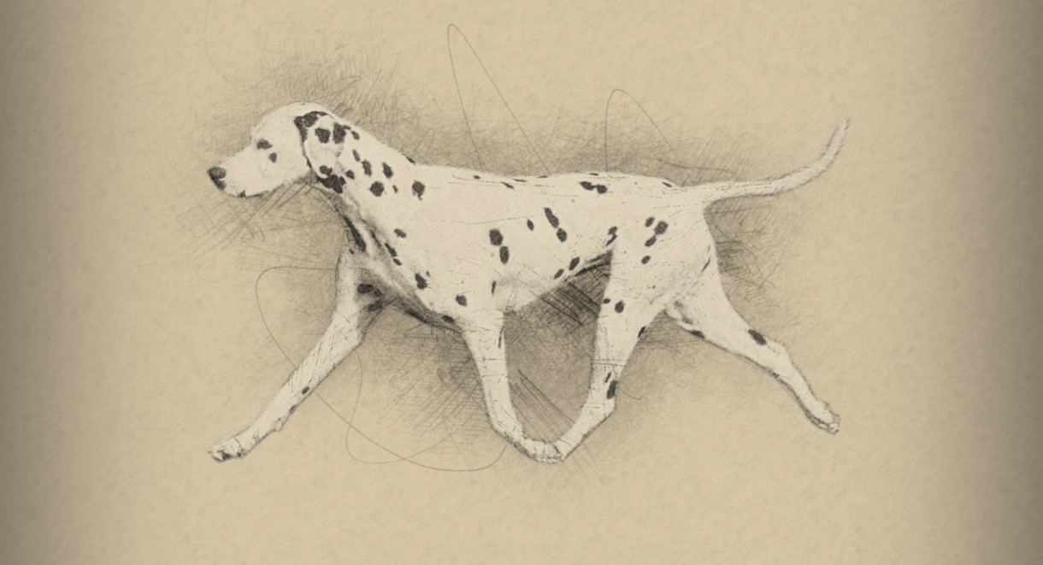
Gait / Movement

Slide 21
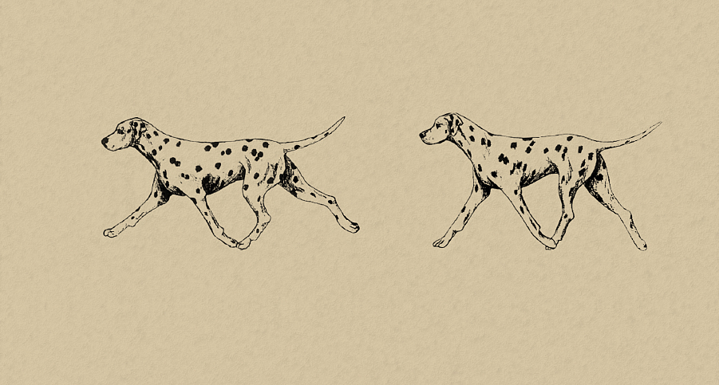
Gait / Movement
Rhythmic action, elegant and smooth movement. Stride and trot long with good reach and strong drive.
Viewed from the front the legs are parallel.
Correct movement
Incorrect movement
COMMENTARY
Gait / Movement: Movement must be harmonious and connected, should be effortless and without twitching. Step, trot and gallop must be long and harmonious. Any anomaly in movement should be punished.

Slide 22
COAT
Hair: Short, shiny, hard and dense all over the body.
Colour: The ground colour is pure white. Black spotted variety with black spots, liver spotted variety with brown spots.
The spots should be symmetrically placed all over the body, clearly defined and without intermingling into the white ground colour.
The size of the spots should preferably be even, with a size of 2 - 3 cm in diameter. In the brown variety the spots are a little smaller,
around 2 cm. The spots on the head and on the legs should be proportionally smaller than on the rest of the body.
It is desirable the tail is spotted too, with spots also proportionally smaller that those on the body. Splashes on the body are not desirable and
should be penalized. The spots must not intermingle, i.e. forming large patches. Patches and coloured areas are not desirable.
The spots on the ears should be especially noted.
COMMENTARY
Coat and coloration: Hair must be typical: short, shiny, hard and dense all over the body. The appearance of longer hair should be severely penalized.
Color is white with black or brown spots. The spots should be symmetrically placed all over the body, clearly defined and without intermingling into the white ground colour. The size of the spots should preferably be even, with a size of 2 - 3 cm in diameter. The spots on the head and on the legs should be proportionally smaller than on the rest of the body. Pronounced small splashes on the body are not desirable and should be penalized.
The spots must not intermingle, i.e. forming large stains. Stains and coloured areas are not desirable. The spots on the ears should be especially noted. Patches are disqualification.
Besides white, ground colour only black or brown spot coloration is permitted. The presence of a third color is not allowed. Lemon or orange spots are not permitted and should be disqualified.
As already described, pigmentation of mucous membrane, nose and eye are in accordance with the spotting (black or brown). It is desirable that the tail is spotted too, with spots also proportionally smaller that those on the body.

Slide 23
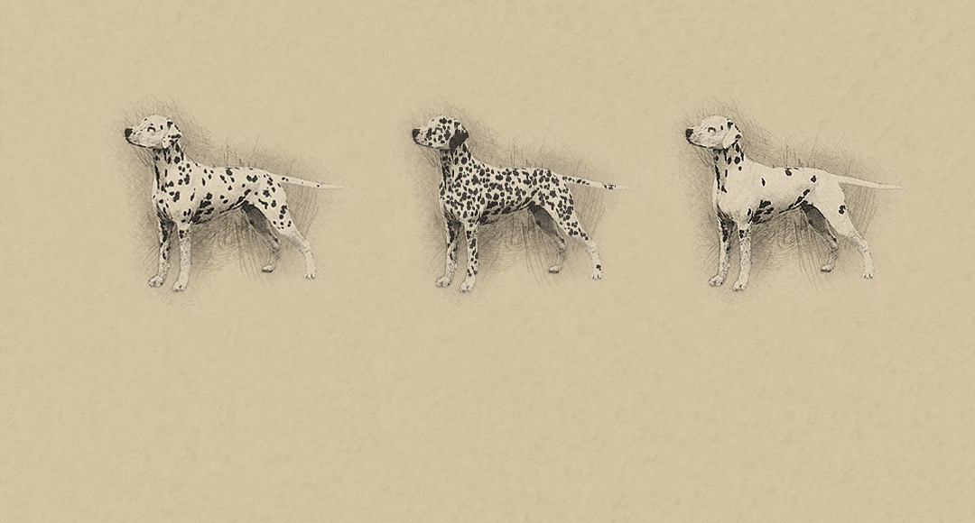
Correct spottedness
Over-spottedness
Not symmetrical spottedness
Size and Weight
Height at the withers: Males 56 - 62 cm. Females 54 - 60 cm.
Dogs with excellent type and balance should not be penalized if above the upper limit.
Faults
Any departure from the foregoing points should be considered a fault and the seriousness with which fault should be regarded
should be in exact proportion to its degree and its effect upon the health and welfare of the dog and on its ability to perform its traditional work.

Slide 24
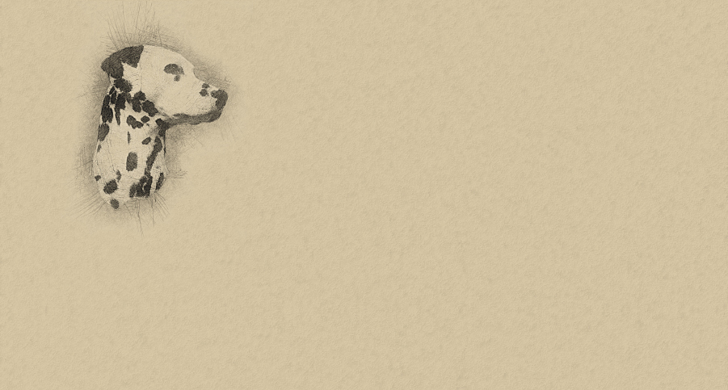
Disqualifying Faults
• Aggressive or overly shy.
• Any dog clearly showing physical or behavioural abnormalities shall be disqualified.
• Converging head line.
• The lack of more than 6 premolars, the lack of M3 is not noted and will not be considered a fault.
• Entropion, ectropion, wall eye, eyes of different colours (heterochromia), blue eyes,
partially blue coloured iris.
• Lack of nose pigment.
• Curled tail.
• Monocle (patching around one or both eyes) or patching elsewhere.
• Tricolour (black and brown spots on the same dog), brindle coloured spots, lemon coloured spots,
orange coloured spots, blue spots and pure white colour without spots.
• Wirehaired or longhaired
• Deafness.
N.B.
Correct marble pigmentation of the ear
• Male animals should have two apparently normal testicles fully descended into the scrotum.
• Only functionally and clinically healthy dogs, with breed typical conformation should be used for breeding.
COMMENTARY
Height: The standard defines the required height. Nowadays there are plenty of dogs (especially males) who exceed the required height. Type and breed characteristics are of the utmost importance and on no account to be sacrificed to size alone. Every dog needs to be examined individually and compared to characteristic typicality and certain deficiencies. Type of dog, elegance and movement is what we should strive for. The tolerance in height both in males and
females of + 3 cm and - 2 cm. is recommended.
Behaviour / Temperament: Dalmatians are very lively, gentle, loyal, independent and very easy to train. They go well with children. Prefer the company of its
family members and are always ready to play. A lot of movement is required. Regarding diet Dalmatian is not overly picky. Some specimens tend to obesity.
This breed is very keen on water and swimming.

Slide 25

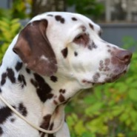
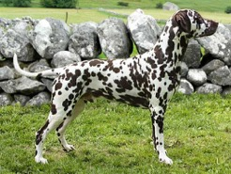
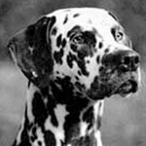
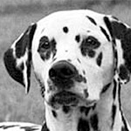
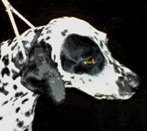
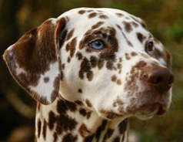
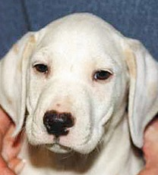
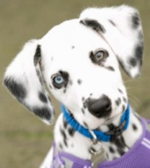
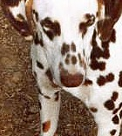
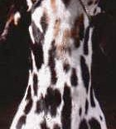
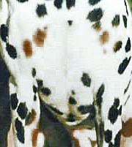
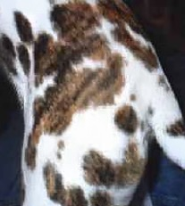
DALMATIAN - Faults
Top row: FAULTS - excessive skin on the neck; over-spottedness; COMPARISON - over-spottedness / correct spottedness; DISQUALIFYING FAULTS: monocle and black patch over the ear;
blue eyes or heterochromia; Bottom row - DISQUALIFYING COLOUR FAULTS: from left to right: lemon, blue, tri-color liver/orange, tri-color black/liver, tri-color black-orange, brindle

Slide 26
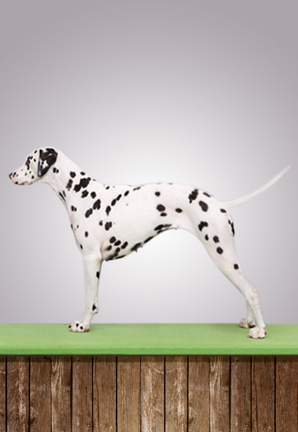
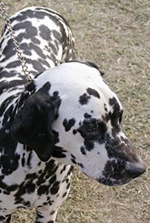
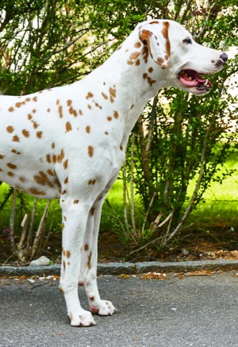
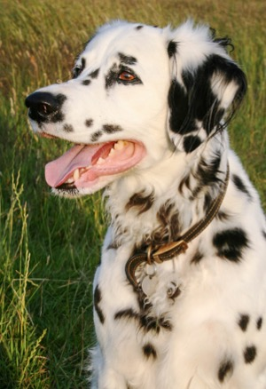
Orange spots
(color not correct)
• Disqualifying fault •
Hair too long
• Disqualifying fault •
Topline too curved,
loins curved with
too steep croup,
open rear angulation
Ears too dark,
over-spottedness

Slide 27
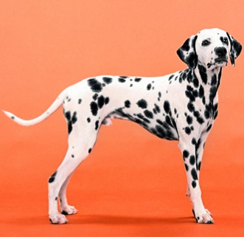
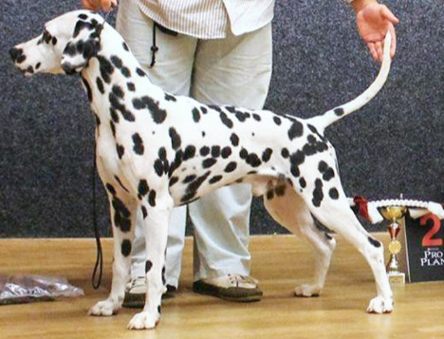
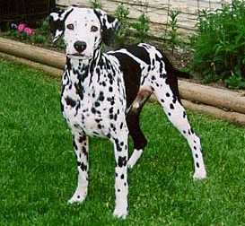
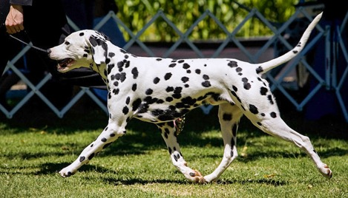
DALMATIAN
Faults and
Qualities
Top Left:
rear angulation too open,
body proportions not correct,
lighter bone structure.
Bottom Left:
ears set too high,
too spotted with large patches,
lacks substance.
Right:
correct stacking, body proportions and
size of the dog (not too big), correct and
even spottedness.
Bottom Right:
correct body proportions and size of
the dog, very elegant movement,
correct spottedness.

Slide 28
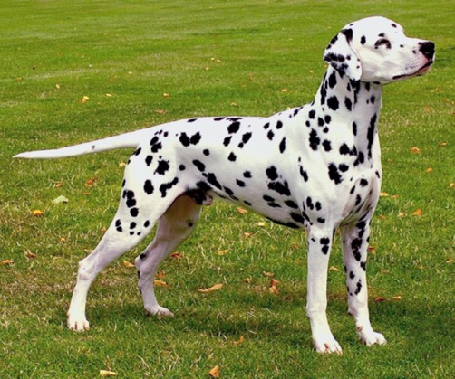
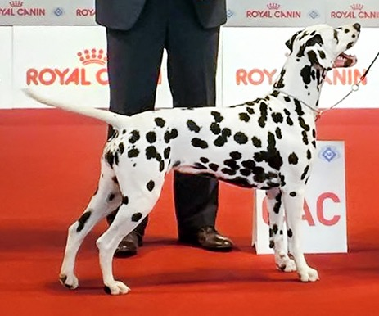
DALMATIAN Breed Ambassadors
Excellent type and quality male
Excellent type and quality female

Slide 29


Slide 30


Slide 31


Slide 32



DALMATIAN TIMELINE
1600 - 1630
Altar painting in Veli Losinj
The first known depiction of Dalmatian
1700 - 1730
Depiction of Dalmatian in Zaostrog
Oil on canvas painting of Dalmatian
1771
Thomas Pennant describes the breed
in his book Synopsis of Quadrupeds, writing that the origin of the breed is
from Dalmatia, and referred to it as Dalmatian
1790
The book by Thomas Bewick
A General History of Quadrupeds published in 1790 refers to the breed as
Dalmatian or Coach Dog

Slide 33




1859
Illustration of Dalmatian
Published in 1859 book “The Dog in Health and Disease” by John Henry Walsh
1906
Famous illustration from Bewick book
A General History of Quadrupeds, as published in “The dog book” (1906), by James Watson
1955
FCI publishes the first Dalmatian standard
on the 7th of April 1955 under the name of “Dalmatian Huntingdog”
1966
First release of Walt Disney’s classic
“101 Dalmatians”

Slide 34






1997
First Croatian dalmatian World Winner
WDS San Juan, Aska, owned by Sanja Jergović
2003
Another Croatian dalmatian World Winner
WDS Dortmund, Lacrima Christi Coppola, bred and owned by Anita and Željko Radić
2007
Euro Dog Show Zagreb
Key role in EDS 2007 logo and Croatia’s ambassador in FCI and worldwide.
2010
Publication of FCI official valid standard
With the date of 13th October, 2010
2016
First Croatian-bred WW with Group win
WDS Milan, Dalmino Voodoo Vision, bred and owned by Željka Halper Dražić and Mihael Dražić

Slide 35

Ear
Skull
Eye
Nape
Stop
Foreface
Crest
Nose bridge
Withers / top of shoulder
Neck
Nose – point of nose
Loin
Back
Shoulder
Muzzle
Set of tail
Croup
Upper
jaw
Chin
Lower jaw
Tail
Corner of
the mouth
Cheek
Point of buttock
Throat
Point of shoulder
Thigh
Flank
Prosternum / point of chest
Hock joint
Elbow
Upperarm
Rear pastern
Underline
Chest/Ribcage
Brisket
Hind foot
Line of belly
Forearm
Stifle joint / Knee
Wrist
Lower thigh
Pastern
Forefoot

Slide 36

© 2016 Hrvatski kinološki savez • Croatian Kennel Club Ilica 61, HR-10000 Zagreb, Croatia www.hks.hr

