Slide 1
What’s a Dogue ?
The Dogue de Bordeaux is the French Molosser just as the Mastiff is the British one and the Neapolitan is the Italian one.
No doubt there were many variants within each breed until the standard defined its features.

Slide 2
What to know about the Dogue
Powerful imposing dog, it is one of the most ancient French breeds even if it was not known by the name Dogue de Bordeaux until the twentieth century.
The Dogue de Bordeaux is very popular in many countries.
NB All photos are just examples of Dogues not perfect Dogues
Notes:
Pour commencer, faites ressortir l'intérêt du sujet pour l'assistance. Donnez une brève vue d'ensemble de la présentation. Tenez compte de l'intérêt de l'assistance pour le sujet ainsi que de leurs connaissances en la matière pour choisir votre vocabulaire, des exemples et des illustrations. Insistez sur l'importance du sujet pour capter l'attention des auditeurs.

Slide 3
DOGUE DE BORDEAUX
What’s a Dogue de Bordeaux ?
Dogue History
Most important points of the standard
The breed in France and in Europe
Notes:
Les présentateurs doivent souvent transmettre des informations techniques à des auditeurs qui connaissent moins bien le sujet et le vocabulaire spécifique. Les informations peuvent être multiples ou complexes. Pour présenter des informations techniques efficacement, utilisez les conseils suivants de Dale Carnegie Training®.
Tenez compte du temps dont vous disposez et préparez la classification de vos informations. Délimitez votre sujet et découpez votre présentation en séquences claires. Suivez une progression logique et ne vous dispersez pas. Terminez la présentation par un résumé, un rappel des étapes clés ou une conclusion logique.
Montrez l’intérêt que vous portez à votre assistance. Par exemple, utilisez toujours des données claires et pertinentes. Choisissez un niveau de détail et un vocabulaire adaptés à l'assistance. Utilisez des aides visuelles pour étayer vos points et étapes clés. Les auditeurs seront plus réceptifs si vous êtes à l'écoute de leurs besoins.

Slide 4
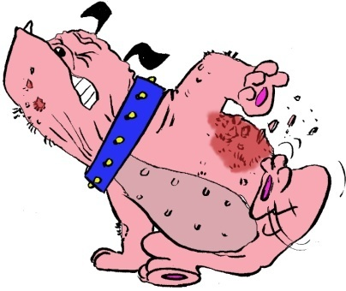
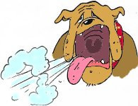
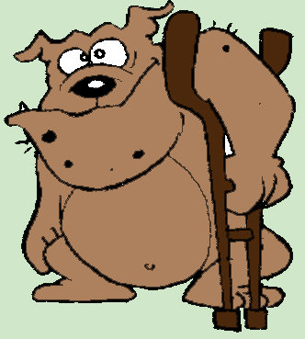
What is a Dogue de Bordeaux ?
It’s a dog ! It means that it should be sound, “fit for function”. It is very important to keep this point in mind.
It should be correctly built, able to breath correctly, to have sound eyes, etc.

Slide 5
History
Few historical details about the Dogue de Bordeaux exist before 1863. In earlier days, this dog was called a Dogue or a Mâtin.
The "alans vautres“, which were the ancestors of the Dogues de Bordeaux, were written about as early as the XIV Century. They were used for hunting, guarding, and probably fighting.
In fact, there were probably mixing between big dogs from Great Britain and big dogs from France, in the old times, during the hundred year’s war. In the middle ages, there were many trading between Great Britain and Bordeaux area (for the wine)

Slide 7
History
During the last centuries, Dogues de Bordeaux were also kept for all sorts of jobs : pulling loads for the butchers, preventing their steers getting away and keeping them in their place . Another task given to them was hunting animals such as boars. During the First World War, some Dogues de Bordeaux helped to drag injured people to safety. You see that they were supposed to be fit for function !

Slide 8
History
In the nineteen century,There were three types of Dogues, the "Parisien" (from the Paris area), the "Toulousain" (from the Toulouse area), and the Bordelais (from the Bordeaux area). There was also the Doguin which was a kind of miniature Dogue (said to be a cross between a Bulldog and a Dogue de Bordeaux).

Slide 9
According to Triquet, the Parisien was born in the Paris area, was hardly undershot and poor stop and was often of mixed appearance.
The Toulousain had a large strong head with less stop, and a slightly down-facing longer muzzle. Caporal, one of the earliest and most famous Dogues was of the Toulousain type.
The Bordelais was very much like the dog as described in today’s standard. In the Bordeaux Science Museum there are two nice stuffed specimen of the breed, the male is a Toulousain type, the bitch is a Bordelais, very similar to current bitches.

Slide 10
1883

Slide 11
A Dogue from 1886, in Paris

Slide 12
Around 1892

Slide 13
Around 1892

Slide 14
Old types

Slide 15
Youssouf best Dogue in Paris 1903
We start to have Bordeaux type in body but not really in type

Slide 16
History
The breed was known and appreciated by fanciers in England at the end of the nineteenth century and at the very beginning of the twentieth. the Dogue de Bordeaux Club was founded in 1897. In December of the same year, the Kennel Club Gazette talked of 14 Dogues de Bordeaux entered at a show and in the November 1898 issue it is possible to read about the judging of Dogue de Bordeaux at the Kennel Club Crystal Palace Show.
.

Slide 17
Some historical details
Then, it disappeared from the British scene.
It’s only in November 1997 that the Dogue was only officially recognised by the Kennel Club.
The Dogue was known and appreciated in Belgium and Germany at the beginning of the century.

Slide 18
Standards
Professor Kunstler who taught at the Bordeaux Natural History Museum, wrote the first standard in 1910. Professor Raymond Triquet wrote the 1971 standard with the help of Doctor Luquet Professor Triquet reformulated this standard in 1995, with the help of Philippe Serouil
Some additional points were added in 2007, mainly to avoid the Dogue to be overdone.

Slide 19
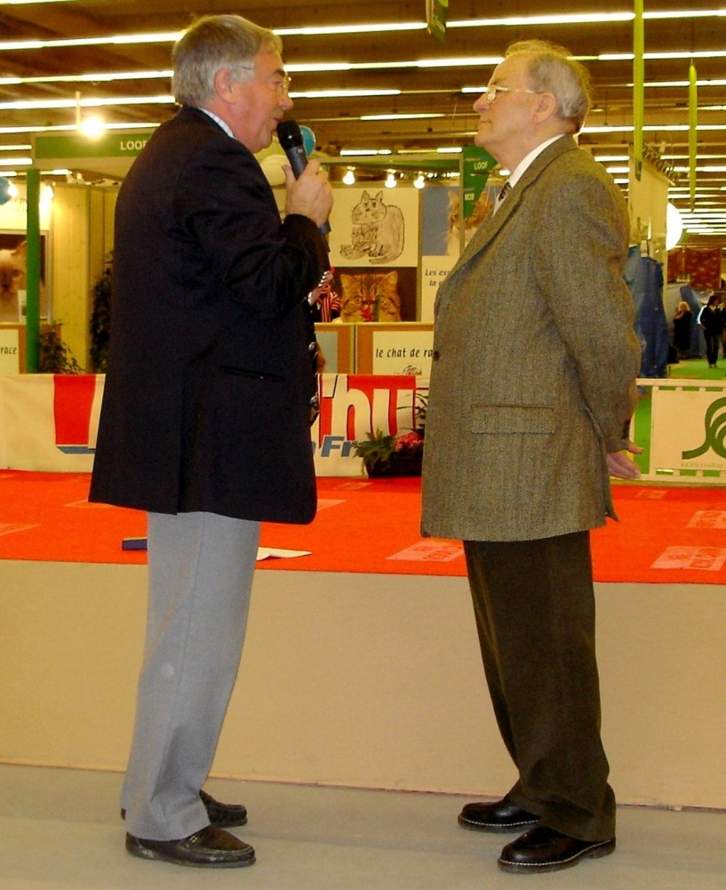
Raymond Triquet
The history of the Dogue de Bordeaux is linked for ever to Raymond Triquet.
After the second World War, there were very few specimen of Dogue left in France. Raymond Triquet has always been a molosser lover.

Slide 20
Raymond Triquet
Once, one of his student talk to him about a big dog. “Sir, you have to go in this pub, there is such a dog ! You have to see him”. This was the beginning of Raymond Triquet and the Dogue de Bordeaux story.
Raymond fall really in love with the breed. He decided to save it and he did.

Slide 21
Raymond Triquet
He first bought a bitch Kanie de Fénélon and it was the beginning of his kennel de la Maison des Arbres. He is the author of the Dogue de Bordeaux 1971 and 1995 standard (with help of Philippe Serouil). He is the author of many articles on canine terminology and standards and originator of the current FCI breed nomenclature. He is also the author of the “Saga”, the bible for Dogues enthusiasts

Slide 22
Raymond Triquet
Raymond is always ready to spread the word about what a good Dogue should be like and his charisma and instructiveness has promoted the breed all around the World.

Slide 23
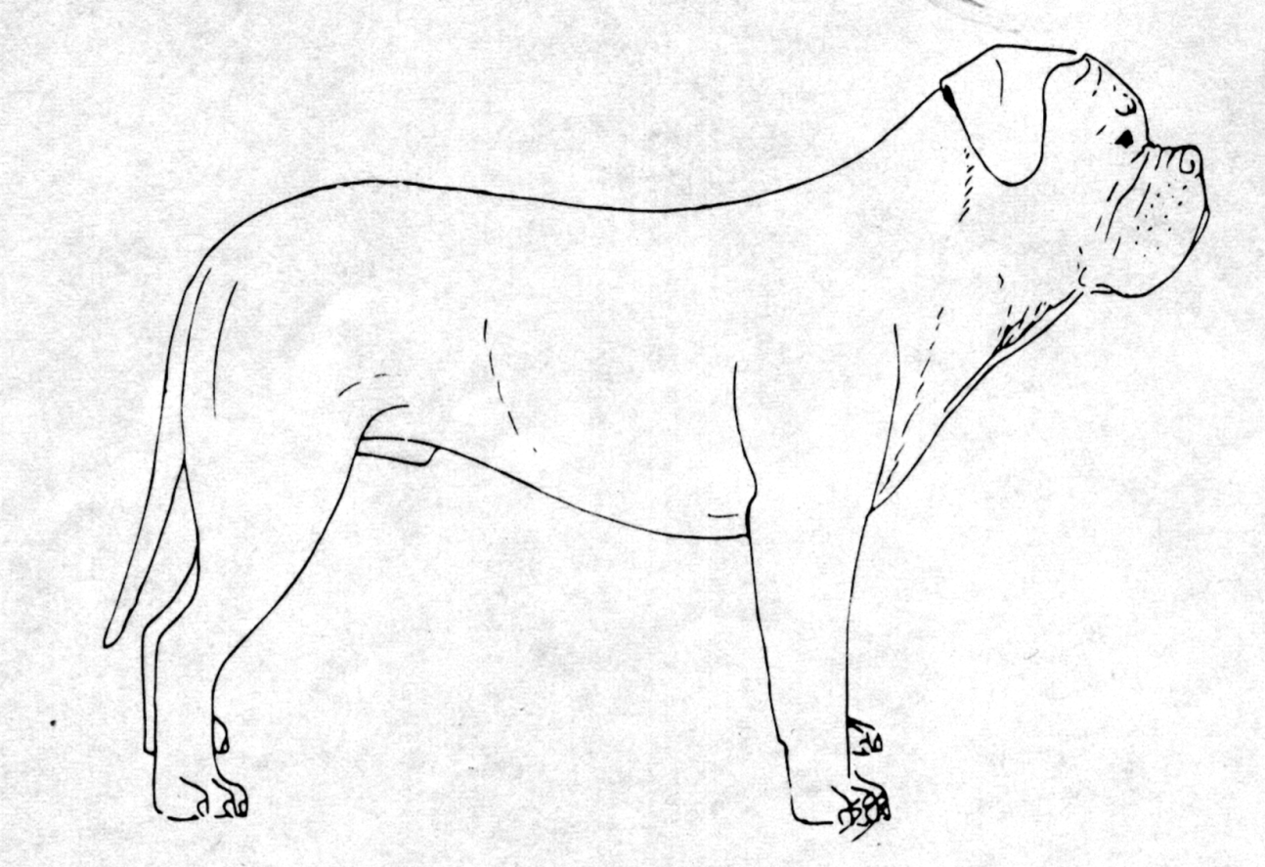
Important points of the standard
A molosser built quite close to the ground.
It must be suitably well balanced.
A concave dog, an essential point
Its features must not be disproportionate.
Notes:
Si vous avez plusieurs points, étapes ou idées-clé à traiter, utilisez plusieurs diapositives. Déterminez si l'assistance est censée comprendre un nouveau concept, apprendre une procédure ou approfondir un concept déjà connu. Choisissez l'explication appropriée pour étayer chacun des points traités. Vous pouvez accompagner votre présentation de données techniques supplémentaires sous formes de copies papier, disquettes, messages électroniques ou sites Internet. Développez chaque point de façon à communiquer avec l'assistance.

Slide 24
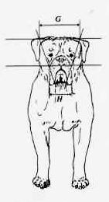
General appearance
Typical concave lined brachycephalic molossoid. The Dogue de Bordeaux is a very powerful dog, with a very muscular body yet retaining a harmonious general outline. It is built rather close to the ground, the distance sternum-ground being slightly less than the depth of the chest. Stocky, athletic and imposing, it has a very dissuasive aspect.

Slide 25
Proportions
IMPORTANT PROPORTIONS : • The length of the body, measured from the point of the shoulder to the point of the buttock, is superior to the height at the withers, in the proportion of 11/10. • The depth of the chest is more than half the height at the withers. • The maximum length of the muzzle is equal to one third of the length of the head. • The minimum length of the muzzle is equal to one quarter of the length of the head. • In the male, the perimeter of the skull corresponds more or less to the height at the withers.

Slide 26
Head

Slide 27
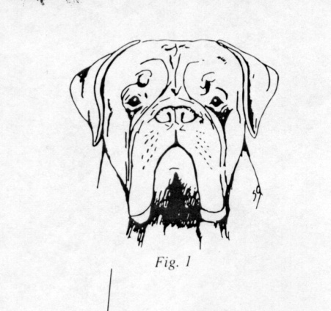
Head
Voluminous, angular, broad, rather short, trapezoid when viewed from above and in front. The longitudinal axes of the skull out of the bridge of nose are convergent (towards the front). The head is furrowed with symmetrical wrinkles, each side of the median groove. These deep ropes of wrinkle are mobile depending on whether the dog is attentive or not. The wrinkle which runs from the inner corner of the eye to the corner of the mouth is typical. If present, the wrinkle running from the outer corner of the eye to either the corner of the mouth or the dewlap should be discreet.

Slide 28
As a preliminary
All pictures in this PowerPoint are just examples. All these dogs are Dogues with qualities and faults, some of them being good examples by comparison with the standards. They are not the ideal dog.
Some of them have faults which are exaggerations .

Slide 29
A good exemple of wrinkles

Slide 30
Typical Head profile
Profile : line from the nose to the mouth outwardly curved

Slide 31
Profile

Slide 32
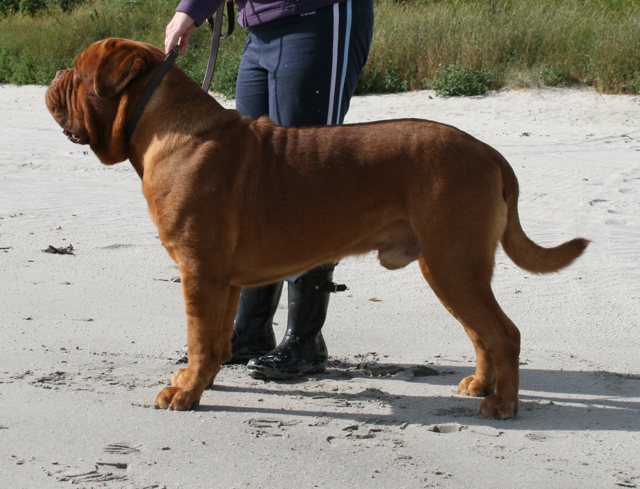
Profile : line from the nose to the mouth outwardly curved

Slide 33
Most important points of the standard
Undershot (the undershot condition being a characteristic of the breed).
But … Remember “fit for function”, that means it should not be exaggerated. Especially, canines constantly visible when the mouth is closed is an eliminating point.

Slide 34
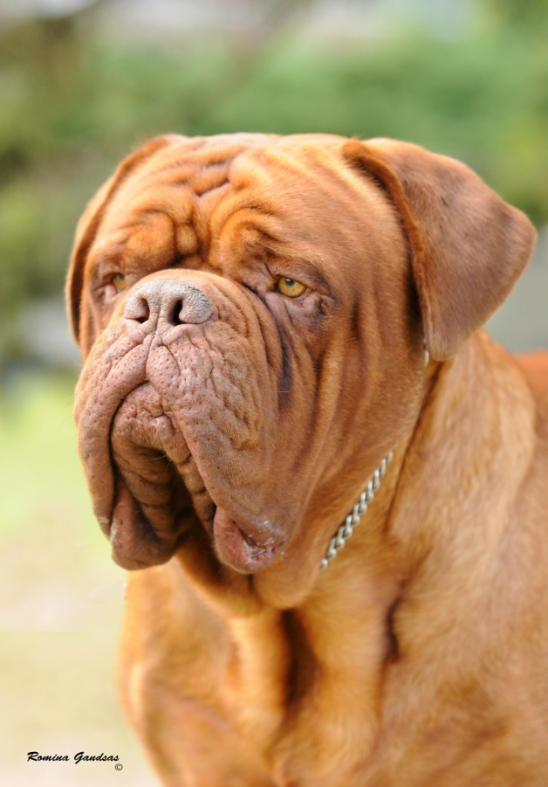
Skull
Its volume and shape are the consequences of the important development of the temporals, supra-orbital arches, zygomatic arches and the spacing of the branches of the lower jaw. The upper region of the skull is slightly convex from one side to the other. The frontal groove is deep, diminishing towards the posterior end of the head. The forehead dominates the face but does not overhang it. However it is still wider than high.

Slide 35
Skull

Slide 36
Lips : from the front the upper lip describes an upside down V which should not be too acute or too curved like a U. The former would look like a Neapolitan, the latter like a Bulldog.

Slide 37
Skull is correct
too light eye
Slightly too acute

Slide 38
Lips
V slightly too round

Slide 39
lips
Eye are whished more ovale shape
too curved like a U

Slide 40
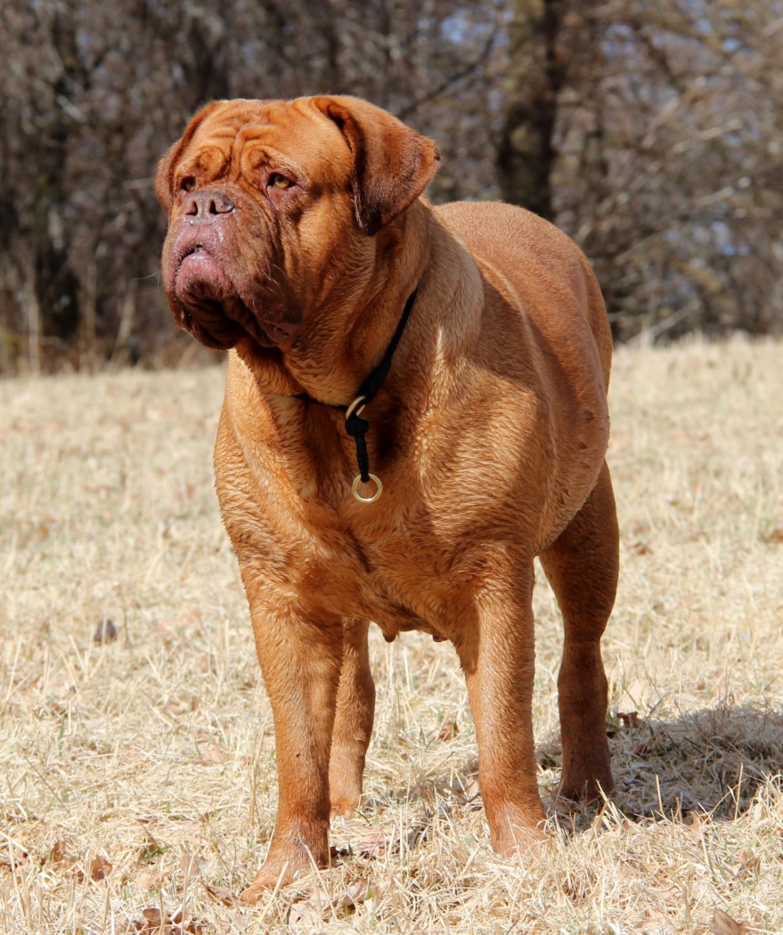
Stop
Stop: Very pronounced, almost forming a right angle with the muzzle (95° to 100°).

Slide 41
Facial region
Nose : Broad, well opened nostrils, well pigmented according to the colour of the mask. Upturned nose permissible but not if it is set back towards the eyes.

Slide 42
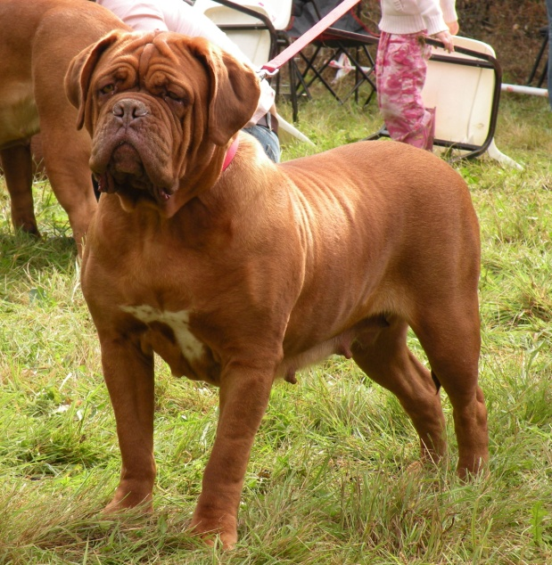
Muzzle
Muzzle : Powerful, broad, thick, but not fleshy below the eyes, rather short, upper profile very slightly concave, with moderately obvious folds. Its width hardly decreasing towards the tip of the muzzle, when viewed from above it has the general shape of a square. In relation to the upper region of the skull, the line of the muzzle forms a very obtuse angle upwards. When the head is held horizontally the tip of the muzzle, truncated, thick and broad at the base, is in front of a vertical tangent to the anterior face of the nose.

Slide 43
Muzzle

Slide 44
Muzzle

Slide 45
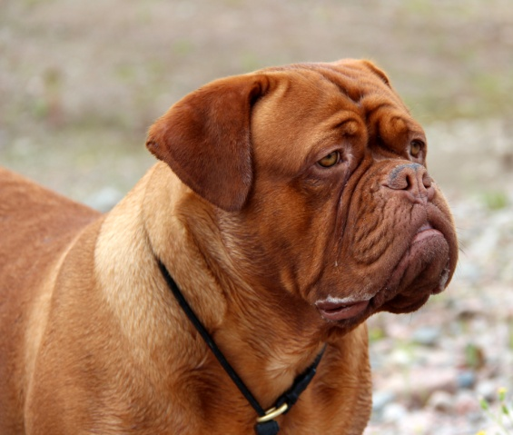
Muzzle
Its perimeter is almost two thirds of that of the head. Its length varies between one third and minimum one quarter of the total length of the head, from the nose to the occipital crest. The limits stated (maximum one third and minimum one quarter of the total length of the head) are permissible but not sought after, the ideal length of the muzzle being between these two extremes.

Slide 46
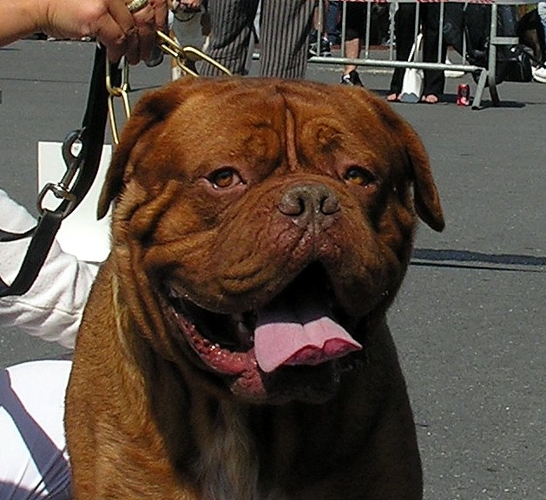
Eyes and expression :
Oval shape and a good distance between the eyes contribute to the typical expression of the breed.

Slide 47
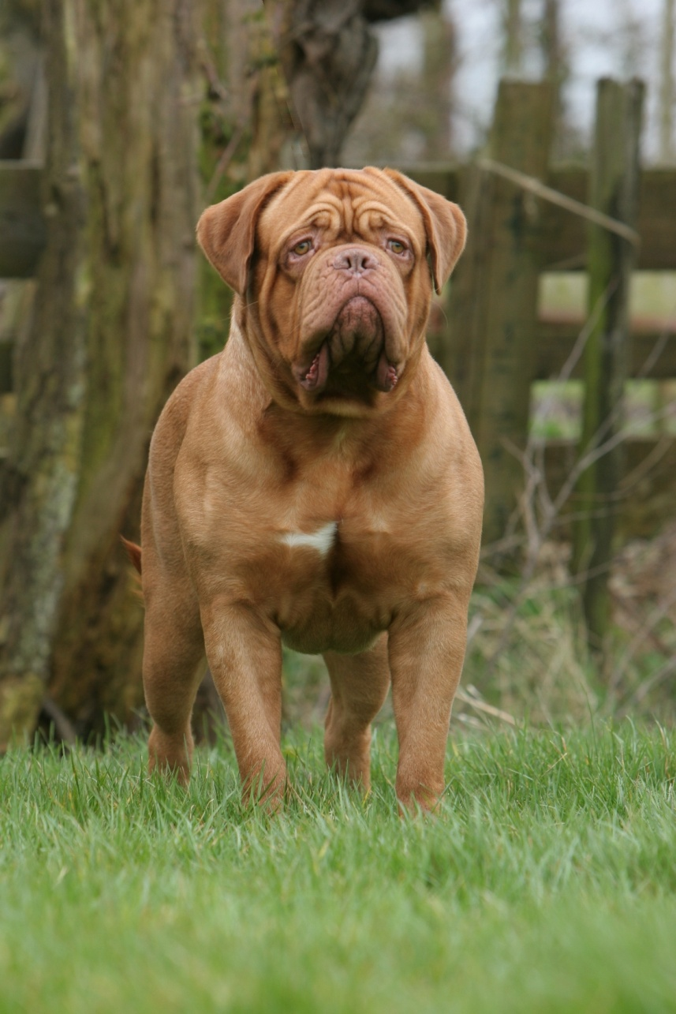
Ears must fall back close to the cheeks
Eye slightly too acute

Slide 49
Lack of undershoot
Too much undershoot
Lack of stop
Too short
Too long

Slide 50
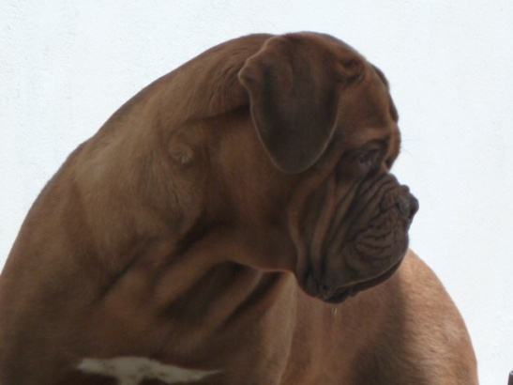
NECK :
Very strong, muscular, almost cylindrical. This skin is supple, ample and loose. The average circumference almost equals that of the head. It is separated from the head by a slightly accentuated transversal furrow, slightly curved. Its upper edge is slightly convex. The well defined dewlap starts at the level of the throat forming folds down to the chest, without hanging exaggeratedly. The neck, very broad at its base, merges smoothly with the shoulders.

Slide 51
Neck

Slide 52
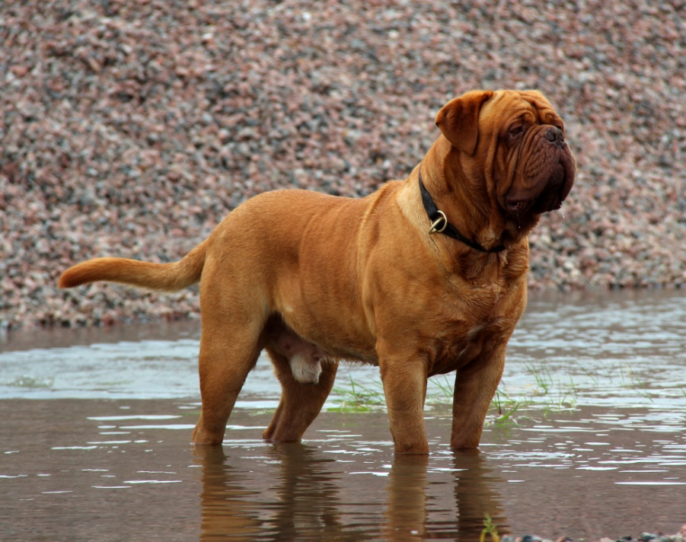
BODY :
Topline : Well sustained. Withers : Well marked. Back : Broad and muscular. Loin : Broad. Rather short and solid.
Croup : Moderately sloping down to the root of the tail. Chest : Powerful, long, deep, broad, let down lower than the elbows. Broad and powerful forechest whose lower line (inter-axillae) is convex towards the bottom. Ribs well let down and well sprung but not barrel shaped.

Slide 53
Body

Slide 56
Body

Slide 57
No more white

Slide 58
Body
Too long in body
Topline not sustained enough

Slide 59
Body
Slightly straight

Slide 60
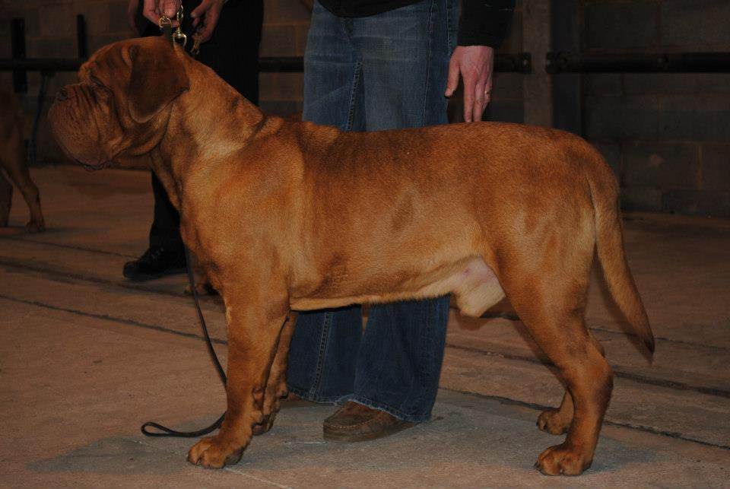
Body
The circumference of the chest must be between 25 cm to 35 cm greater than the height at the withers. Underline and belly : Curved from the deep brisket to the rather tucked up, firm abdomen, being neither pendulous nor nor too tucked up.

Slide 61
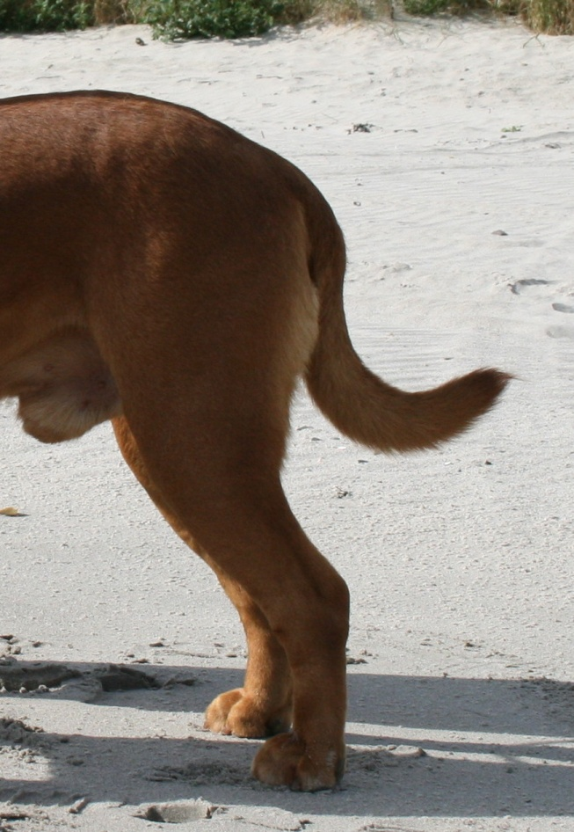
TAIL :
Very thick at the base. Its tip preferably reaching the hock and not below. Carried low, it is neither broken nor kinked but supple. Hanging when the dog is at rest, generally rising by 90° to 120° from that position when the dog is in action, without curving over the back or being curled.

Slide 62
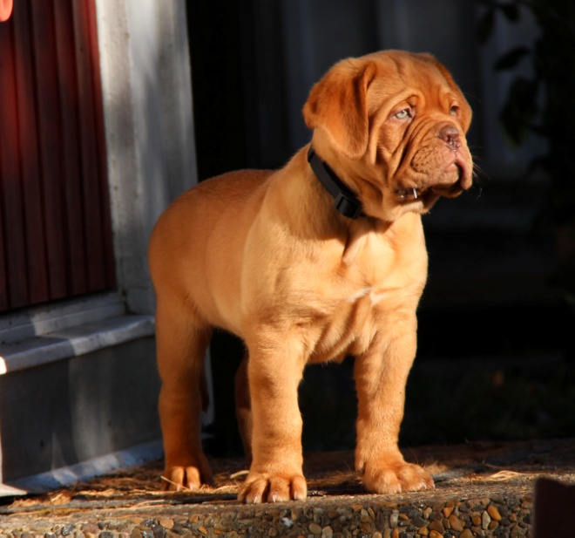
FOREQUARTERS
Strong bone structure, legs very muscular. Shoulders : Powerful, prominent muscles. Upper Arms : Very muscular. Elbows : In the axis of the body, neither too close to the ribcage nor turned out. Forearms: Viewed from the front, straight or inclining slightly inwards thus getting closer to the median plane, especially in dogs with a very broad chest. Viewed in profile, vertical.

Slide 63
FOREQUARTERS
Metacarpus (Pastern) : Powerful. Viewed in profile, slightly sloping. Viewed from the front sometimes slightly outwards compensating for the slight inclination of the forearm inwards. Forefeet : Strong. Toes tight, nails curved and strong, pads well developed and supple : the Dogue is well up on his toes despite his weight.

Slide 64
HINDQUARTERS :
Robust legs with strong bone structure; well angulated. When viewed from behind the hindquarters are parallel and vertical thus giving an impression of power even though the hindquarters are not quite as broad as the forequarters.

Slide 65
Topline Well sustained.
In the Dogue de Bordeaux, the back never slopes down to the rear (it would be against its nature). The topline is never perfectly "straight" in a mathematical meaning, nor is it horizontal. At best, after the "dip" behind the withers, the line rises insensibly to melt into the slightly arched loin. This is what we call a "well-sustained" topline. This is why in my Saga of the Dogue de Bordeaux I said in the commentaries to the standard "No molossus has a rectilinear topline. In the Dogue de Bordeaux we aim for it as straight as possible in a concave-lined dog“ (Raymond Triquet)

Slide 68
It has a good reaching movement like a lion.

Slide 69
Gait
Quite supple for a molossoid. When walking the movement is free and supple, close to the ground. Good drive from the hindquarters, good extension of the forelegs, especially when trotting, which is the preferred gait.

Slide 70
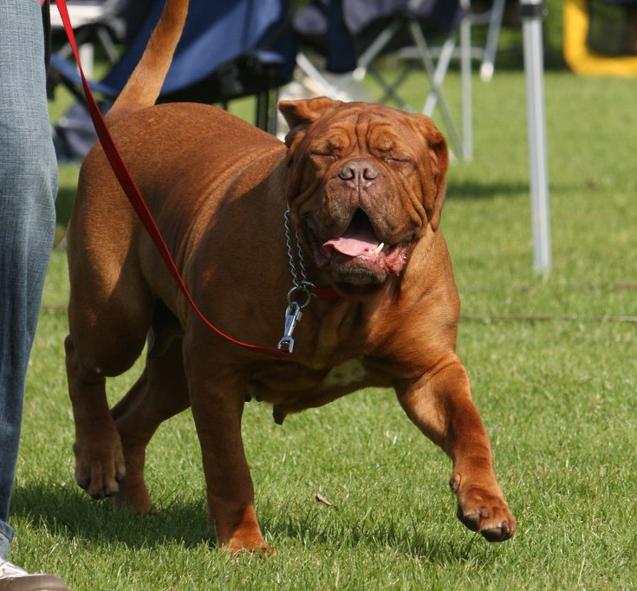
Gait
When the trot quickens, the head tends to drop, the topline inclines towards the front, and the front feet get closer to the median plane while striding out with a long reaching movement of the front legs. Canter with rather important vertical movement. Capable of great speed over short distances by bolting along close to the ground.

Slide 72
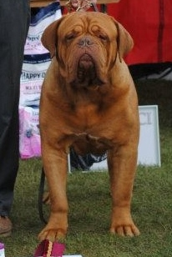
COAT
HAIR : Fine, short and soft to the touch. COLOUR : Self-coloured, in all shades of fawn, from mahogany to isabella. A good pigmentation is desirable. Limited white patches are permissible on the forechest and the extremities of the limbs.

Slide 73
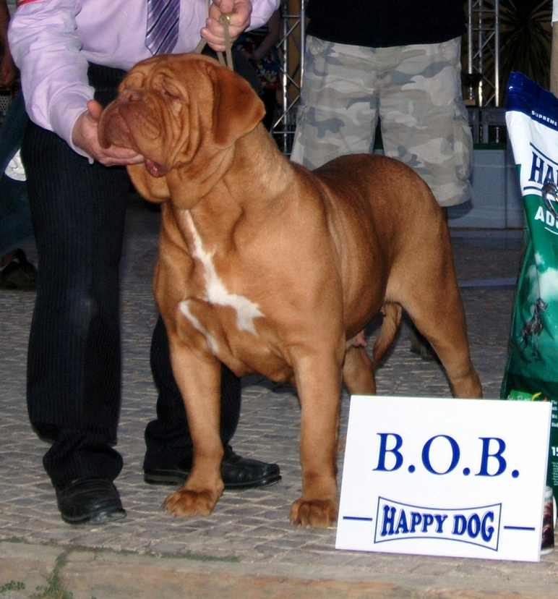
Coat

Slide 74
Mask :
• Black mask : The mask is often only slightly spread out and must not invade the cranial region. There may be slight black shading on the skull, ears, neck and top of body. The nose is black. • Brown mask : (used to be called red or bistre). The nose is brown; the eyerims and edges of the lips are also brown. There may be non-invasive brown shading; each hair having a fawn or sandy zone and a brown zone. In this case the inclined parts of the body are a paler colour. • No mask : The coat is fawn : the skin appears red (also formerly called “red mask”). The nose can then be reddish.

Slide 75
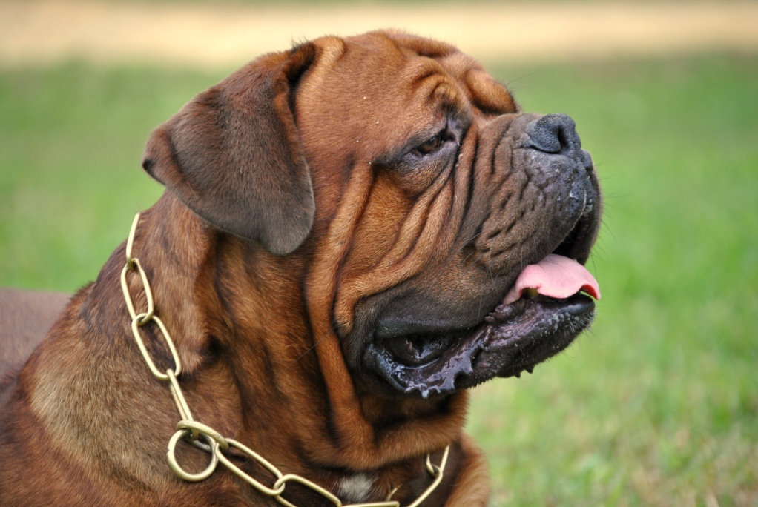
Black Masks
Very different from Mastiffs or Bullmastiffs

Slide 76
Severe faults
• Disproportioned head (too small or exaggeratedly voluminous). • Bulldoggy hypertype : Flat skull, muzzle measuring less than a quarter of the total length of the head. Swollen fold (roll) behind the nose. Important fold around the head. • Important lateral deviation of the lower jaw. • Incisors constantly visible when the mouth is closed. Very small incisors, unevenly set. • Arched back (convex). • Fused but not deviated vertebrae of the tail. • Forefeet turning inwards (even slightly). • Forefeet turning outwards too much.

Slide 77
Severe faults
• Flat thighs. • Angle of hock too open (straight angulation). • Angle of the hock too closed, dog standing under himself behind. • Cow hocks or barrel hocks. • Stilted movement or serious rolling of rear. • Excessive shortness of breath, rasping. • White on tip of tail or on the front part of the forelegs, above the carpus (wrist) and the tarsus (hock) or white, without interruption, on the front of the body from the forechest to the throat.

Slide 78
Not acceptable

Slide 79
Behaviour
An ancient fighting dog, the Dogue de Bordeaux is gifted for guarding, which it assumes with vigilance and great courage but without aggressiveness. A good companion, very attached to its master and very affectionate. Calm, balanced with a high stimulus threshold. The male normally has a dominant character.

Slide 80
Temperament

Slide 81
Disqualifying faults
• Aggressive or overly shy. • Long, narrow head with insufficiently pronounced stop, with a muzzle measuring more than a third of the total length of the head (lack of type in head). • Muzzle parallel to the top line of the skull or downfaced, Roman nose. • Twisted jaw. • Mouth not undershot. • Canines constantly visible when the mouth is closed. .

Slide 82
Chocolate Dogue not acceptable

Slide 83
Disqualifying faults
• Tongue constantly hanging out when the mouth is closed. • Blue eyes; bulging eyes. • Tail knotted and laterally deviated or twisted (screw tail, kink tail). • Atrophied tail. • Fiddle front and down on pasterns. • Angle of the hock open towards the rear (inverted hock).

Slide 84
Disqualifying faults

Slide 85
Disqualifying faults
• White on the head or body, any other colour of the coat than fawn (shaded or not) and in particular brindle or solid brown called “chocolate” (each hair being entirely brown). • Identifiable disabling defect. Any dog clearly showing physical or behavioural abnormalities shall be disqualified

Slide 86
The Dogue de Bordeaux in Europe
The breed has became popular in many countries. In all breeds the increase in numbers carries the risk of derivatives with the onset of easily recognizable mediocre subjects with little type and others such as hypertypes which are a danger for the breed even if they are admired by some adepts of canine showbiz.

Slide 87
Think about the future
Each year, in September, Dogues de Bordeaux come from all over the world to the French Specialty Show.
It’s an excellent thing for the breed that in many countries, breeders are working to produce good quality Dogues.

Slide 88
Hyperkeratose
1- Footpads hyperkeratosis: Thickening of the pads with cracks, sometimes with lameness and pain. Symptoms appear in 6 months old puppies.
The gene was identified

Slide 89
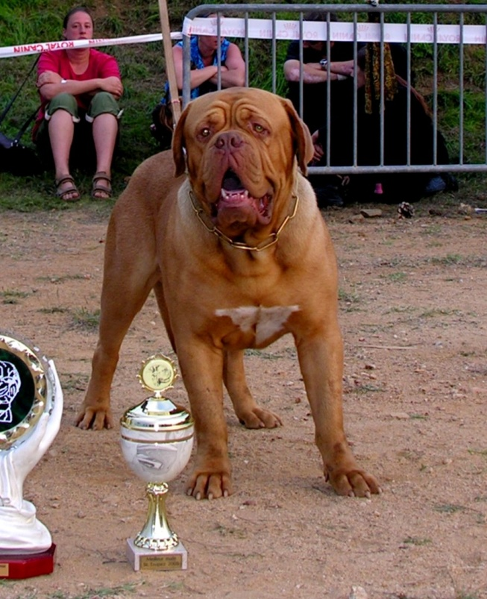
Winners of French Club Show

Slide 91
Let’s LEAVE the last words to Raymond Triquet
The Dogue de Bordeaux has become more and more popular over the last thirty years.

Slide 92
Let’s LEAVE the last word to Raymond Triquet
Asked about the current Dogue, he says :
“Be careful with some too much marked, excessive folds. We see sometimes a too deep roll over the nose, this was already pointed by Kunstler” (Kuntler who “created” the modern Dogue at the beginning of the nineteenth century)

Slide 93
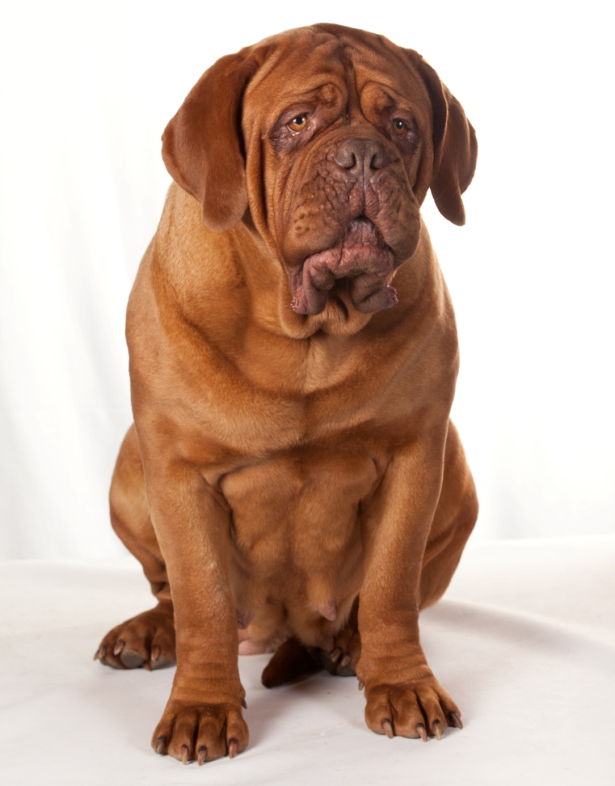
Let’s the last word to Raymond Triquet
“Currently, we see too many Dogues with excessive wrinkles, especially those going from the outer palpebral angle down to the lip angle.” “These excessive wrinkles are not typical of the Dogue and belong to other molosser breeds as the Neapolitan or the Bulldog”.
Slightly too much folds

Slide 94
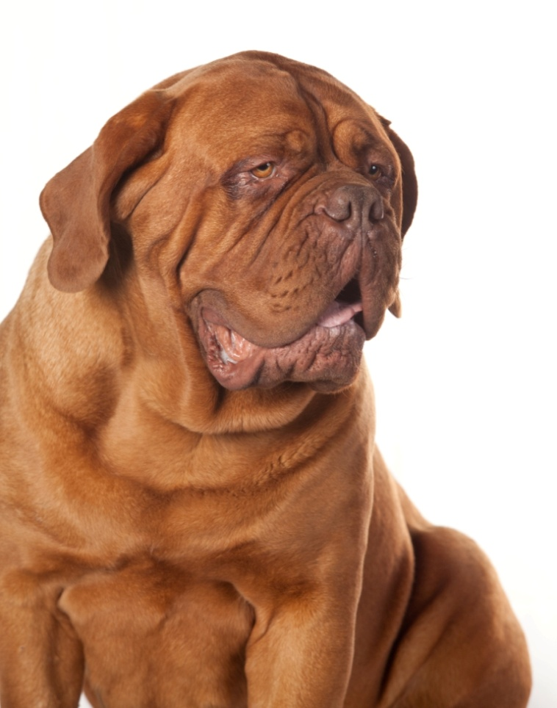
Let’s leave the last word to Raymond Triquet
“Hindquarters must absolutely be strong, too many are closed to the hocks”.
“Remind us that the Dogue head has a shape of a trapezium and the deep ropes of wrinkle must be mobile” ”The Dogue has no “wet dewlaps”

Slide 95
Let’s leave the last word to Raymond Triquet
“Another point on which it is necessary to be careful are teeth. Dogs with badly lined up and very small incisors must be penalized. According to the standard incisives should form a straight line.”

Slide 96
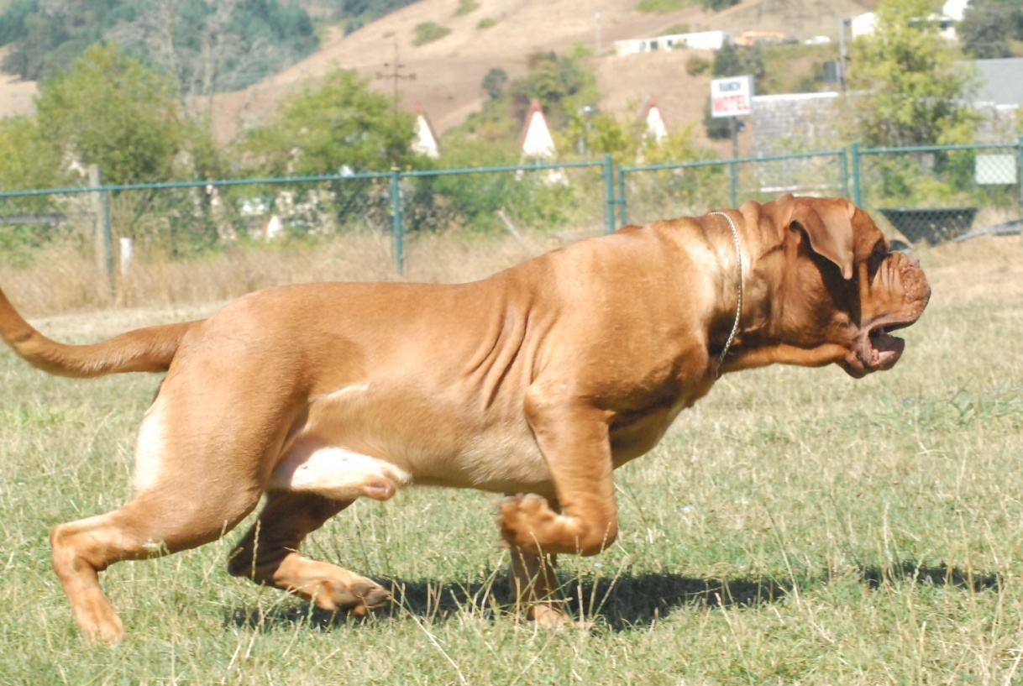
"Sour mug hide a heart of gold"
Raymond Triquet always took the opportunity to explain that" Dogues de Bordeaux like many Molossers are dissuasive and not dangerous dogs, their powerful appearance is a deterrent in itself " .

Slide 97
In conclusion
It is of major importance to preserve a typical and sound Dogue de Bordeaux avoiding any exaggeration detrimental to its fitness and functionality.
A show Dogue de Bordeaux is nice but it is more interesting to have lots of Dogues, living a normally long life and staying “fit for function”.

Slide 98
Thanks for your attention

