Slide 1
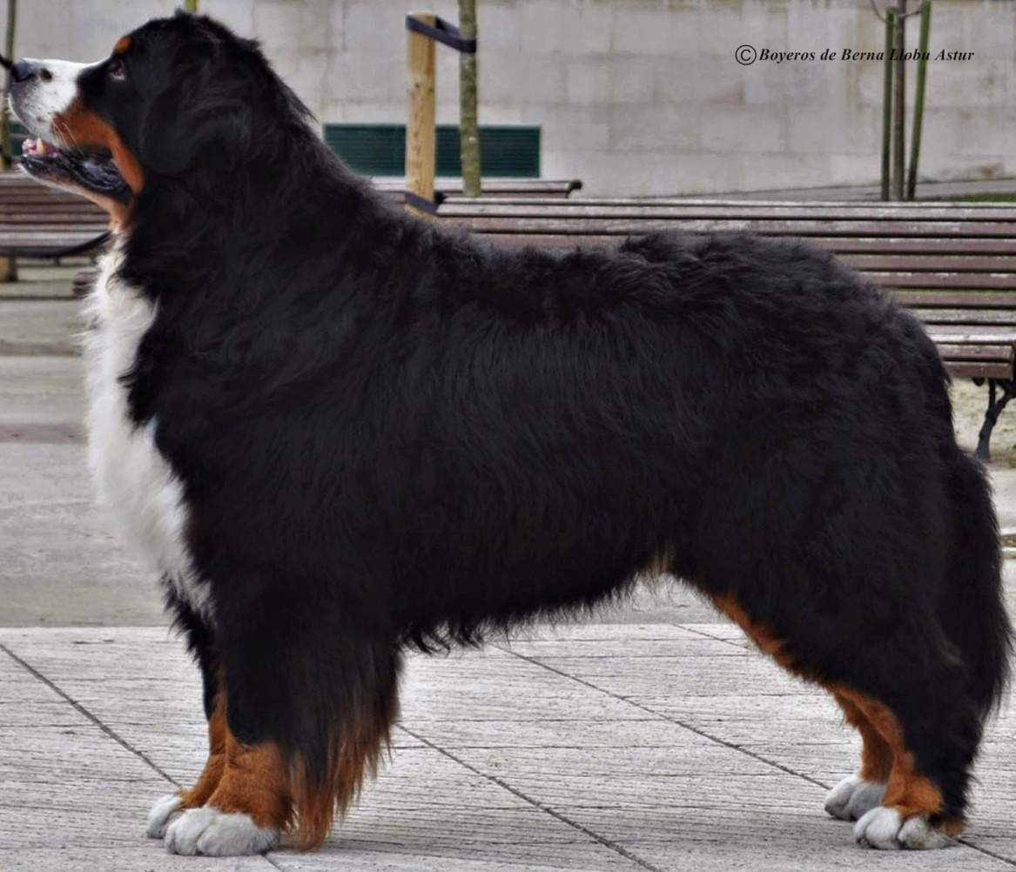

Illustrated
FCI – Standard No. 45
Bernese Mountain Dog
(“Dürrbächler”)
Approved by the Swiss Club of Bernese Mountain Dog
© 2020 Swiss Club of Bernese Mountain Dog

Slide 2
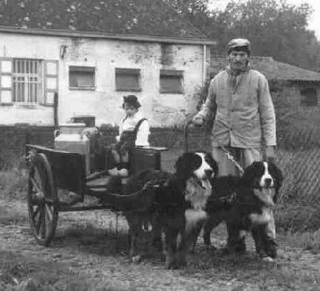
ORIGIN: Switzerland
UTILIZATION
Originally used as a guard-, draught-and cattle dog on farms in the Canton Bern, today also family dog and versatile working dog.

Slide 3
FCI CLASSIFICATION
Group 2: Pinscher and Schnauzer, type-Molossoid, breeds-Swiss Mountain and Cattle-Dogs
Section 3: Swiss Cattle Dogs without working trial
BRIEF HISTORICAL SUMMARY
The Bernese Mountain Dog is a farm dog of ancestral origin which was used as a guard and draught dog and for driving cattle in the prealpine regions and in the midland areas around Bern. Originally he was named “Dürrbächler” according to the name of the hamlet and of the inn of Dürrbach, near Riggisberg in the Canton Bern where these long-haired tricoloured farm dogs were especially numerous. In 1902, 1904 and 1907 specimen of this breed had already been exhibited at dog shows, and in 1907 some breeders of the region of Burgdorf decided to promote the pure breeding of these dogs by founding the “Schweizerischer Dürrbach-Klub”, and fixing the characteristic traits of the breed. In 1910, at a show in Burgdorf where many farmers of that region brought their Dürrbächler dogs to, already 107 specimen were shown.
From that day onward this dog, renamed “Bernese Mountain Dog” following the example of the other breeds of Swiss Mountain Dogs became rapidly appreciated all over Switzerland and in the neighbouring parts of Germany. Today the Bernese Mountain Dog is well known and appreciated all over the world as a family dog thanks to its striking tricoloured coat and its great adaptability

Slide 4
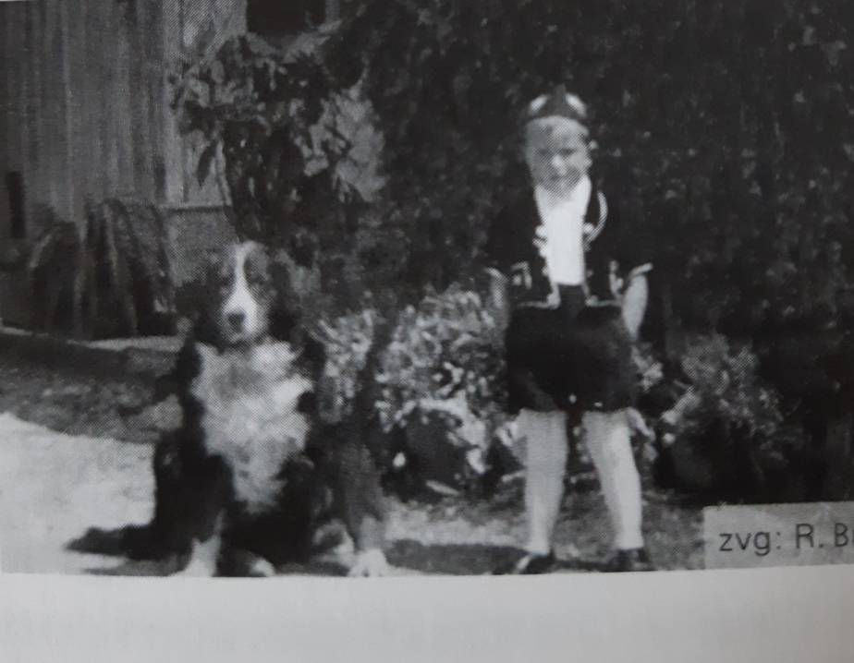
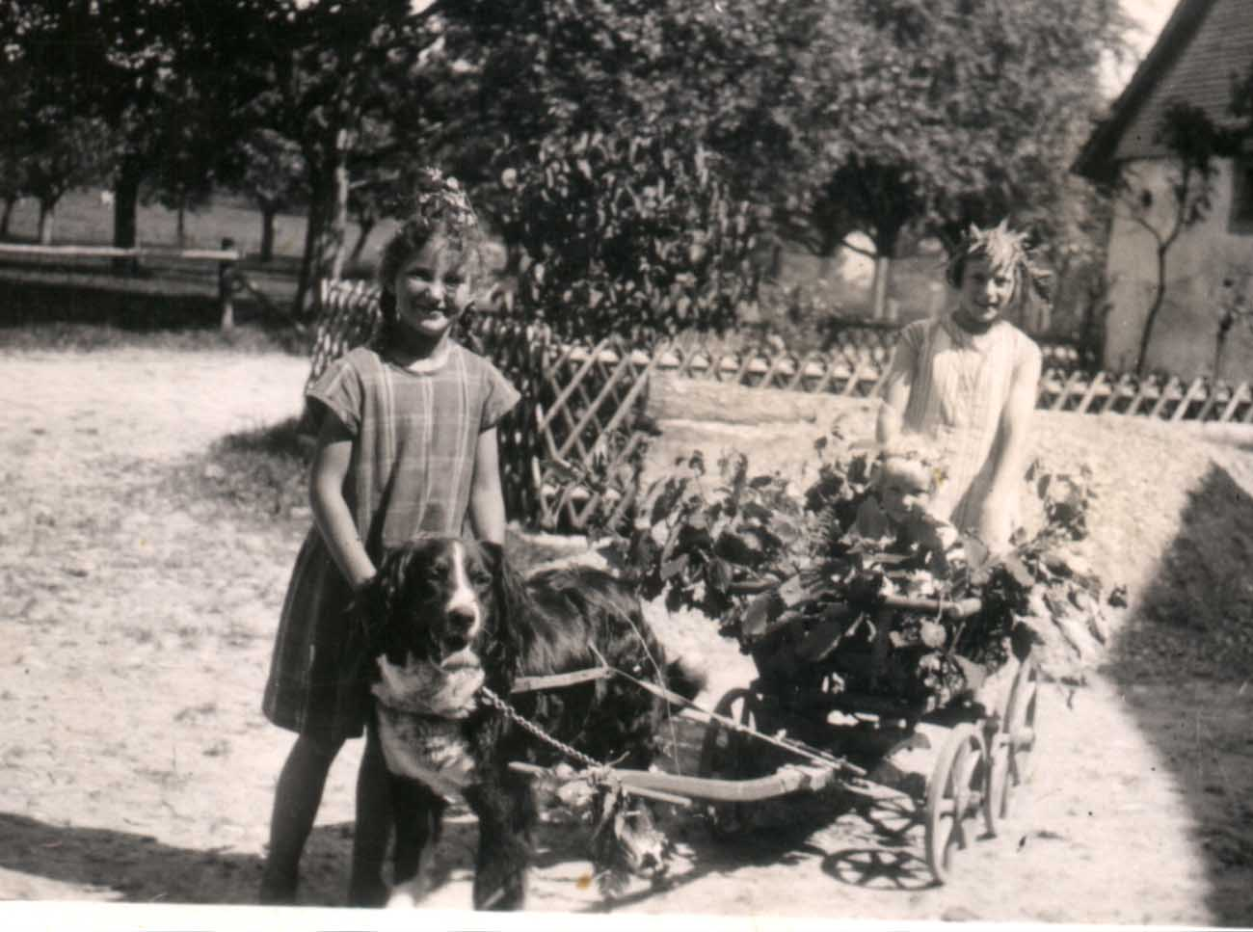

Slide 5
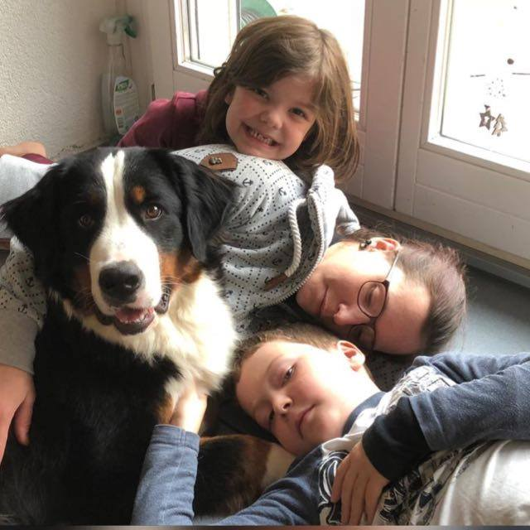
The optimal family dog

Slide 6

GENERAL APPEARANCE
Longhaired, tricoloured, strong and agile working dog, of above medium size, with sturdily built limbs; harmonious and well balanced.

Slide 7
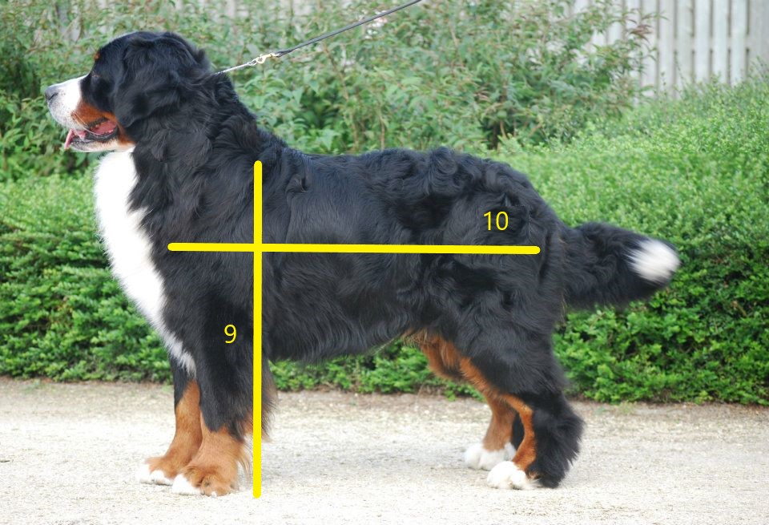
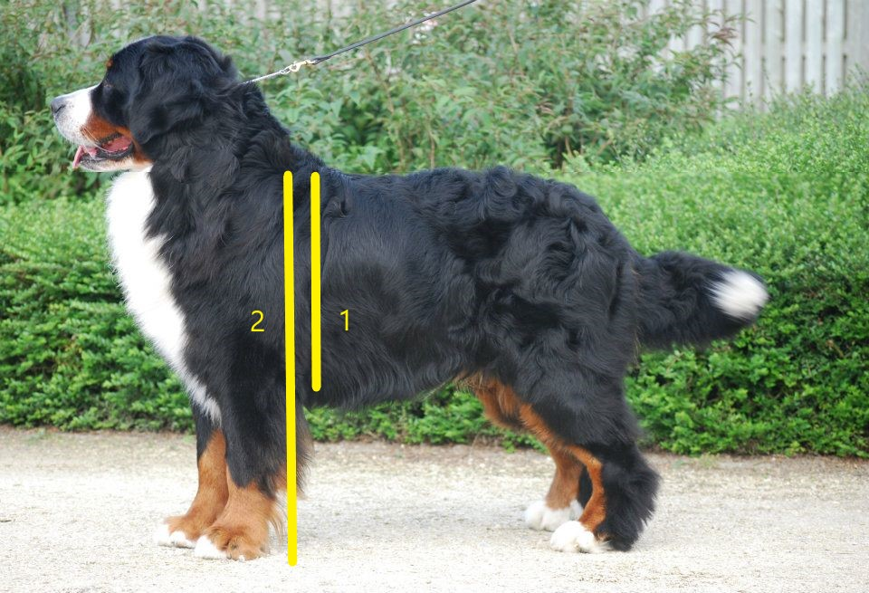
IMPORTANT PROPORTIONS
- Height at withers : length of body (measured from the point of the shoulder to the point of the buttock) = 9 : 10, rather compact than elongated
- Ideal relation of height at withers : depth of chest = 2 : 1.
SIZE
Height at withers : for dogs 64 – 70 cm → ideal size 66 – 68 cm
for bitches 58 – 66 cm → ideal size 60 – 63 cm

Slide 8
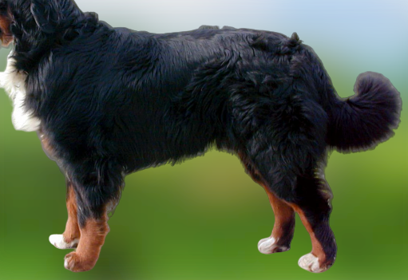
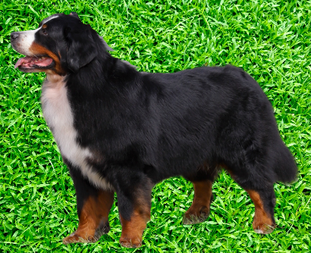
✗ incorrect
format square
✗ incorrect
format too long

Slide 9
BEHAVIOUR / TEMPERAMENT
Self-confident, attentive, vigilant, fearless in every day situations, good-natured and devoted to his own people, self-assured and placid towards strangers, of medium temperament, docile.

Slide 10
Behavior is one of the most important trademarks of the Bernese Mountain Dog!
The unique, good-natured and philanthropic being farther much attention is paid. From the former farm dog he has become versatile family, companion, therapy, social and sports dog and has created a whole new status in society. Much higher expectations are placed on mental resilience and nerve costumes today.Today's Bernese Mountain Dog must be absolutely adaptable, without losing its independence and security. A strong reserved breed representative should therefore not be graded excellent.
Only with a free behavior the sequence of movements, the tail sets and the posture can be optimally assessed. Dogs showed like puppets and that stand like statues in the ring can not really be judged of behavior and/or character.
☞ Aggressiveness and anxiety are disqualifying faults!

Slide 11
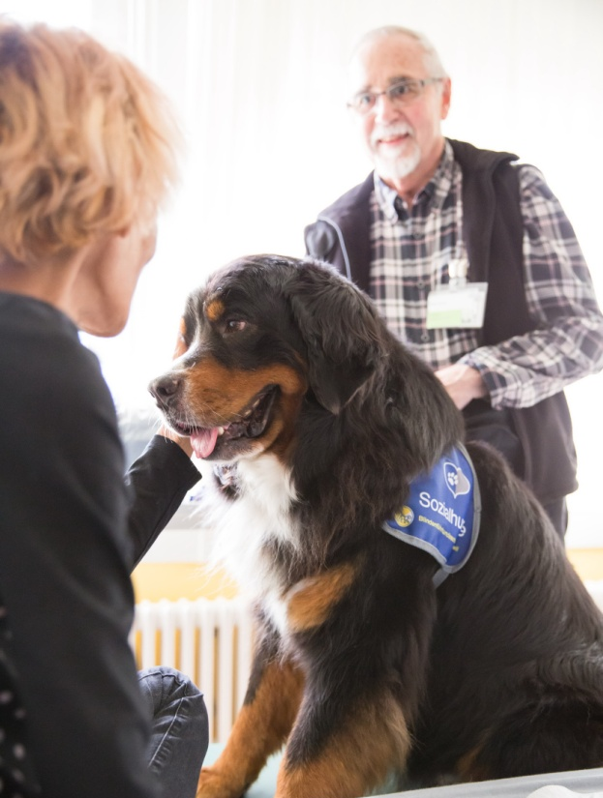
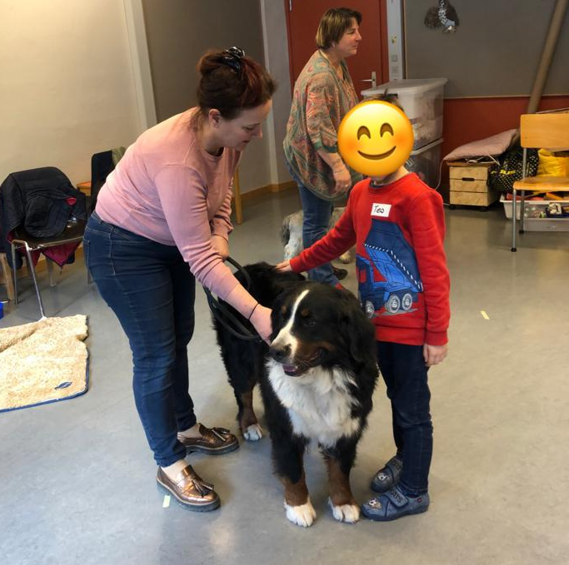
Bernese Mountain Dogs in use as therapy and social dogs

Slide 12
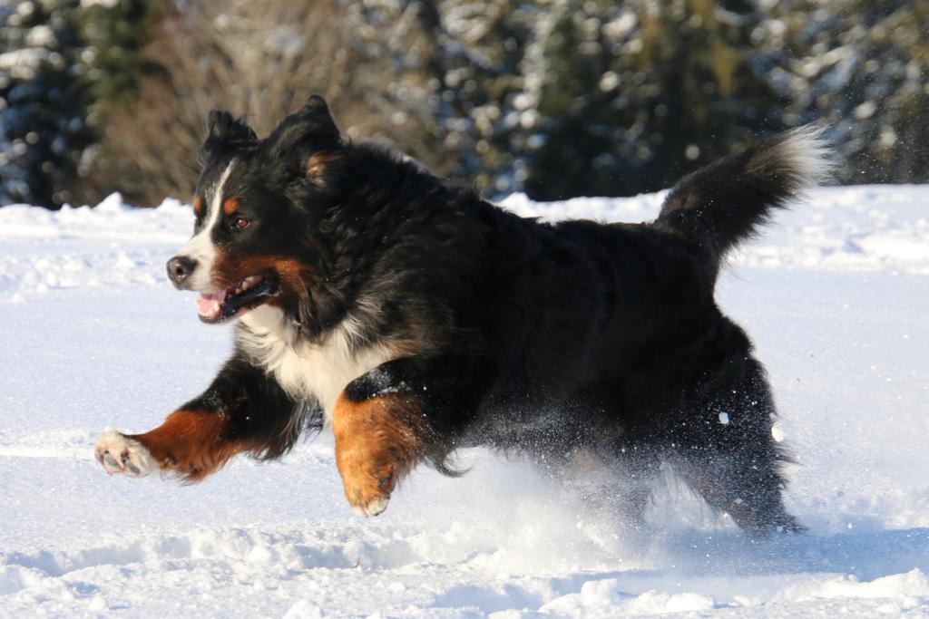

Slide 13
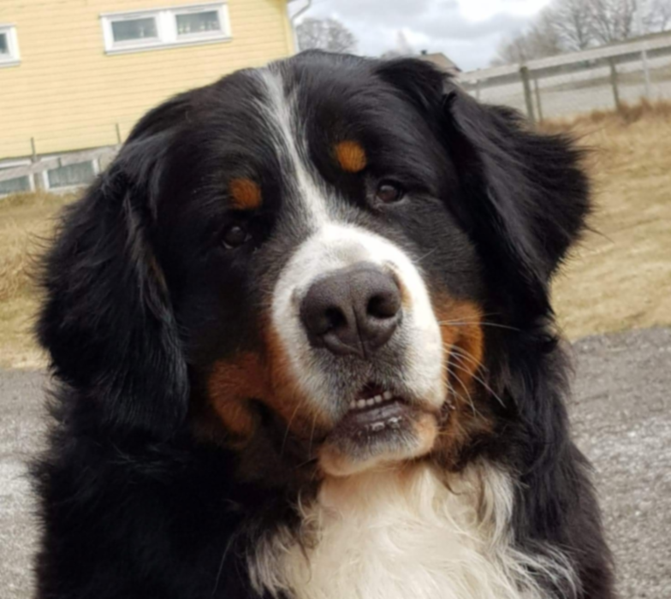
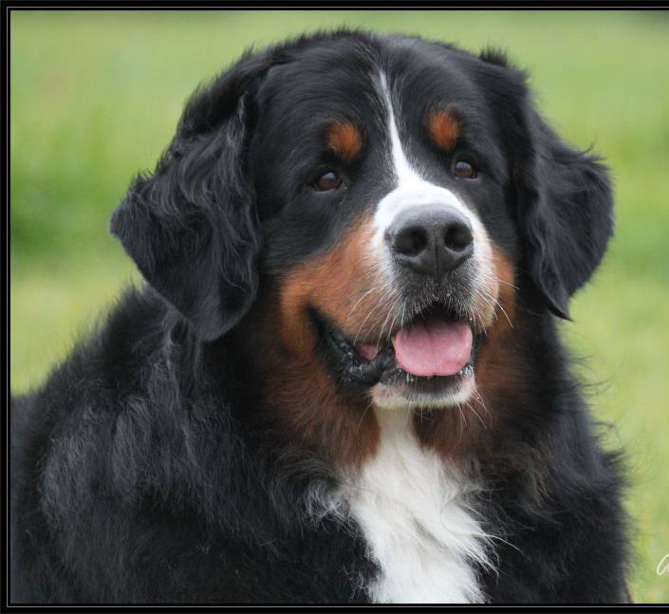
HEAD
Strong, in size balanced to general appearance, not too massive
Cranial Region:
Skull : Viewed from the front and in profile little rounded. Frontal furrow hardly marked
Stop : Well defined, but without being too pronounced
✓ Correct dog head
✓ Correct bitch head

Slide 14
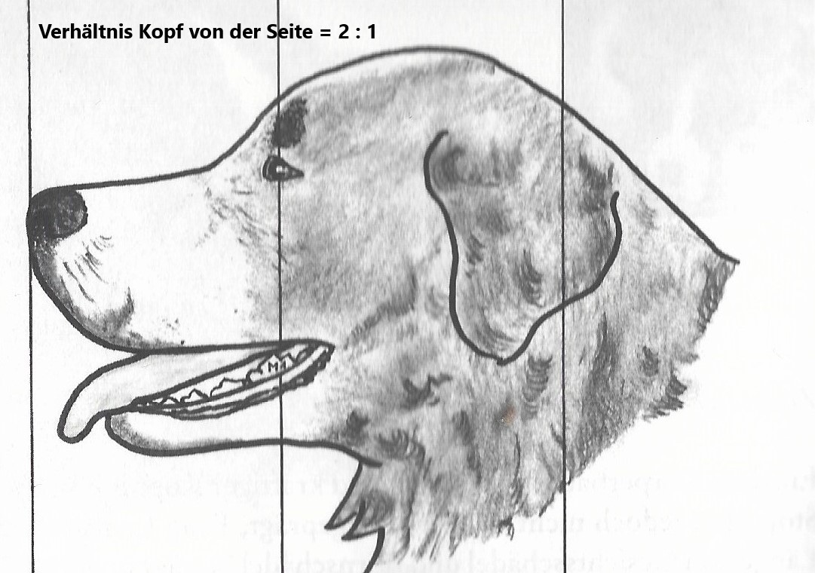
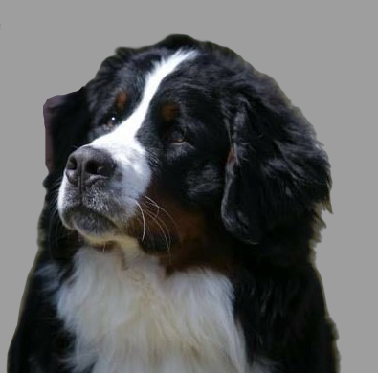
Ratio head to muzzle 2:1
Correct
stop and skull

Slide 15
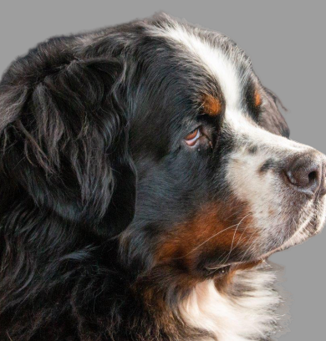
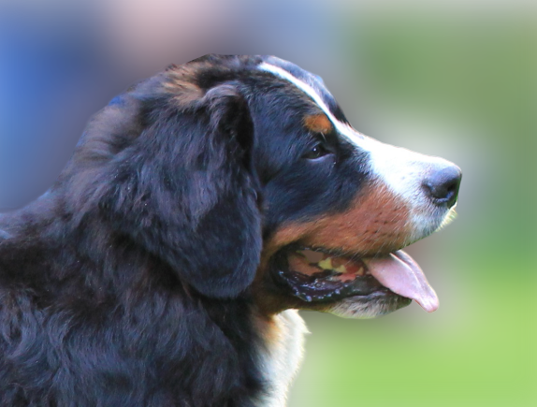
✗Incorrect
Short muzzle in ratio to the head
Stop is too pronounced
Eyes light brown
Spots of pigmentation
Incorrect
Flat skull, not enough stop

Slide 16
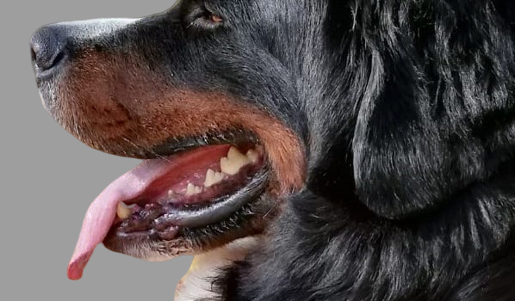
FACIAL REGION
Nose: black
Muzzle: strong, of medium length, nasal bridge straight.
Lips: close fitting, black
✓Correct

Slide 17
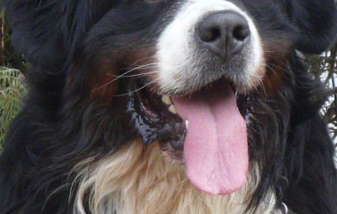
✗ Incorrect
Open lips
✓Correct
Black pigmentation

Slide 18
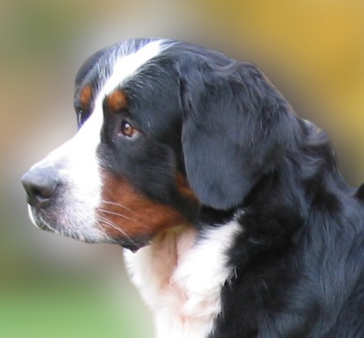
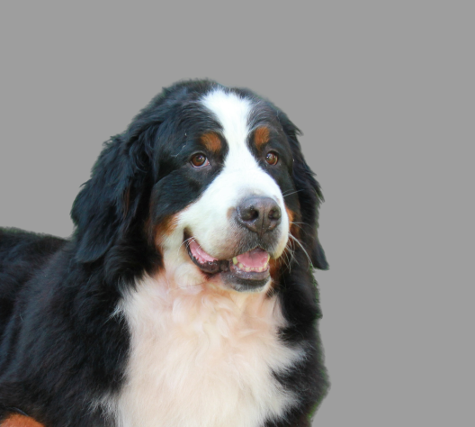
✗Incorrect
Overall to much loose skin
Open lips
Big ears
✗ Incorrect
Lack of pigmentation
Low earset

Slide 19
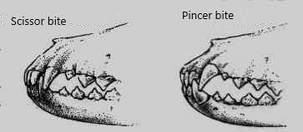
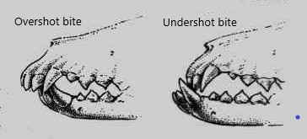
Jaws/Teeth
Strong, complete scissor bite (molars 3 (M3) are not taken into consideration). Pincer bite accepted
correct just tolerated !!
Undershot or overshot mouth +
wry mouth are disqualifying faults !
In the country of origin, a maximum of two P1 may be missing for breeding use
(M3 (molars 3) are not taken into consideration) !

Slide 20
Eyes:
Dark brown, almond-shaped, with close fitting eyelids. Neither too deep-set nor prominent. Loose eyelids are faulty.
✓ Correct

Slide 21
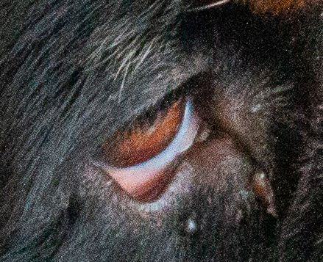
✗ Incorrect
Open loose eyelids
Disqualifying faults are entropion and ectropion and also
one or two blue eyes (wall eye) !

Slide 22
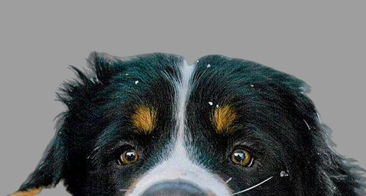
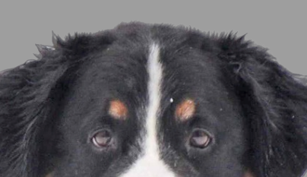
✗Incorrect light round eyes
✗ Incorrect
round eyes

Slide 23
Ears :
Medium-sized, set high, triangular in shape, slightly rounded at the tips, in repose hanging flat and close to the head. When alert, the rear part of the set-on is raised while the front edge of the ear remains close to the head.
✓Both correct earset

Slide 24
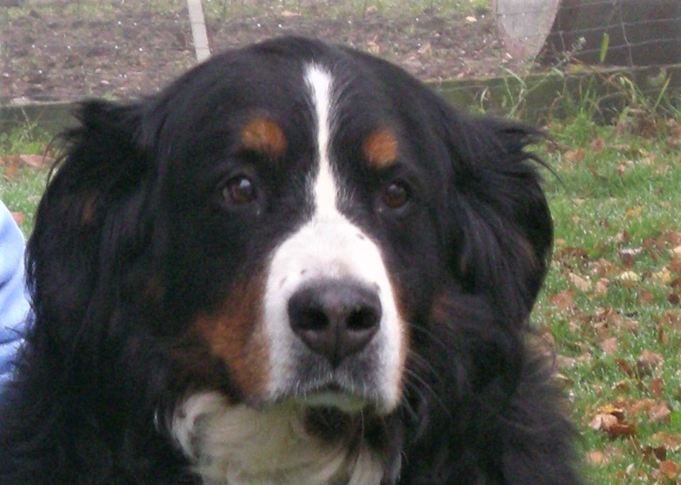
✗ Incorrect:
low and open earset
too rounded skull

Slide 25
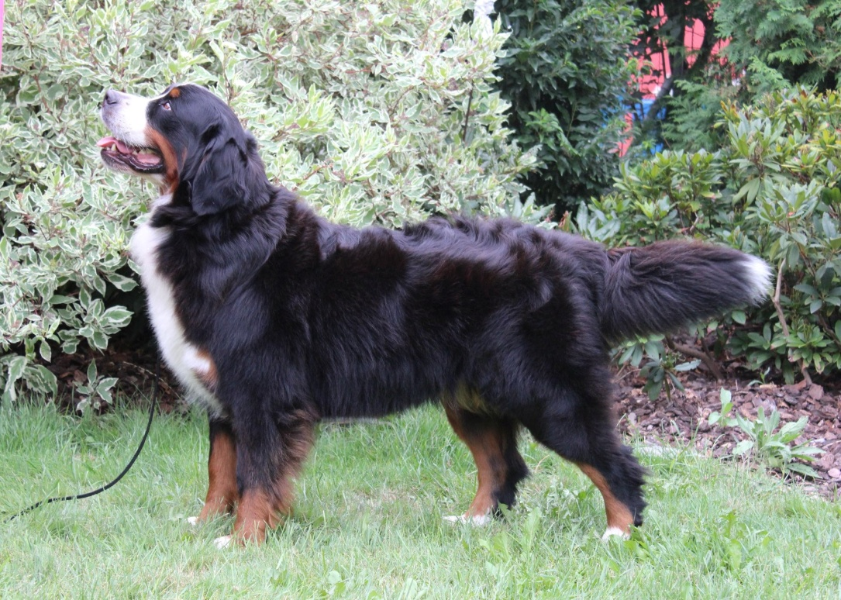
NECK
Strong, muscular, of medium length
BODY
Topline: From the neck running slightly downwards to the withers in a harmonious
line, then running on straight and level.
Back: Firm, straight and level.
Loins: Broad and strong, seen from above slightly less broad than the chest.
Croup: Smoothly rounded

Slide 26
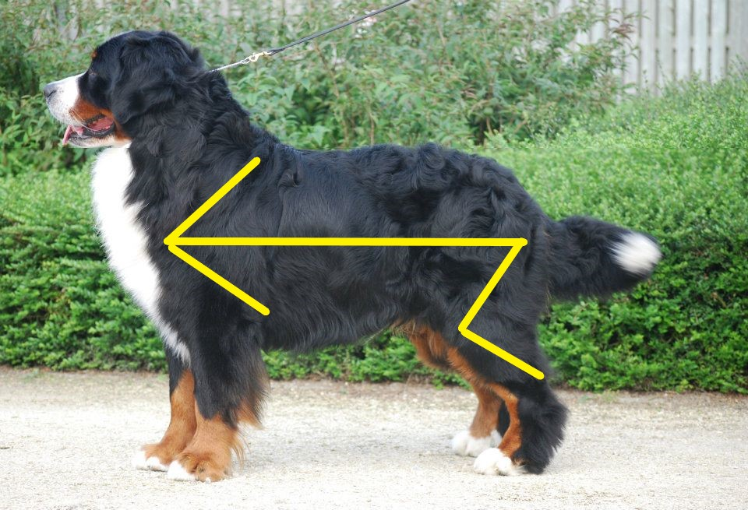
✓Correct
Back line is parallel to line from the shoulder point to the buttock
☞ A weak back line is not to be rewarded in the judgement,
especially with a large and heavy dog breed

Slide 27
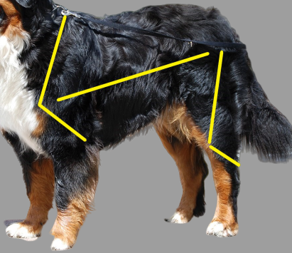
✗ Incorrect:
The back line is not parallel to the line from the shoulder point to the buttock
Short upper arm and lower thigh

Slide 28
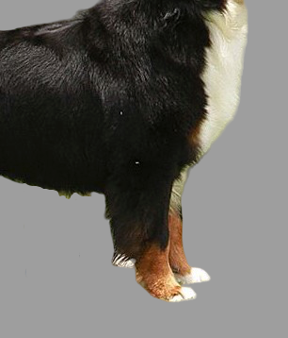
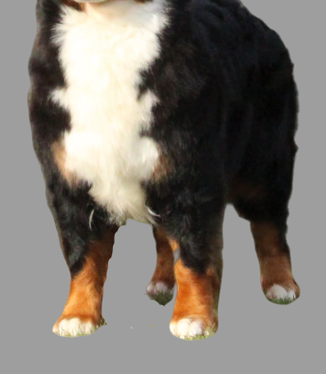
Chest:
Broad and deep, reaching to the elbows; forechest distinctly developed; ribcage of wide-oval section extending as well back as possible.
✓Correct
✓Correct

Slide 29
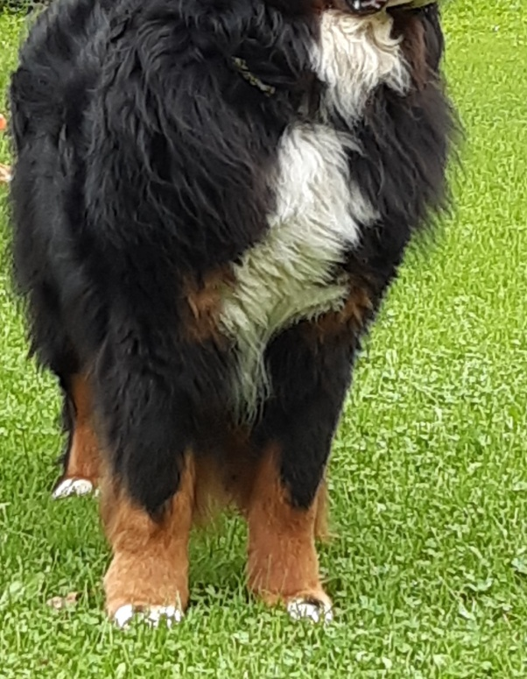
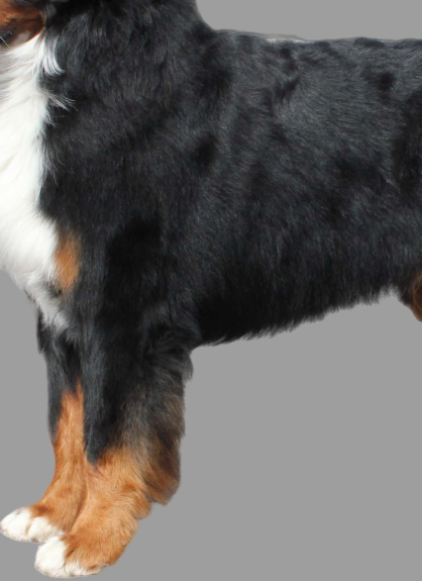
☞ For a long time, poor breast shape has been a striking problem for the
Bernese Mountain Dog. Since this entails further faulty features, great care
should be taken. That requires an exact palpation with both hands!
✗ Incorrect
narrow chest
✗Incorrect
not enough forechest

Slide 30
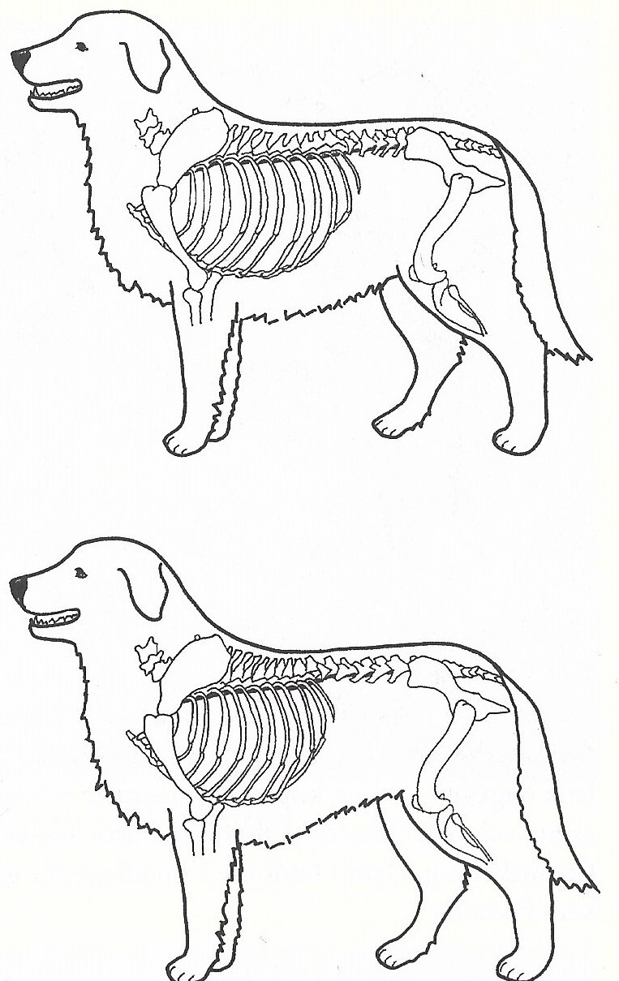
✓Correct long ribcage short in the loin
✗ Incorrect
short ribcage
long in the loin

Slide 31
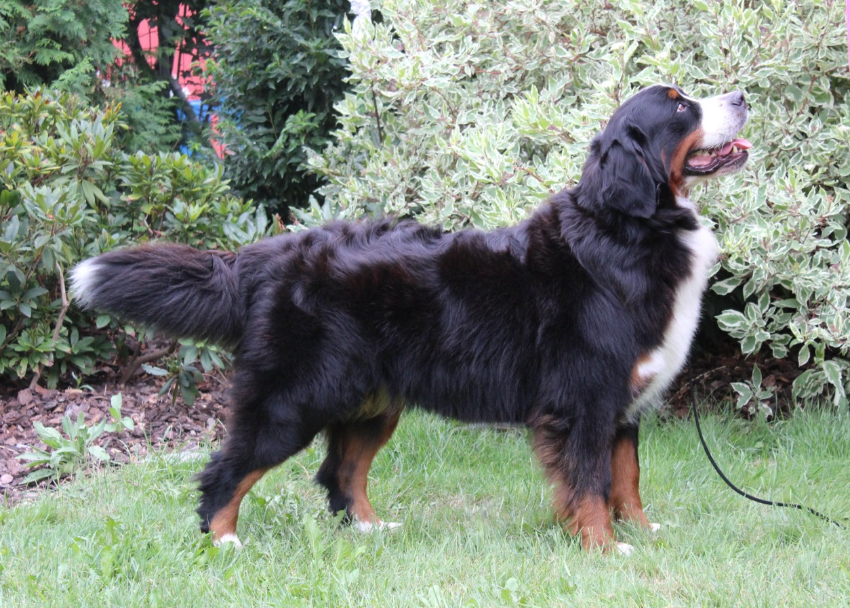
Underline / belly
Slightly rising from chest to hindquarters

Slide 32
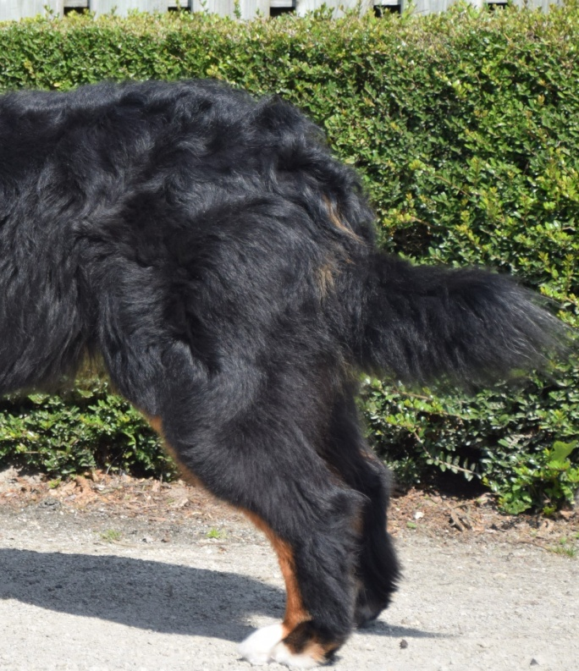
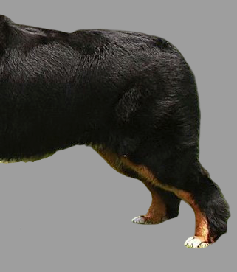
✓Correct hanging when at rest
TAIL
Bushy, reaching at least to the hocks, hanging straight down when at rest, carried level with back or slightly above when moving.
✗Incorrect
tail between the legs

Slide 33
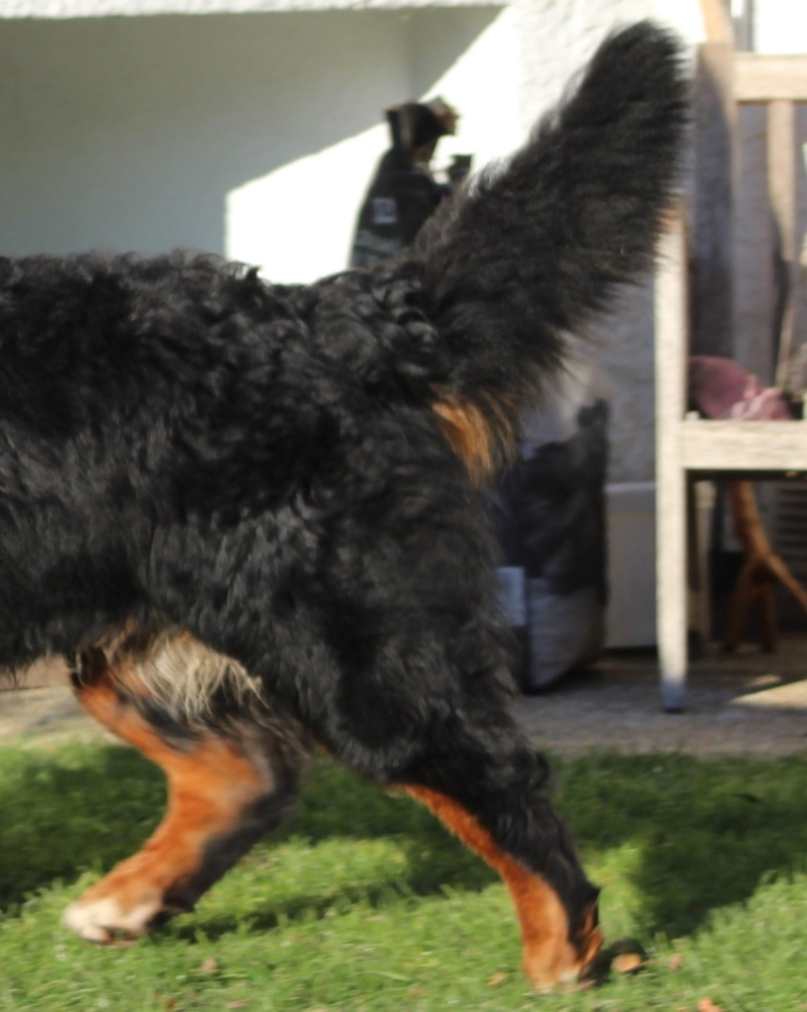
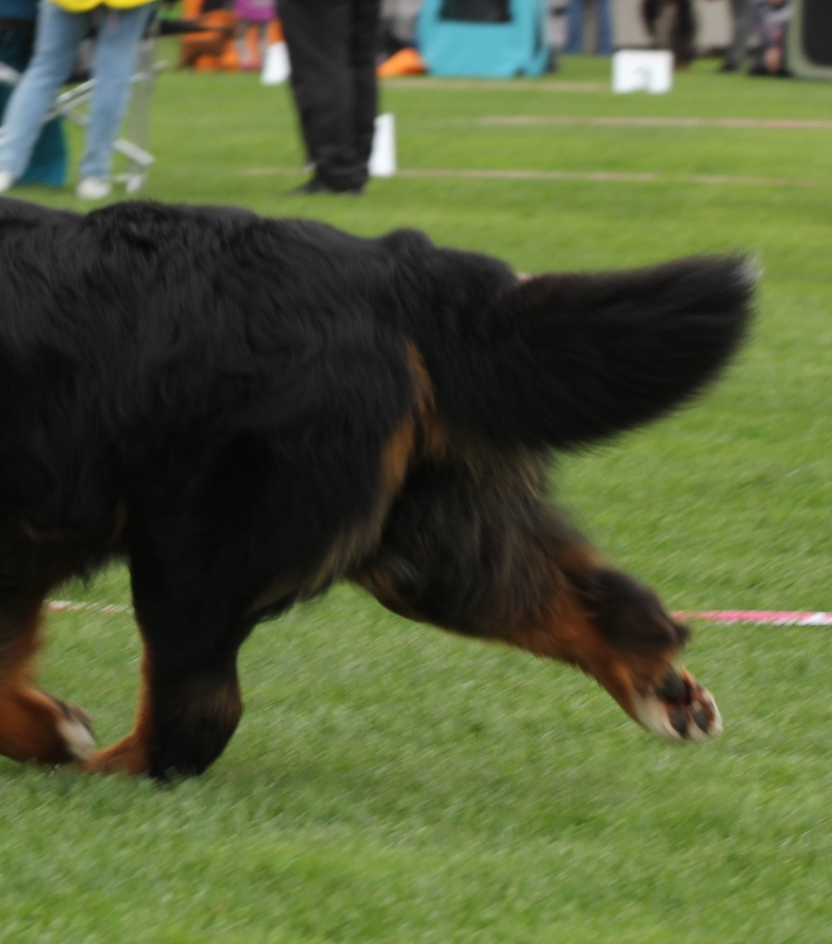
✓Correct
Slightly above the back when moving
✓Correct
Carried level with back when
moving

Slide 34
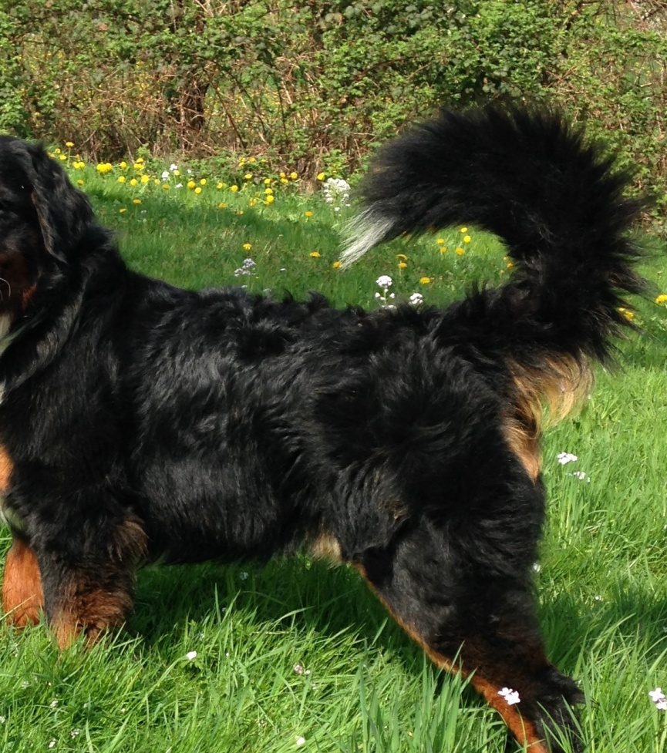
✗Incorrect high tail set, but not touching the back
Kinky tail and ring tail are disqualifying faults!

Slide 35
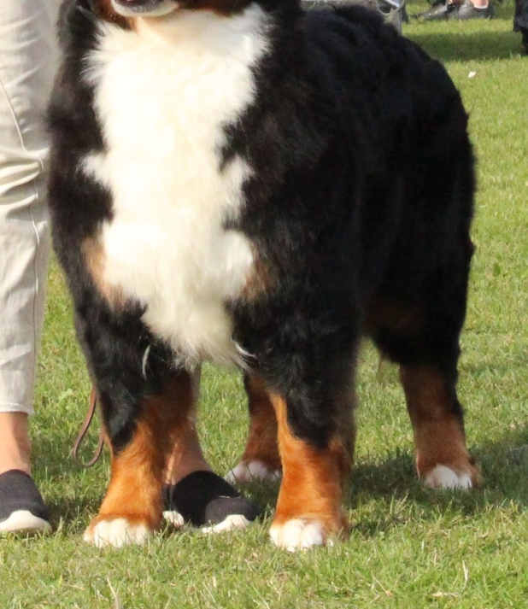
LIMBS
Generally: Strong bones
Forequarters: Forelegs seen from the front straight and parallel,
standing rather wide apart
✓Correct
parallel and rather wide apart

Slide 36
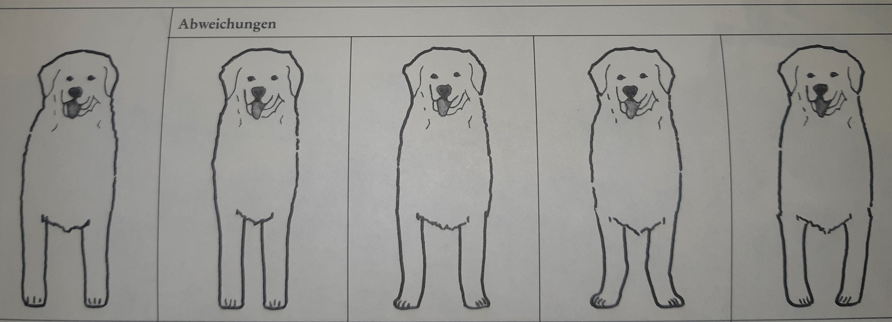
1 2 3 4 5
✓Correct -> parallel and straight, standing rather wide apart
✗ Incorrect -> parallel and straight, but narrow
✗ Incorrect -> standing rather wide apart, but toes turned out
✗ Incorrect -> Elbows turned in, forefeet strongly turned out
✗ Incorrect -> Elbows turned out, forefeet turned in

Slide 37
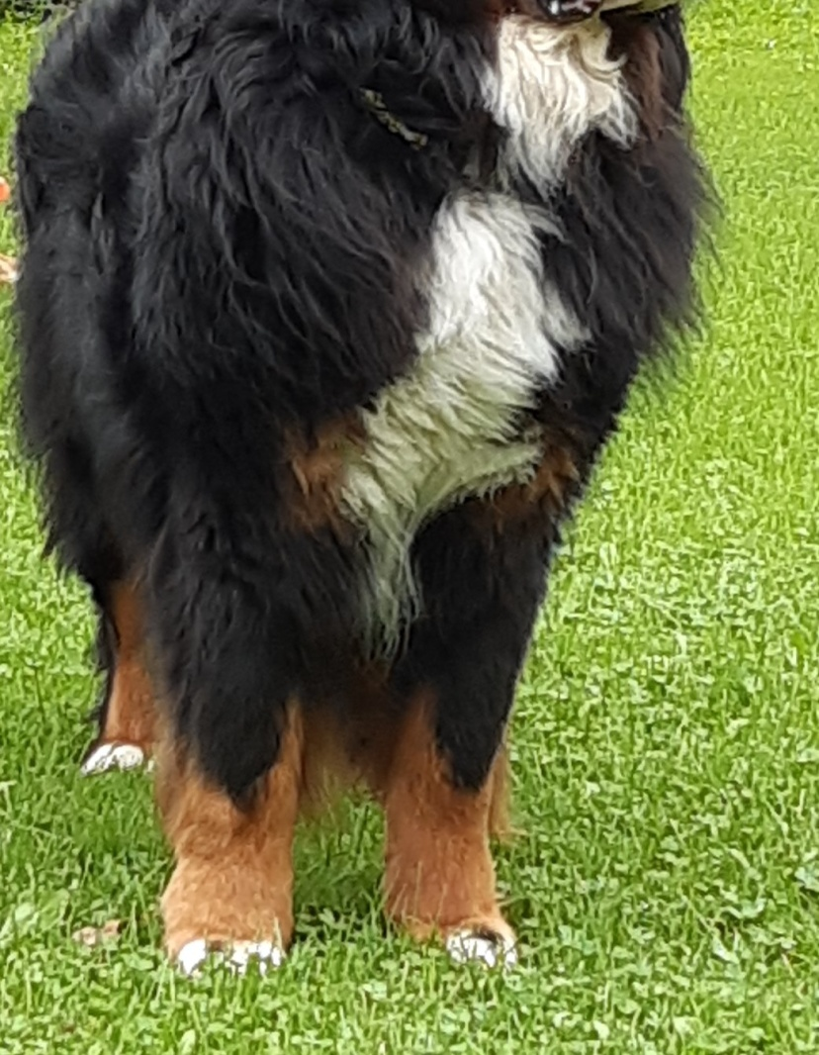
✗ Incorrect
Elbows turned in and narrow standing

Slide 38
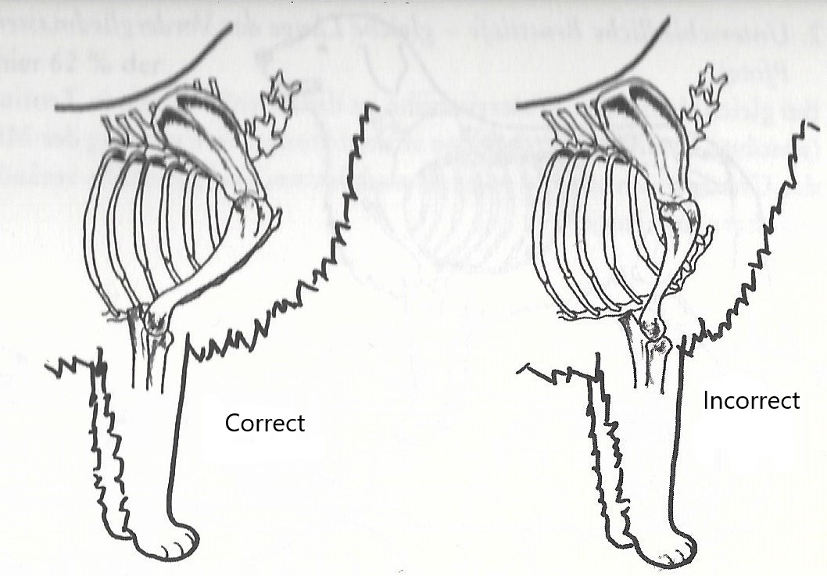
Shoulders: Shoulder blade long, strong and well laid back, forming a not too obtuse
angle with the upper arm, well attached to the chest, well muscled.
Upper arm: Long, set oblique
✓Shoulder well laid back ✗ Shoulder not enough laid back
= clear angulation = not enough angulation
Shoulder and upper arm both long Shoulder long and upper arm short

Slide 39
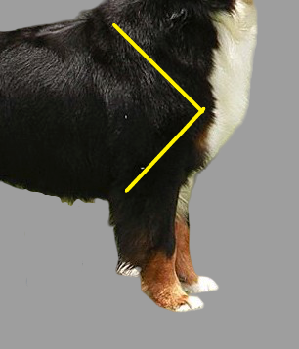
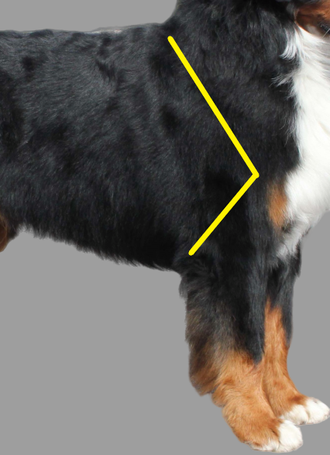
✓Correct clear forechest, shoulder and upper arm same length
✗ Incorrect
Upright shoulder, not enough
forechest, upper arm short

Slide 40

Elbows: Close fitting; neither turned in nor out.
✓Correct

Slide 41
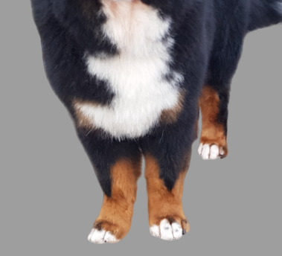
✗Incorrect
Elbows turned in, narrow standing, weak in the pastern

Slide 42
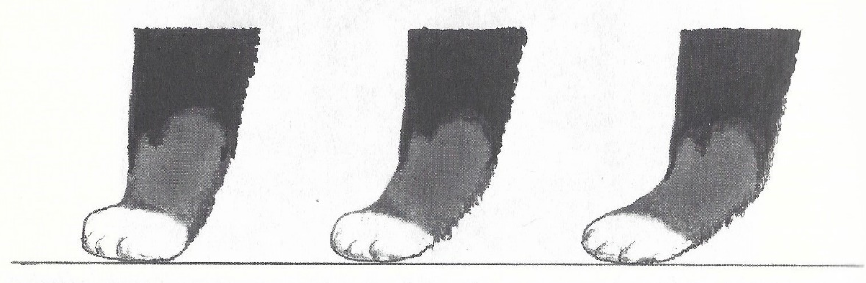
Forearm: strong, straight
Pastern: Seen from the side almost upright, firm; seen from the front in straight line with the forearm.
✗ too upright ✓correct ✗ not strong enough firmed
Forefeet: Short, roundish; with well-knit, well-arched toes.
Turned neither in nor out.

Slide 43

HINDQUARTERS
Generally: Seen from the rear straight and parallel, not too close.
✓Correct ✗turned in ✗turned out and ✗ Close hocks ✗ bandy legged
with cow hocks

Slide 44
Upper thigh : Long, broad, strong and well muscled.
Stifle : Distinctly well bent.
Lower thigh : Long and oblique.
Hock joint : Strong, well angulated.
Metatarsus : Set almost vertically. Dewclaws to be removed (except in those countries where it is prohibited by law).
Hind feet : Slightly less arched than forefeet, turned neither in nor out.

Slide 45


✓Correct well angulated
✗Incorrect
overangulated

Slide 46


✗Incorrect straight, long upper thigh, short lower thigh
✗Incorrect
sufficent angulated

Slide 47


✗Incorrect rear to far extended behind
→ atypically!

Slide 48

GAIT / MOVEMENT
Sound and balanced movement in all gaits covering a lot of ground, free stride reaching well out in front, with good drive from behind, at the trot, coming and going, legs moving forward in a straight line.
✓Correct
seen from the side
with a correct tailset

Slide 49


✓Correct ✓ Correct
not too close Elbows neither turned in nor turned out

Slide 50

COAT
Hair: Long, shining, straight or slightly wavy.

Slide 51

✗Incorrect open and overgroomed hair texture not jet black colour → not natural →not accepted!

Slide 52

✗Incorrect short coat
Disqualifying fault → short coat, double coat (Stockhaar)!
The long coat is also a typical feature of the Bernese Mountain Dog! Therefore, attention should be paid to the natural appearance. This means long top coat and undercoat must be present!

Slide 53
COLOUR
Jet black main colour with rich tan markings on the cheeks, above the eyes, on all four legs and on the chest with white markings as follows :
Clean white symmetrical markings on the head : blaze extending towards the nose on both sides to a muzzle band, the blaze should not reach the tan markings above the eyes, and the white muzzle band should not extend beyond the corners of the mouth.
Moderately broad, unbroken white marking on throat and chest.
Desirable : white feet, white tip of tail.
Tolerated : small white patch on nape of neck, small white anal patch.

Slide 54



All of these head white and paw markings are accepted! The focus should be on more important features. White on the tip of the tail or on the paws are welcome, but should not be punished if the rating is missing!
Only a main color other than black and a lack of tri-color are
disqualifying mistakes!

Slide 55
FAULTS 1/2
Any departure from the foregoing points should be considered a fault and the seriousness with which the fault should be regarded should be in exact proportion to its degree and its effect upon the health and welfare of the dog.
· Unsure behaviour
· Fine bones
· Irregular set of the incisors provided that the bite remains correct
· Absence of any other theeth than 2 PM1 (premolars 1); the M3 (molars 3)
are not taken into consideration
Coat :
- Distinctly curly coat

Slide 56
Faults of colour and markings :
Absence of white on head
Blaze too large and/or muzzle band reaching noticeably beyond the corners of the mouth.
White collar.
Large white patch on nape of neck (maximum diameter more than 6 cm).
White anal patch (maximum size 6 cm).
White markings on forelegs reaching distinctly beyond half-way of pasterns (“boots”).
Disturbingly asymmetrical white markings on head and/or chest.
Black ticks and stripes within the white on the chest
“Dirty” white (strong spots of pigmentation).
Black coat with a touch of brown or red.

Slide 57
DISQUALIFYING FAULTS
· Aggressive, anxious or distinctly shy
· Any dog clearly showing physical or behavioural abnormalities shall be disqualified
· Split nose
· Undershot or overshot mouth, wry mouth
· One or two blue eyes (wall eye)
· Entropion, ectropion
· Kinky tail, ring tail
· Short coat, double coat (Stockhaar)
· Other than tricoloured coat
· Other main colour than black
N.B.
- Male animals should have two apparently normal testicles fully descended into the scrotum.
- Only functionally and clinically healthy dogs, with breed typical conformation should be used for breeding.

Slide 58


Slide 59

Help us to maintain this wonderful, versatile breed in the sense of «Fit for function». We thank you for the careful selection when straightening

